Slide 1
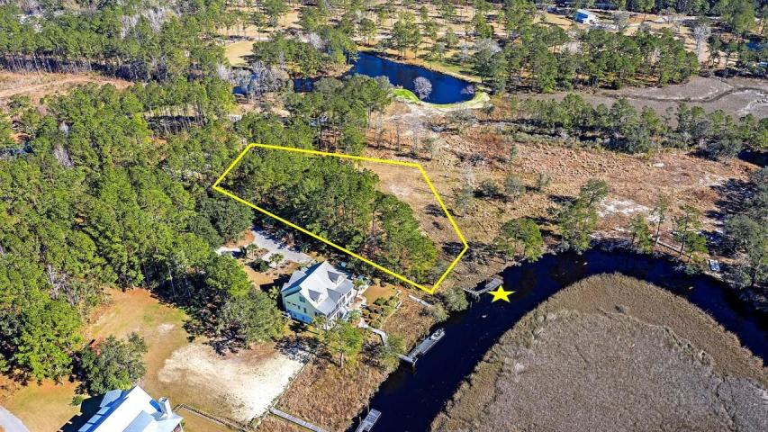
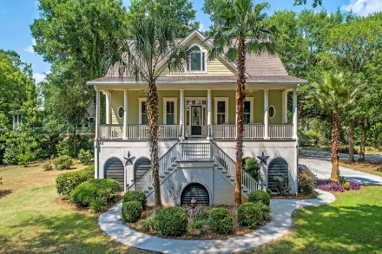
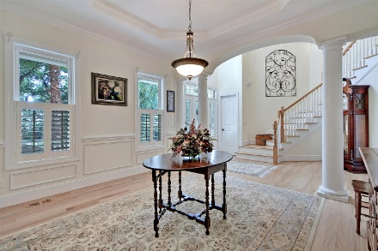
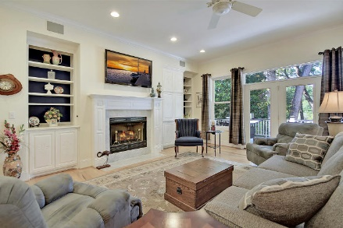

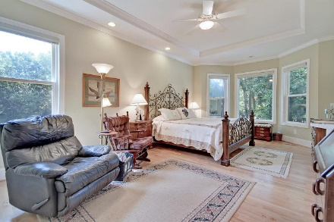
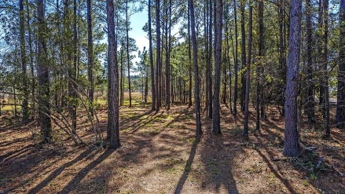
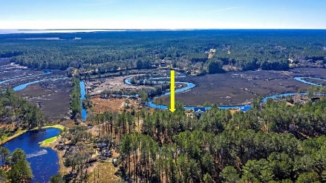
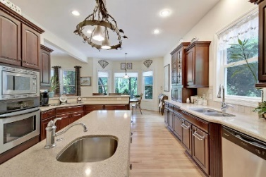
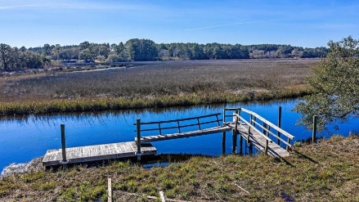
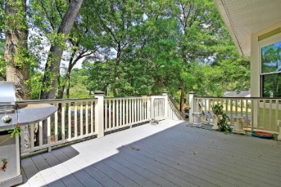
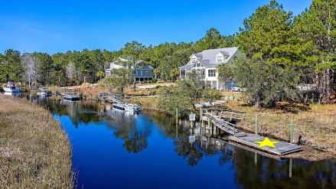
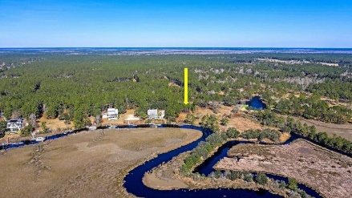
Plenty of Space for Your Waterfront Dream Home
NEW PRICE
7581 Ladys Secret Lane Bridal Gate at Bulls Bay Landing
Awendaw, SC 29429 ~ MLS# 20001891 ~ $450,000
1.57 pristine acres on a tidal creek in Awendaw present the perfect opportunity to build the home of your dreams. Situated on the end of a cul-de-sac with a dock already built on the winding creek that brings you out to Sewee Bay and Bulls Bay.
Many towering trees offer privacy for the site location that will enjoy water views from the back of the home. This location is approximately 15 miles to Mount Pleasant and 12 miles to McClellanville.
If you've really been searching for a site to capture the charm and natural beauty of the low country while escaping the hustle and bustle of the major cities, this is the perfect opportunity. Several homes in the neighborhood have been completed so you will be able to easily envision what your home will look and feel like.
Verna Bunao-Weeks verna@mattoneillteam.com (843) 364-2447

