Slide 1
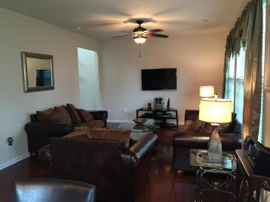
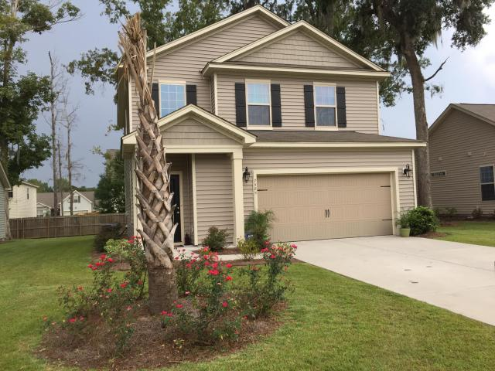
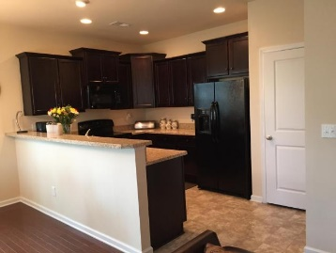
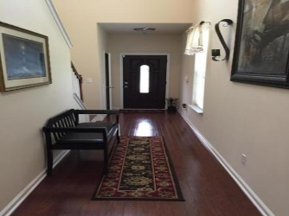
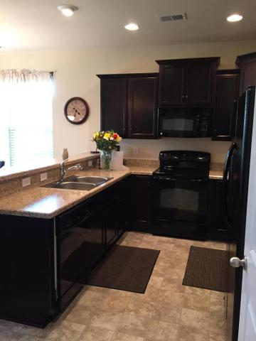
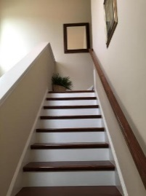
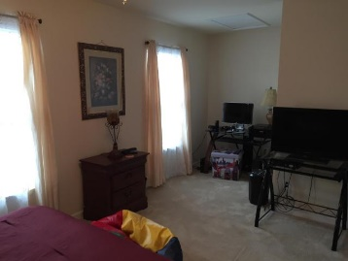
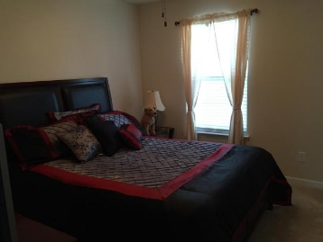
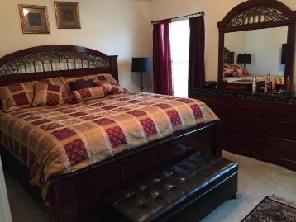
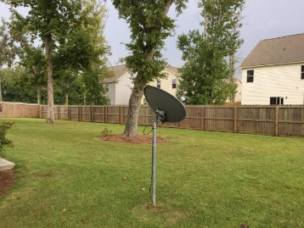
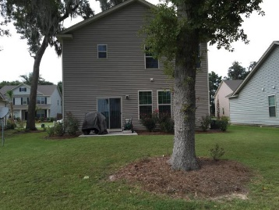


Price Reduced!
Price Reduced!
7585 High Maple Circle
Brookdale
North Charleston, SC 29418
MLS# 15023523 - $183,000
Why Wait to Build! DR Hortons Flagstone floor plan offers an open and inviting two story foyer.
The home was built in 2013 and is the original owner occupied.
Come see this Beautiful Home in the Brookdale Community that is conveniently located within minutes to shopping, dining, recreation and Bosch, Boeing, Air Force Base and the Charleston International Airport.
Engineered Wood Floors , Security System and Many Upgrades!
A MUST SEE!
Robyn Lane, Realtor
843-222-5599
robynlane01@icloud.com
ERA Wilder Realty, 125-F Wappoo Creek Dr, Charleston, SC 29412

