Slide 1
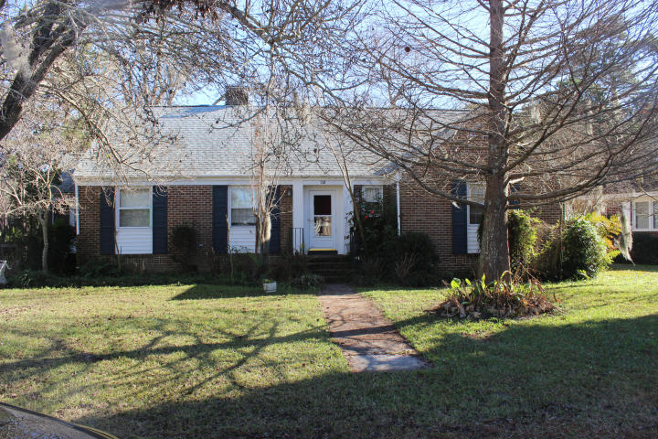


75 Chadwick Drive
Charleston ~ South Windermere
MLS# 15000466 ~ $399,000
Come see 75 Chadwick in one of Charleston's oldest and most sought after neighborhoods. South Windermere is 5 minutes to Downtown Charleston and 10 minutes to Folly Beach with excellent highway connections. Surrounded by the oldest shopping center in Charleston, Coburg Creek and St. Andrews Magnet School, South Windermere has long been a wonderfully convenient place to live. You can shop at Earth Fare Organic Grocery or Half Moon Outfitters, go the library and Starbucks/restaurants, exercise on the Green Way Trail or take yoga and attend school within steps of your home. There is the back way to St. Andrews Shopping Center within 5 minutes. 75 Chadwick has good size rooms including L-shaped living/dining room,2 baths, 3 bedrooms, 3rd bedroom/office/den & bonus upstairs.
Kay Kennerty
MBA, ABR, CRS, GRI
843-345-5011
Kay@agentownedrealty.com
www.KayKennertyHomes.com
The AgentOwned Realty Company
824 Johnnie Dodds Blvd
Mt. Pleasant, SC 29464

