Slide 1
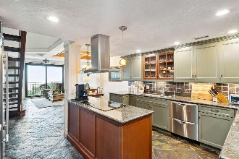
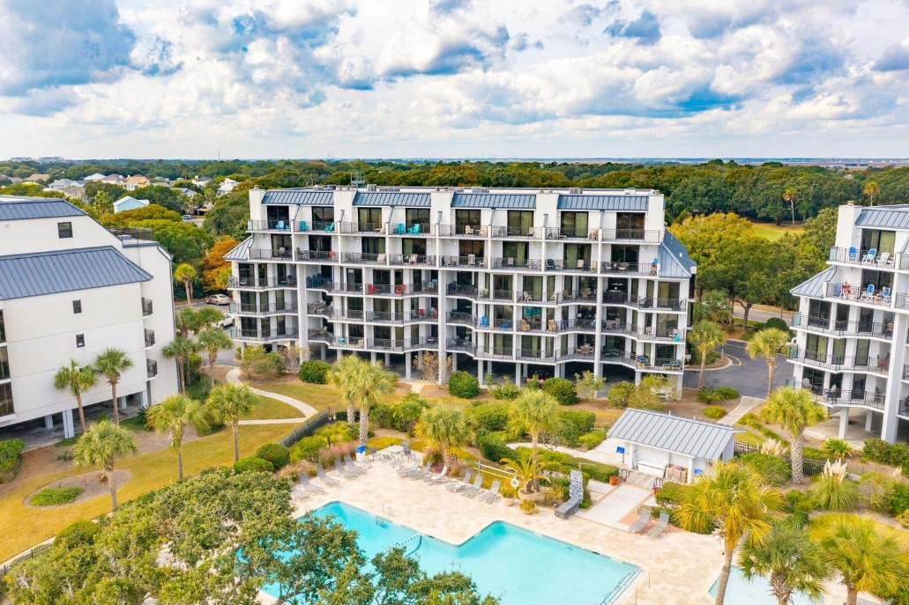
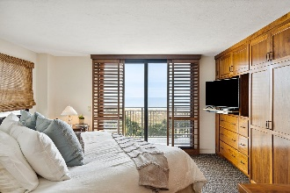
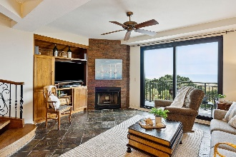
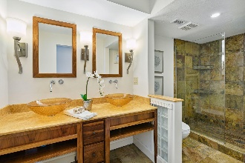
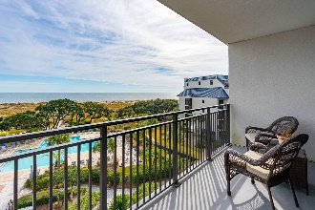
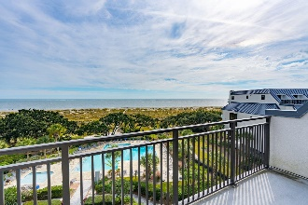
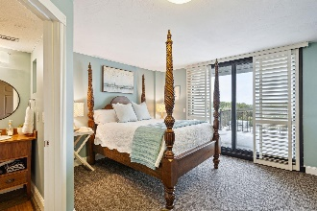
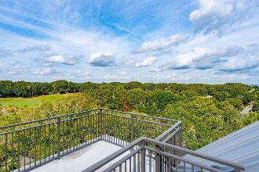
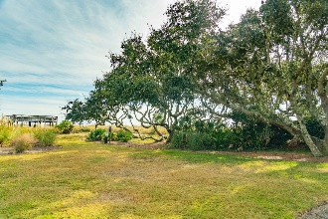

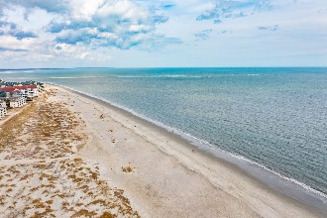


Oceanfront Price Drop! Motivated Seller!
7600 Palmetto Drive B409
Shipwatch Villa | Isle of Palms, SC 29451 | MLS# 23025857 | $1,785,000
A Luxurious PENTHOUSE Retreat. Experience the pinnacle of coastal luxury in this exquisite penthouse, one of just eight elite residences gracing the private Shipwatch Villas at Wild Dunes. Commanding an enviable position, this stunning 3-bedroom, 3-bath abode is a sanctuary of sophistication and tranquility, offering unrivaled views of the sparkling ocean and an unparalleled living experience. Property Highlights: Exclusive Penthouse Unit: Occupying a privileged spot within Shipwatch Villas, this penthouse promises a life of exceptional privacy and serenity. Breathtaking Ocean Views: Awaken to the gentle lull of the waves and the majestic sunrise over the ocean from the comfort of your master suite and expansive living area.
Golf Course Panoramas: The upstairs guest room presents an inspiring vista of the 12th hole of the prestigious Wild Dunes Golf course.
Masterful Design: Indulge in the master suite's custom walnut cabinetry, offering elegant aesthetics coupled with abundant storage solutions.
Gourmet Chef's Kitchen: Revel in the generous dimensions of one of the largest kitchens in the building, complete with ample counterspace, top-tier storage facilities, an electric cooktop with a sleek stainless vent hood, and a state-of-the-art subzero refrigerator.
Elegant Living Spaces: The open and airy living areas are perfectly aligned to capture the alluring views, ensuring every moment is framed by the natural beauty of the Isle of Palms. The HVAC is 2 yrs. old with a 10 yr remaining warranty and hot water heater is new.
Your new home within the exclusive confines of the Shipwatch Villas presents a rare opportunity to secure a lifestyle coveted by many but experienced by few. With direct beach access, you are mere steps away from sandy shores and turquoise waters. The Wild Dunes community enriches your living experience with access to premier amenities, including championship golf, tennis courts, swimming pools, and fine dining options.
Enjoy a video tour!
Debbie Rogers (843) 990-2915
deborah.rogers@carolinaone.com
www.DebbieRogersSellsCharleston.com
Carolina One Real Estate | 2713 Highway 17 North | Mt. Pleasant, SC 29466

