Slide 1
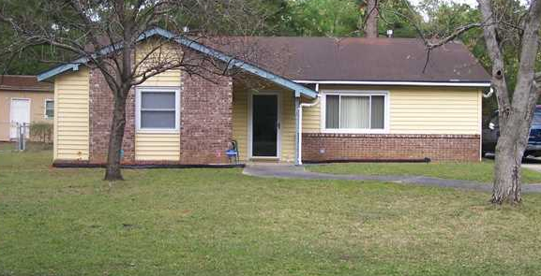
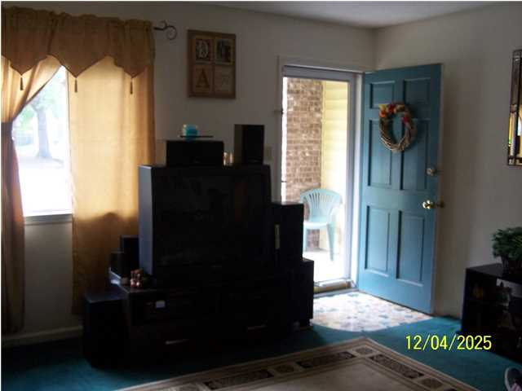
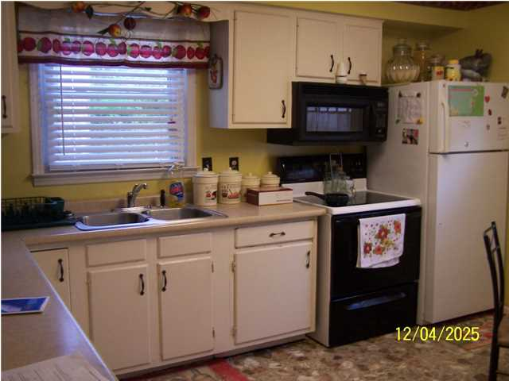
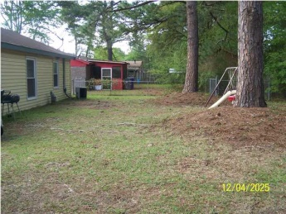
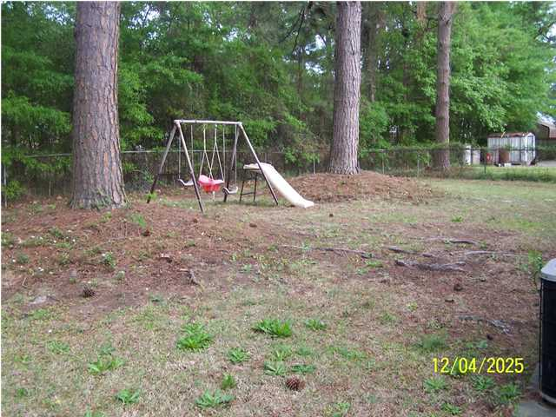


7614 Vanderbrook Place Pepperhill - North Charleston MLS# 1410167 - $88,000
Open House
June 14th ~ 12-2
Light Refreshments
Great starter home sitting on almost a quarter of an acre in an established neighborhood. Move in ready ranch style with large eat in kitchen, spacious living room, and large15x7 utility room. Concrete drive way extends to the rear of home. Large back yard almost totally fenced in. Home has gone through extensive preparation including beautiful landscaping, fresh paint throughout entire home and owner is providing a carpet allowance with reasonable offer.
Don't miss this one! Reduced $2,000 in established neighborhood. Agent bonus for ratified contract by 6/30/14.
Twala Scott
843-324-9274 M
843-261-7161 O
twala.scott@agentownedrealty.com

