Slide 1
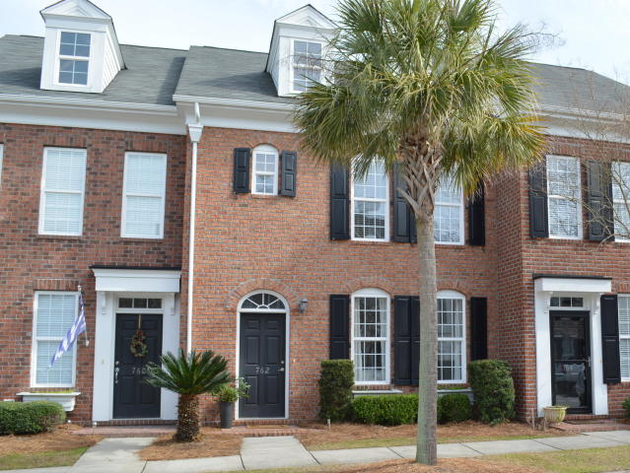
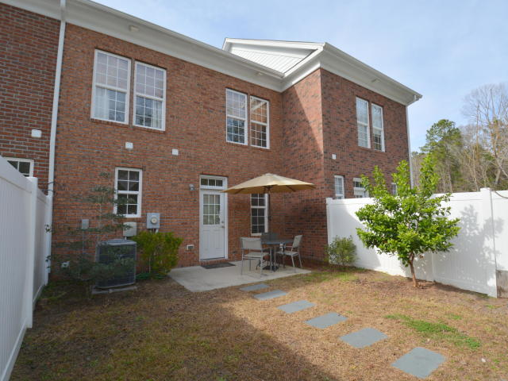
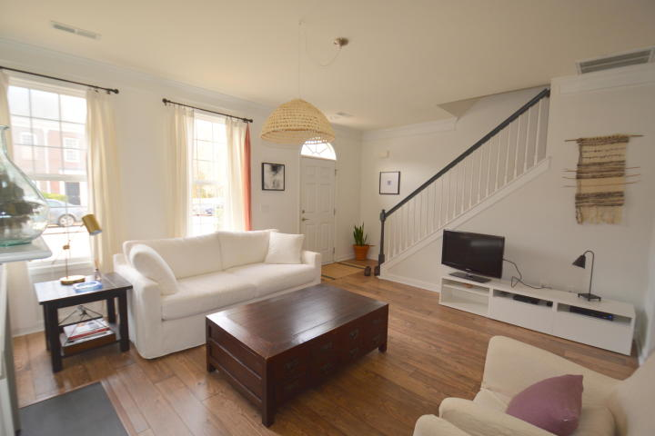
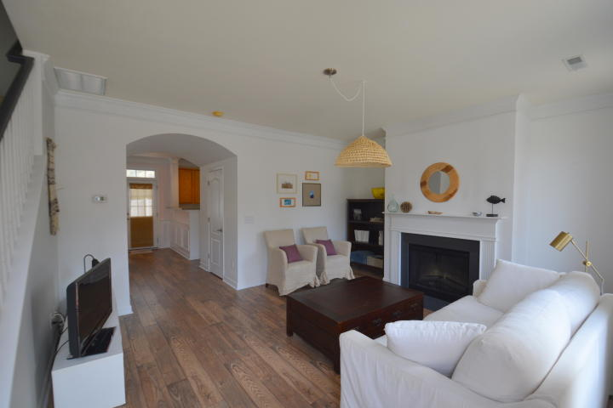
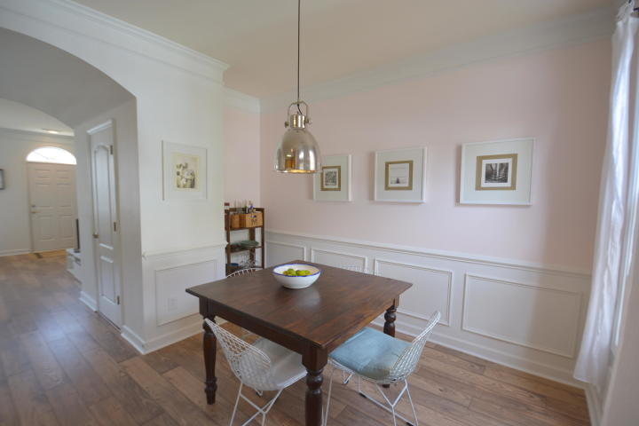
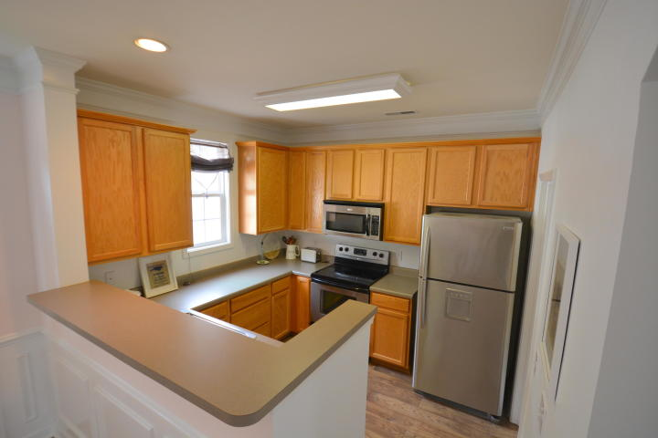
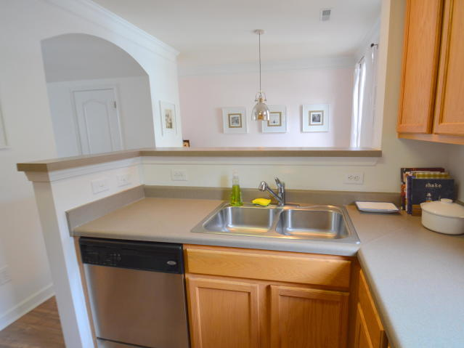
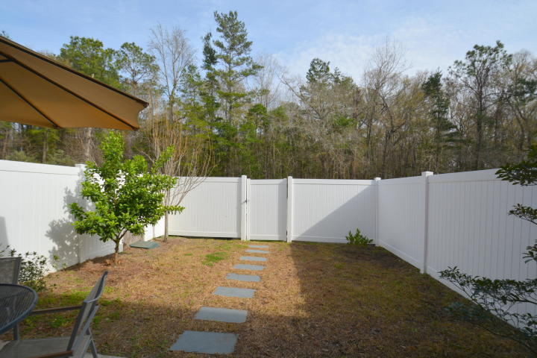
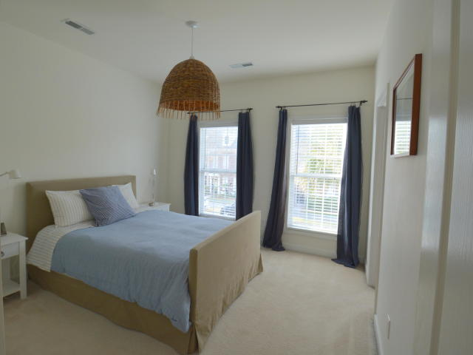
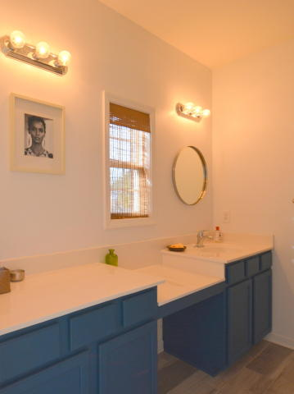
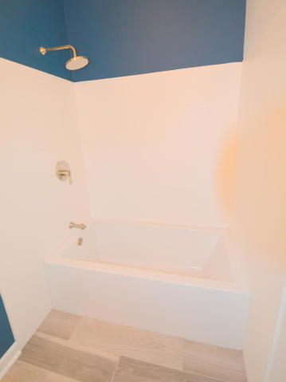
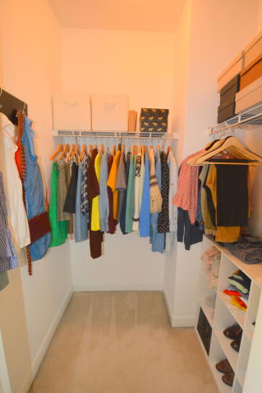
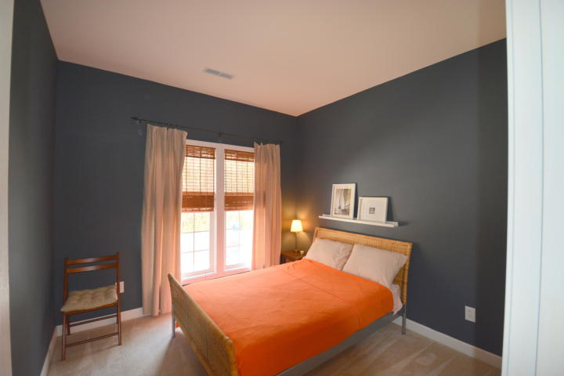
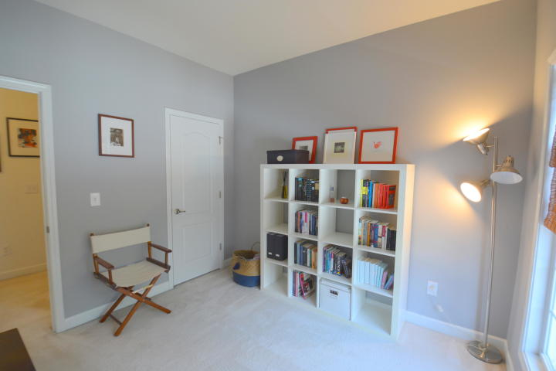
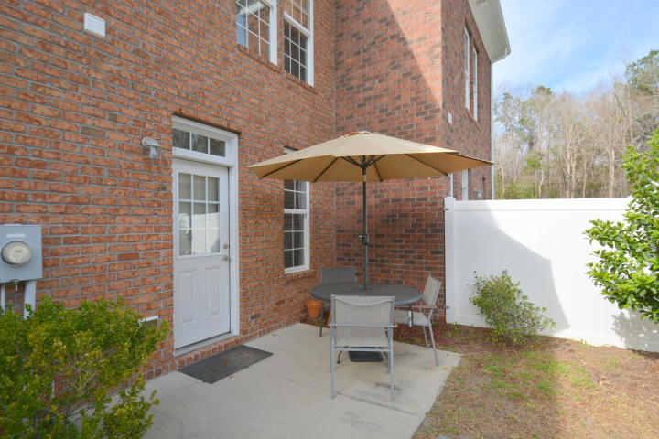
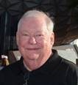

Open House ~ Saturday & Sunday from 1-4
Hosted by Mark Goldsmith | 843-743-4177 | markgoldsmith@kw.com
Buy.......Build.....Begin
762 Certificate Court
Grand Oaks Townhomes | Charleston | MLS# 19004122 | $226,000
Welcome to 762 Certificate Court. Located in the Sanctuary Section of Grand Oaks Plantation, this well designed one owner Town Home has 3 bedrooms and 2 and one half bathrooms. It has 1328 square feet of well designed and upgraded living space. Touches like crown molding, chair rail molding, picture frame molding, upgraded engineered hardwood floors downstairs, and an open floor plan add to the desirability of this fantastic home. The large living room features a fireplace and an alcove. The storage closet downstairs has additional finished space under the stairwell. The dining room also has an alcove and is open to the kitchen. The kitchen has a stainless steel appliance package which contains a smooth top range, dishwasher, built in microwave and refrigerator. Adjacent to the kitchen is your laundry room. The back door off the dining room opens to a nice patio and a courtyard enclosed with a vinyl privacy fence. Upstairs you will find two guest bedrooms and the master bedroom, master bath and guest bathroom. The master bedroom has a large walk-in closet. The recently remodeled master bathroom has ceramic tile floors, a Mirabelle soaking tub, upgraded surround, upgraded fixtures and an upgraded tub and shower trim package with a Single Function Rainbird Shower Head. The guest bathroom was renovated in 2017 and has ceramic tile floors, new toilet, new floating vanity and new fixtures. The HVAC was replaced in 2016. The homeowner does not need flood insurance.
Bob Ramella, Broker
CRS, CDPE, RCC, e-Pro
(843) 330-8300
bob@bobramella.com | bobramella.kw.com
Keller Williams Realty Charleston | 496 Bramson Ct Ste 200 | Mt. Pleasant, SC 29464

