Slide 1
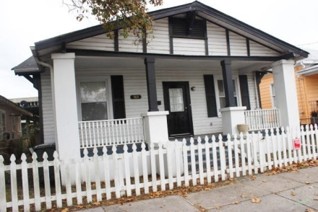
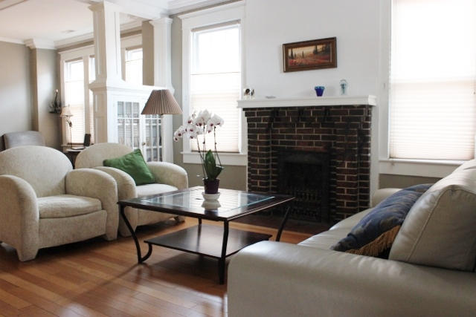
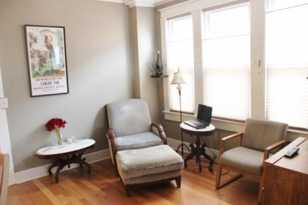
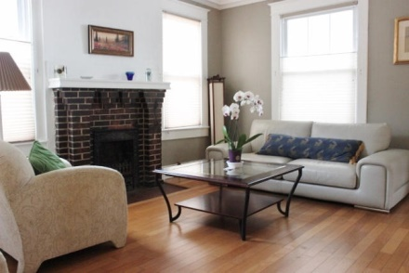
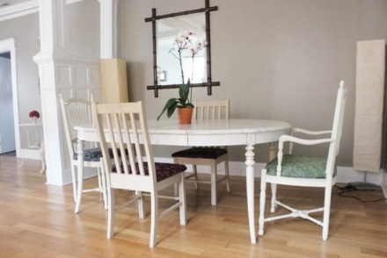
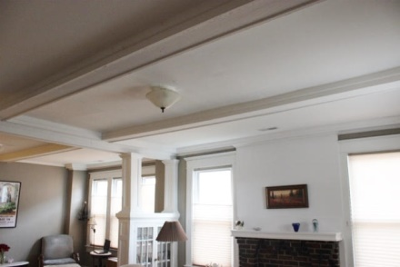
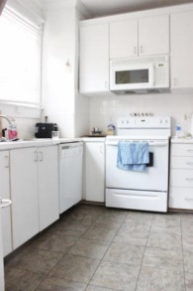
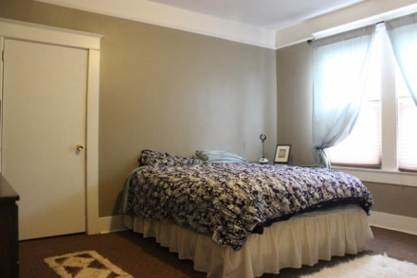
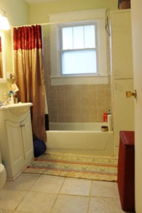
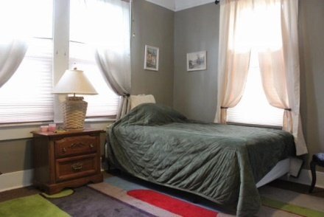
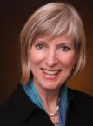

North Central Surprise
763 Meeting St
Charleston ~ MLS# 14030602 ~ $285,000
What a surprise in the middle of the bustling North Central neighborhood! A craftsman style house that can be used for residential living or as a commercial property with its limited business zoning. Located across form the Edmond Oust and the office buildings in its parking lot, 763 Meeting can be the next successful business in this vibrant neighborhood. Or a residence located in the middle of the new restaurant area of NOMO. The house has the charm of a 1920s house located close to I-26 and the major thoroughfares into the Downtown district. There is a spacious living room, dining room and three bedrooms. The bedrooms can be used as private offices and the dining room maybe able to be a conference room. Let your imagination explore this house for your family or business.
Kay Kennerty MBA, ABR, CRS, GRI
843-345-5011
Kay@agentownedrealty.com
www.KayKennertyHomes.com
The AgentOwned Realty Company
824 Johnnie Dodds Blvd
Mt. Pleasant, SC 29464

