Slide 1
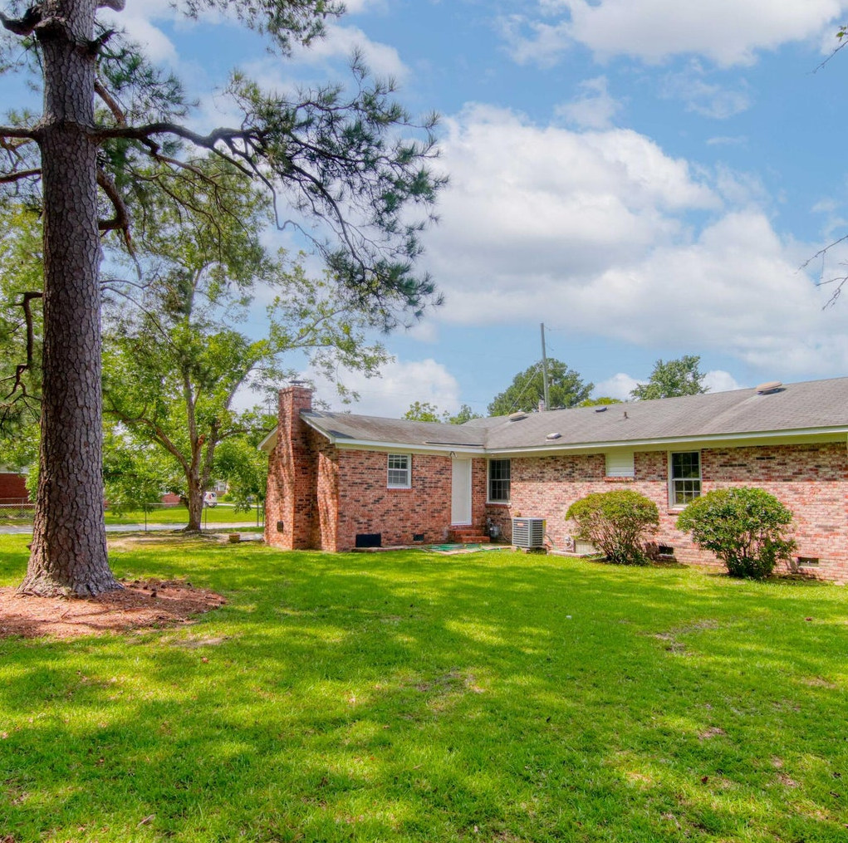
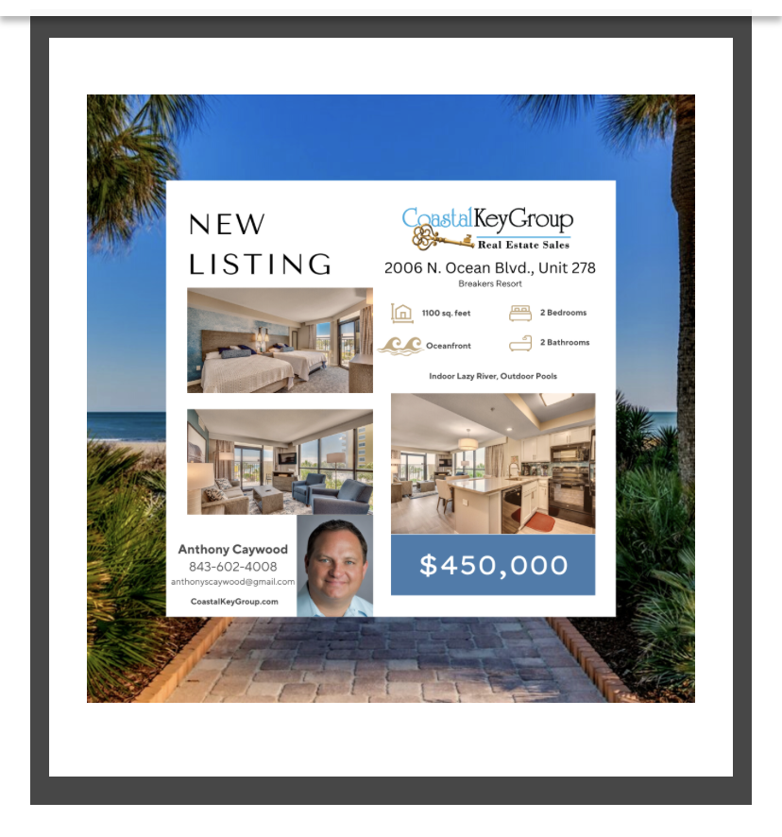

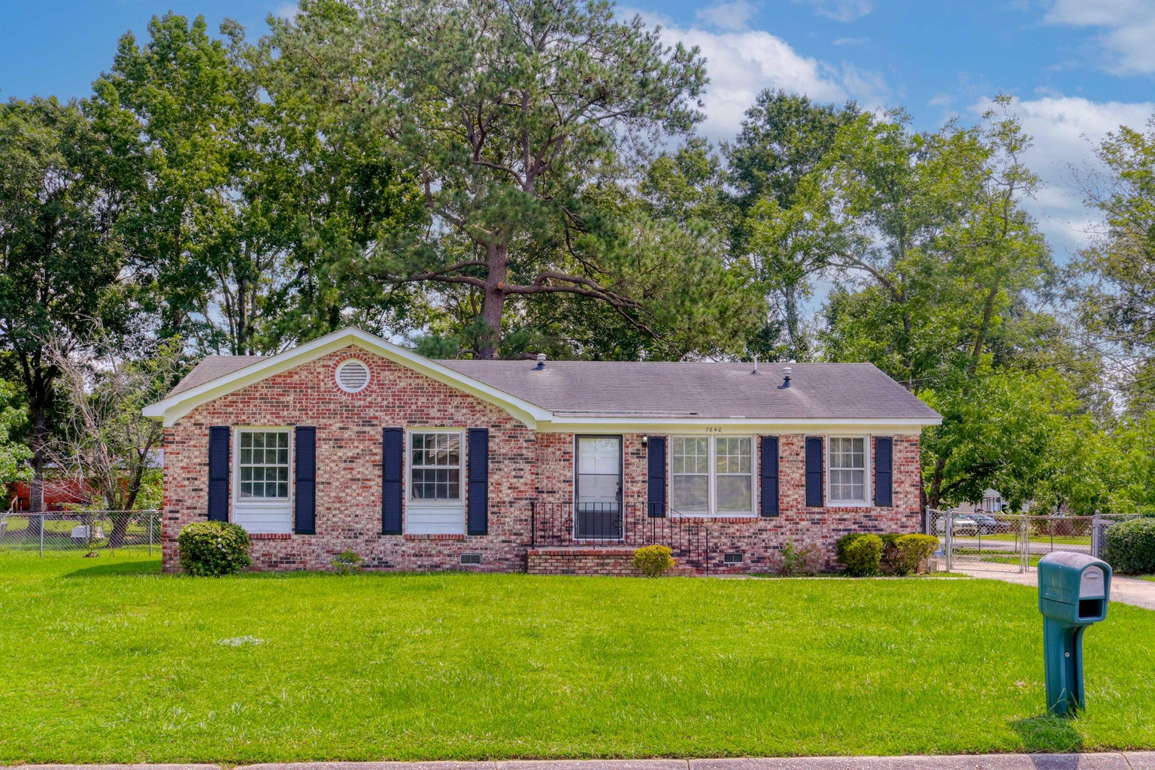



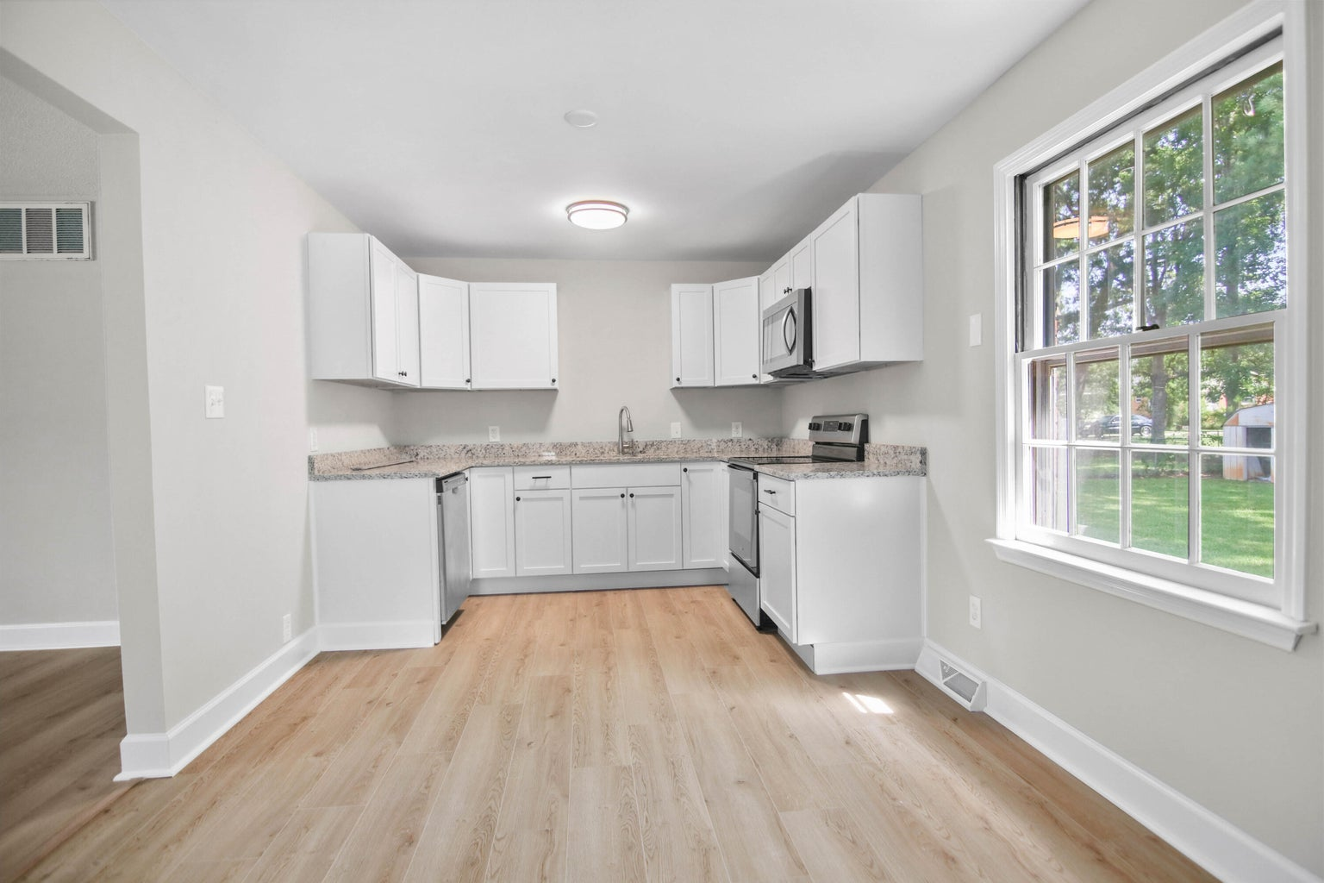
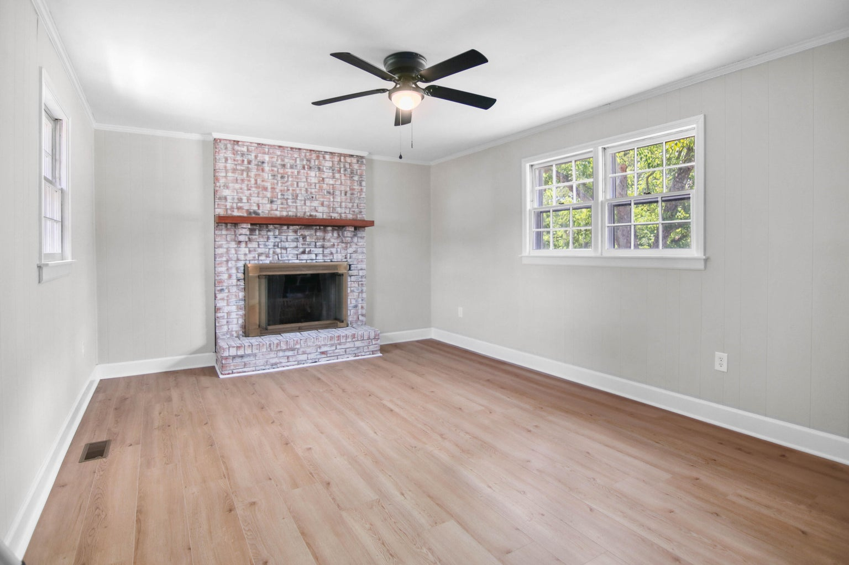
SHOWCASE HOME
A BRIGHT GEM
7640 Brandywine Rd
Pepperhill
North Charleston
MLS# 23018422 | $310,000
1,502 SF
3 BEDS
2 BATHS
Susan Stanley
843-323-5573
susancstanley@gmail.com

