Slide 1
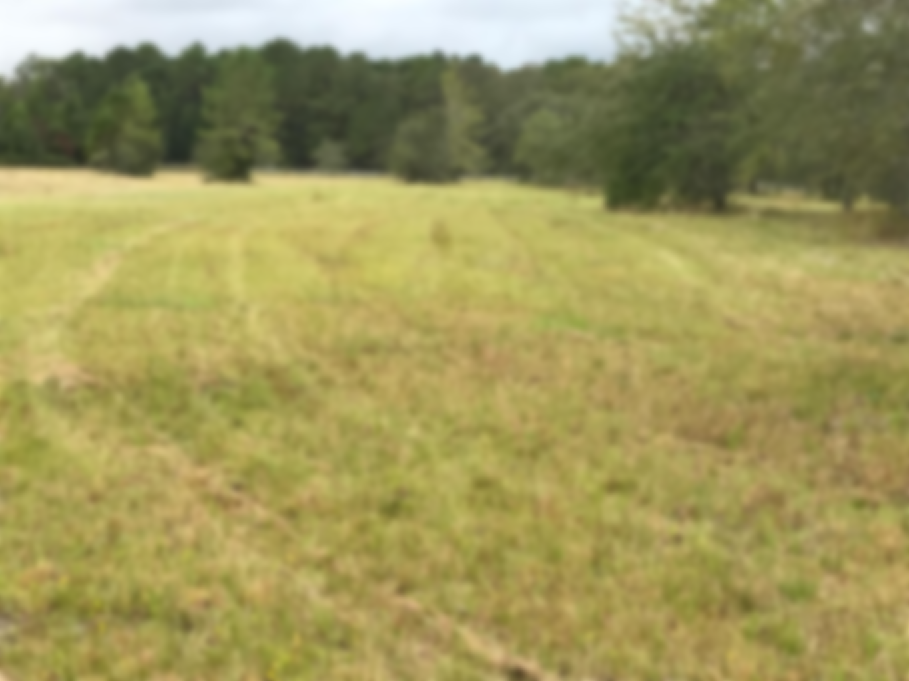
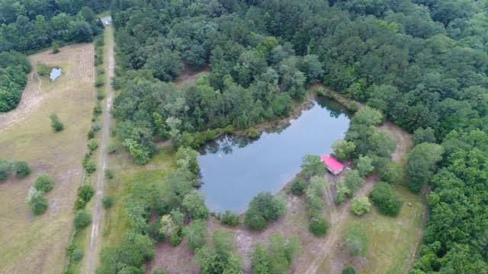
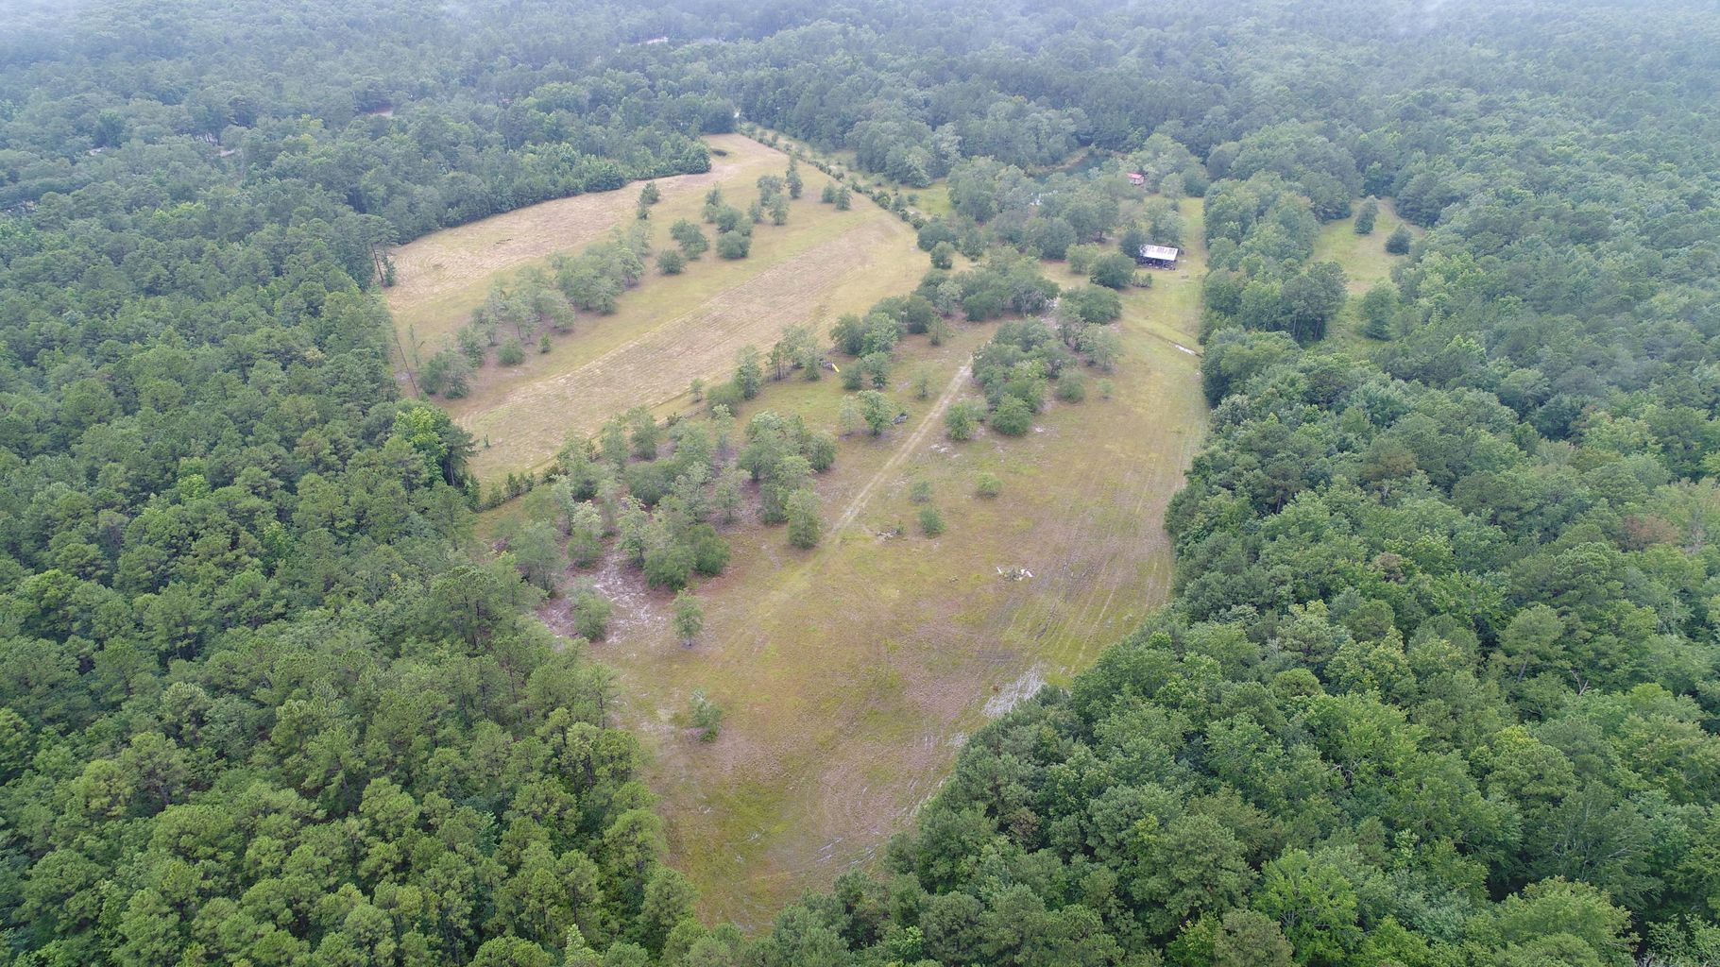
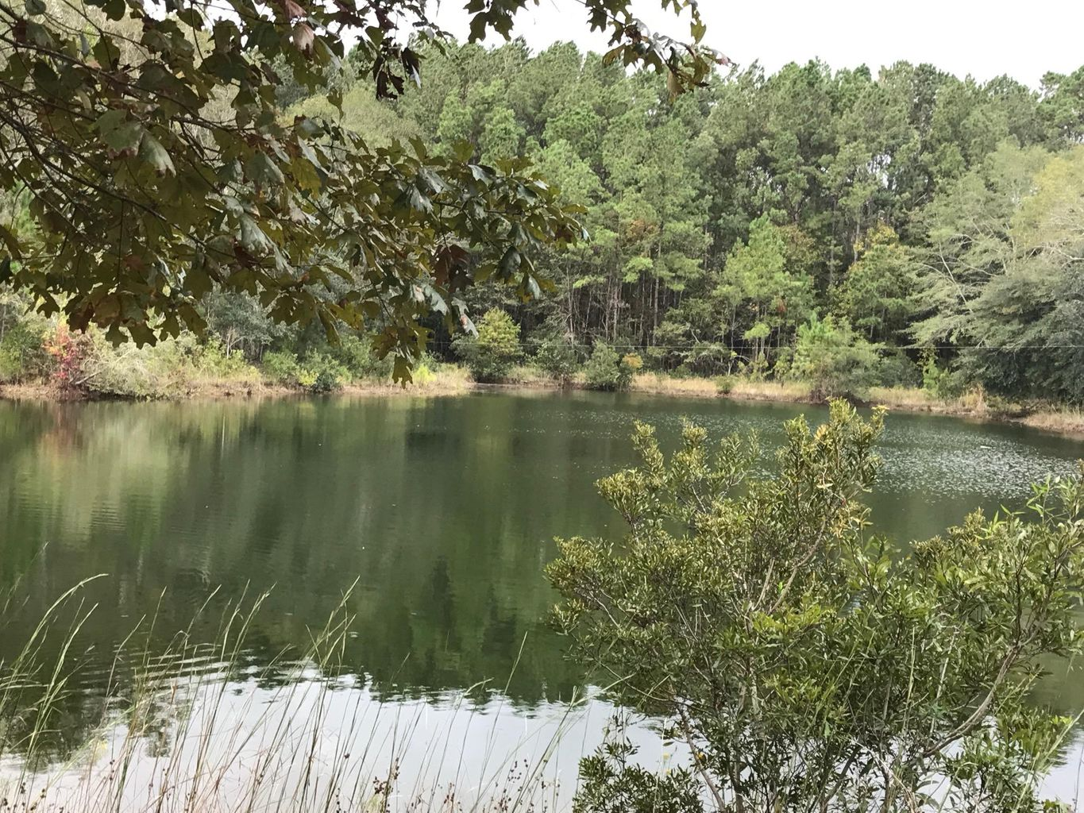
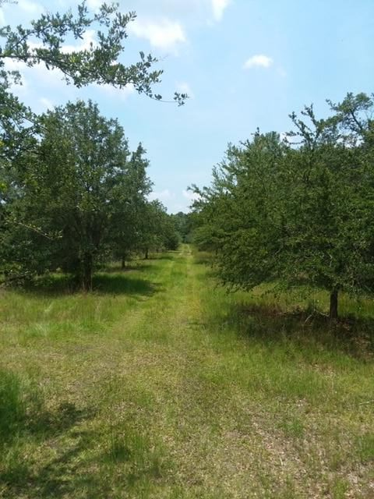

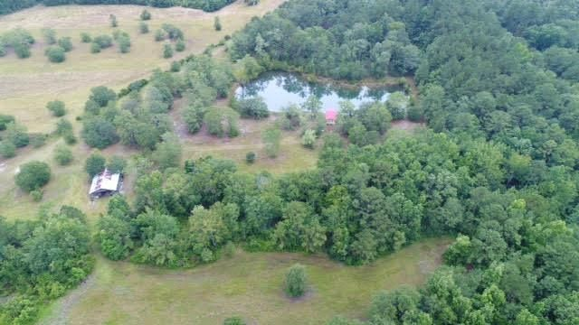
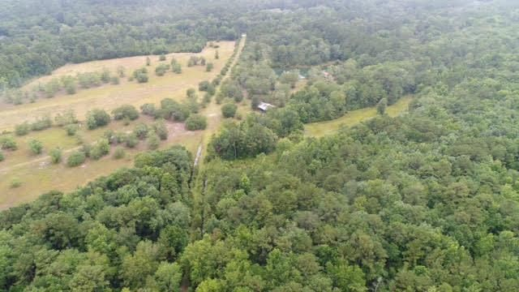
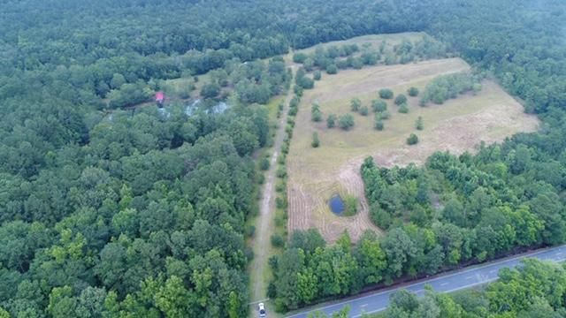
57 Acres in Meggett
7650 SC Hwy 162
Hollywood, SC 29449 | MLS# 20018903 | $595,000 | 57.43 Acres
Offered for sale is 57 acres located in the town of Meggett. It is conveniently located 25 minutes from Edisto Island and 25 minutes from downtown Charleston. This property is very versatile and can be used for many things. First it has a 14 acre pasture with horse fencing, no barbed wire, with 6 feed stalls built in. There is also a watering hole in the pasture, so the water never runs out. The property has a mixture of cleared land and wooded areas. The mix is about 25 acres of cleared grassy areas and the rest in woods. There is a large fresh water pond on the property stocked with bass and bream. The pond measures almost 1.5 acres. Deer and turkey's are prevalent in this area and the back property line is a common border with a large Westvaco tract. The land is currently zoned agricultural, and the taxes are less than $100.00 per year.
Fudgy Brabham
(843) 568-1241
fudgy@hbrtwn.com
www.hbrtwn.com
Harbourtowne Real Estate
672 Marina Drive, Ste 110
Daniel Island, SC 29492
Harbourtowne Real Estate | 672 Marina Drive, Ste 110 | Daniel Island, SC 29492

