Slide 1
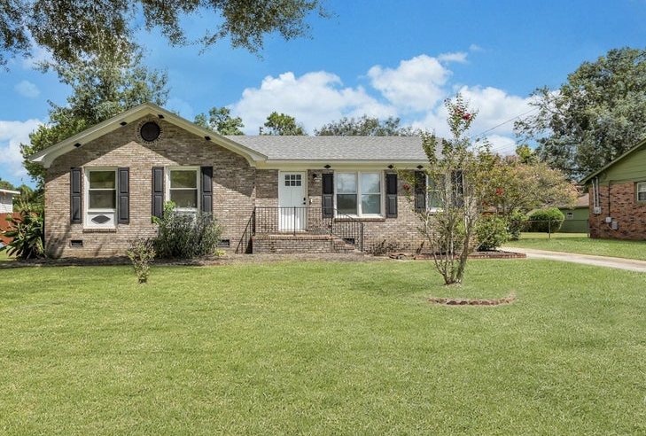
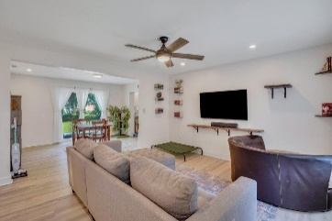
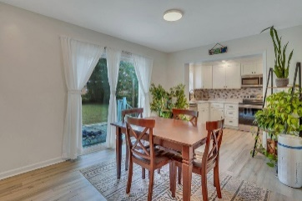
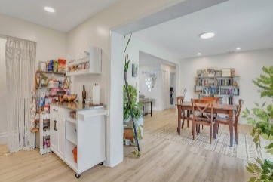
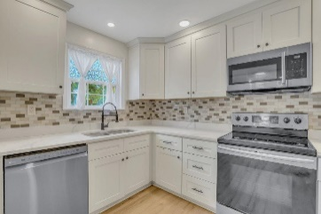
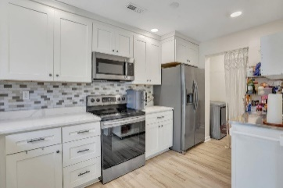
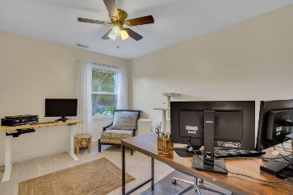
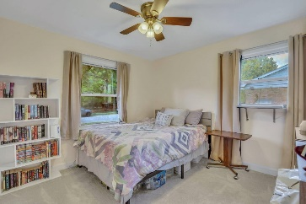
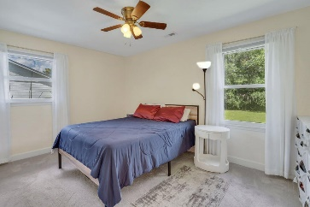
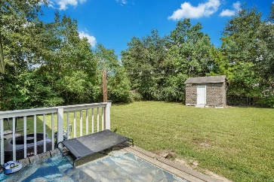
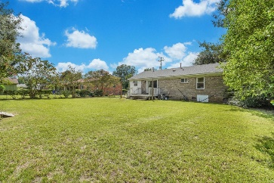



Renovated Brick Ranch Under $300k!
7652 Brandywine Road
Pepperhill
North Charleston, SC 29420
MLS# 24021862
$299,000
3 Bed | 2 Bath | 1,262 sf
Welcome to your new home! This charming 3-bedroom, 2-bathroom brick ranch offers a perfect blend of cozy comfort and modern updates. Step inside to an open yet intimate living, dining, and kitchen area, perfect for everyday living and entertaining. The kitchen, renovated just 6 years ago, boasts beautiful countertops, stainless steel appliances (which convey with the sale), and an inviting atmosphere that makes cooking a delight. Both bathrooms have also been thoughtfully updated, and the entire home features durable LVP flooring in the common areas and newer carpet in the bedrooms. The HVAC system was replaced 6 years ago, ensuring efficient heating and cooling. The roof, installed in 2022, provides peace of mind for years to come.
Outside, you'll find a huge fenced-in backyard, perfect for gatherings, gardening, or just enjoying the outdoors. A shed in the backyard, which conveys with the sale, offers extra storage or workspace. The separate laundry area adds convenience to this already functional layout. As a bonus, the seller is offering to pay for professional cleaning before closing, making your move-in experience even smoother. Located minutes to restaurants, shopping, entertainment, hardware stores, fast food, Snafu brewery and more! Don't miss out on this cute and cozy home, schedule your showing today! This property qualifies for a special community lending program offering buyers more affordable financing options.
Nick Mazzilli
843-640-5575
nick@themazzilliteam.com
themazzilliteam.com
Maven Realty
2180 McMillan Ave
#71672
Charleston, SC 29405

