Slide 1
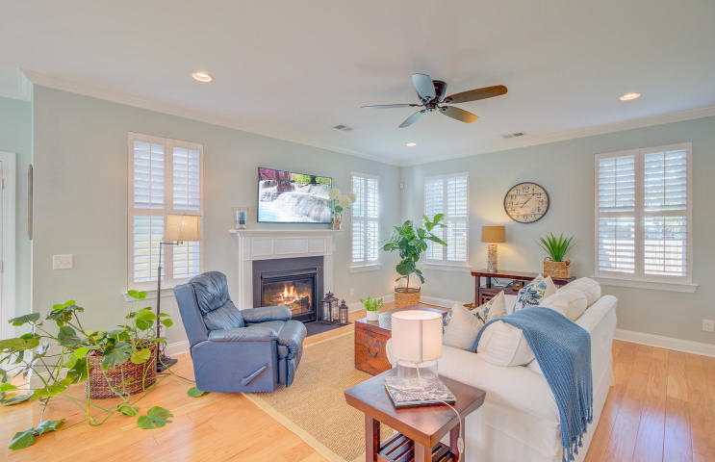
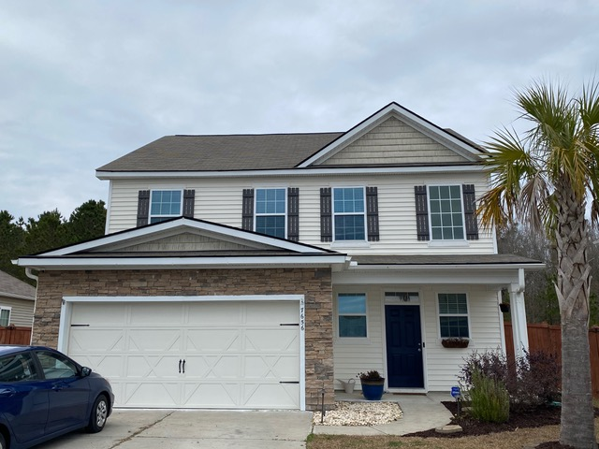
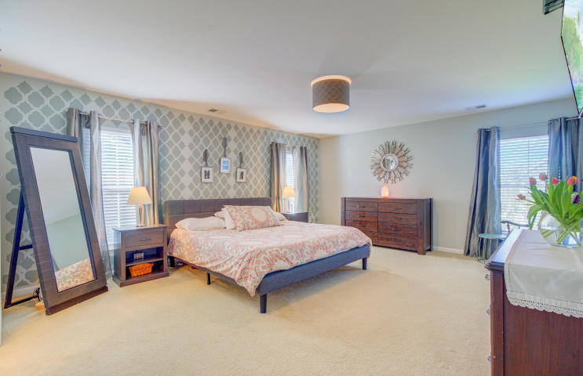
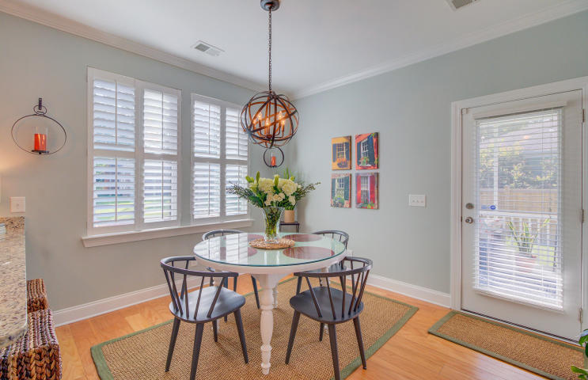
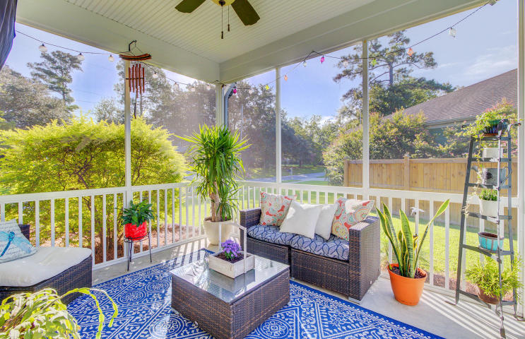
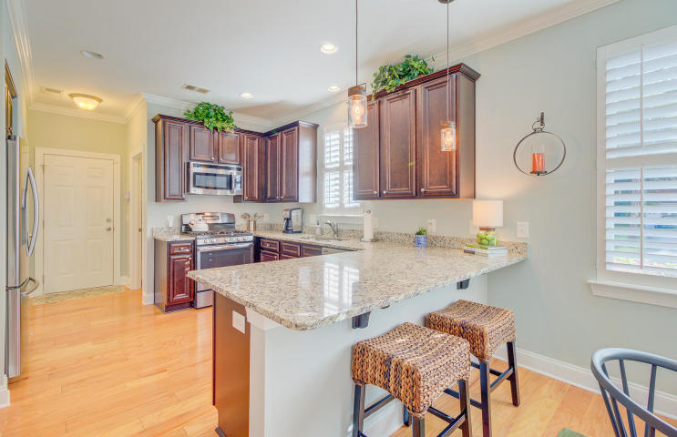
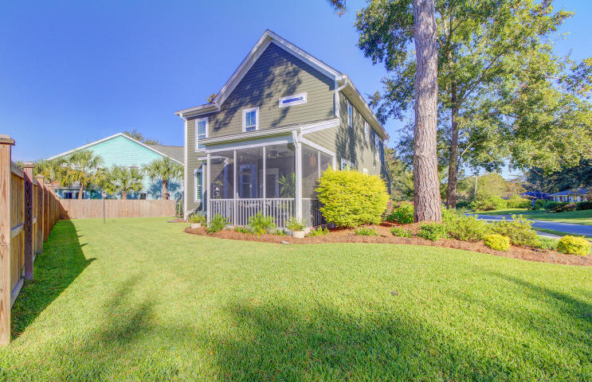


COMING SOON! 4 Bedroom Move-In Ready Home Priced to Sell
7656 High Maple Circle
Brookdale | North Charleston, SC | $275,000
Located in the Brookdale community close proximity to Boeing and Dorchester Rd.
* 4 Bedroom
* 2.5 Baths
* Over 2,200 square feet
* Open Concept
* Wooded Lot
* Fully Enclosed Fenced Yard
* 2 Car Garage
Contact Ellen O'Neil to arrange for showing before we go live on the MLS on Friday. This home is priced to sell with a popular price point.
Ellen O'Neil
Broker/Owner, ABR, e-PRO, CNE
Charleston Realtor of Distinction
(843) 300-8530
www.EllenONeilProperties.com

