Slide 1

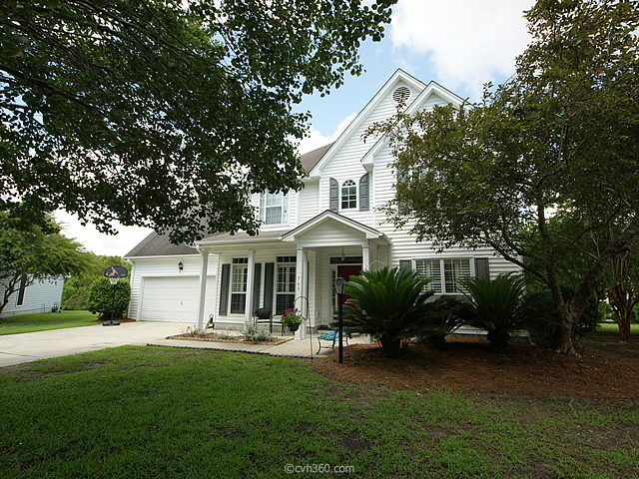
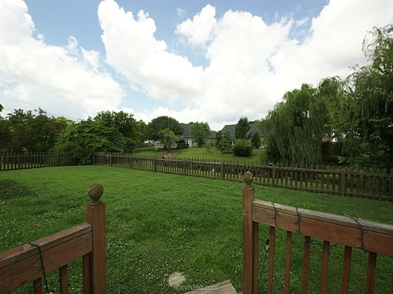
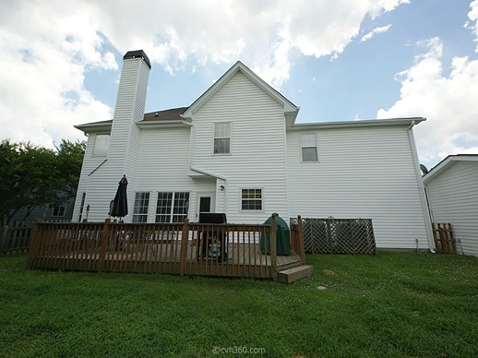
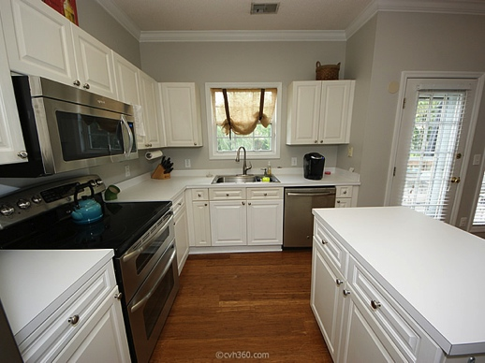




NEW LISTING
Glenlake Subdivision
A must see at $397,000
Located In The Heart Of Mount Pleasant, SC 29464
Home Features
• Spacious home with 2203 Square Feet
• 4 Bedrooms up or 3BR Plus BONUS RM
• Premium Cul-de-sac location
• Large Fenced-In Backyard overlooking POND
• Wood deck off the back of the house
• Office with French Doors
• Formal Dining Room
• White Kitchen w/Stainless Steel Appliance
• New Microwave & Large Basin Kitchen Sink
• 12 x 12 separate WORKSHOP w/AC
Wonderful 4BR home w/great curb appeal situated in the heart of Mt. Pleasant in desirable Glenlake subdivision. Home is ideally located on premium cul-de-sac lot w/large fenced in backyard & deck overlooking pond. The main floor boasts lots of natural lighting & open floor plan great for entertaining. Features include: Two-story Foyer, hardwoods, formal Dining Rm, Office/Den w/French Doors & plantation shutters, Large Family Rm w/ceiling fan & fireplace that opens to the eat-in Kitchen. Bright Kitchen w/stainless steel appliances including a new microwave, large one basin kitchen stainless sink as well as generous counter space, island & pantry. Added bonus: 12x12 workshop w/cable & A/C unit. Walking distance to Mt. Pleasant Tennis & Rec Department & short drive into Downtown Charleston with easy access to I526!
Margaret Hekker
BIC/Realtor
843-296-7520

