Slide 1
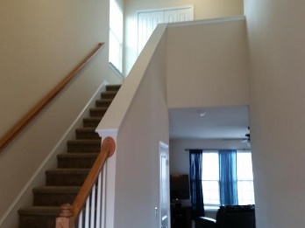
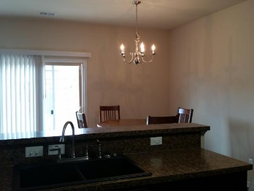
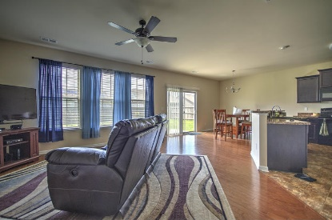
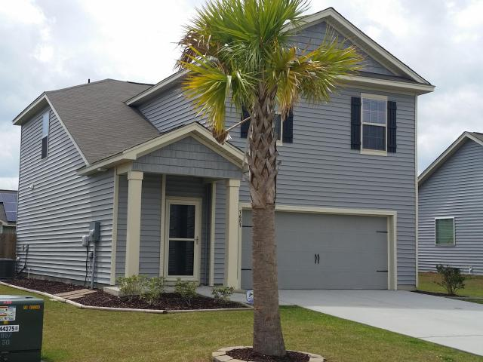
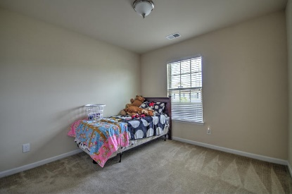
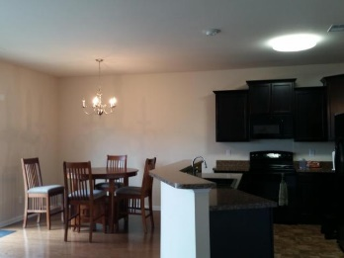
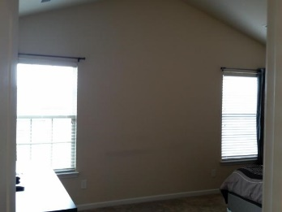
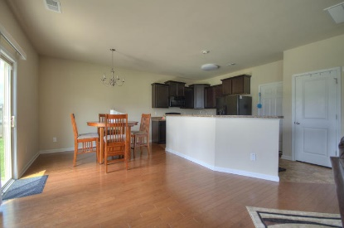
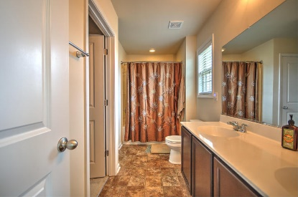
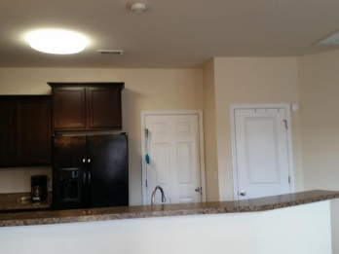
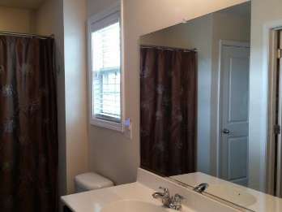
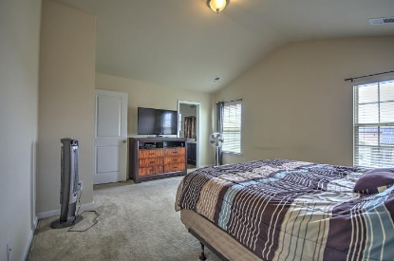
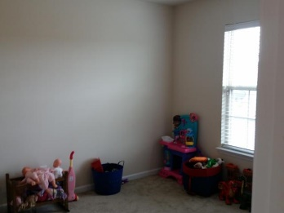
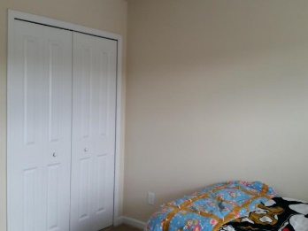
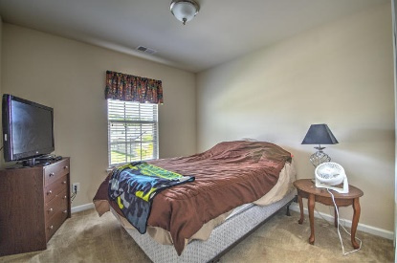
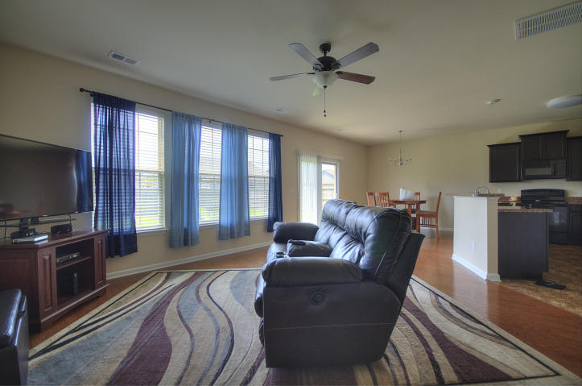
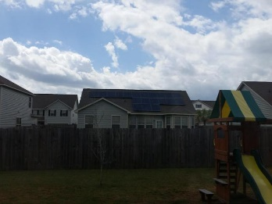
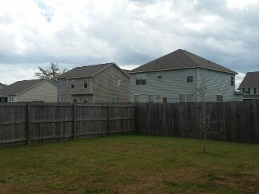


Immaculate Home In A Great Neighborhood!
New Price!
$50 Gas Card Drawing
7687 Haywood Street
Brookdale ~ North Charleston, SC 29418 ~ MLS# 17009132 ~ $210,000
Beautiful, freshly painted, immaculate home in convenient Brookdale subdivision. Walk into a bright hallway, then on into a sunlight great room with a modern kitchen and eating area! Double sliding doors take you into the fully privacy fenced backyard. Upstairs you have a private master with a huge bath; down the hall are 3 bedrooms and a bath. Garage is an extra foot long; the storage system remains. Lots of closet and storage space; 10' gate in fence for boat storage; Neutral colors so it will be easy to get settled and make this home your own.
Susan Woodworth Kraber
Mobile - (843) 779-9655
susankraber1@gmail.com
ERA Wilder Realty, 125-F Wappoo Creek Dr, Charleston, SC 29412

