Slide 1
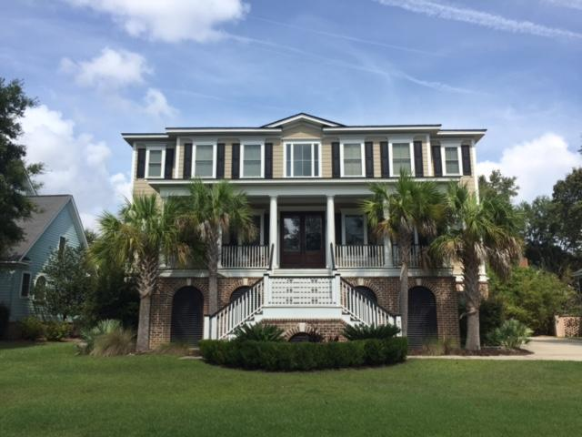
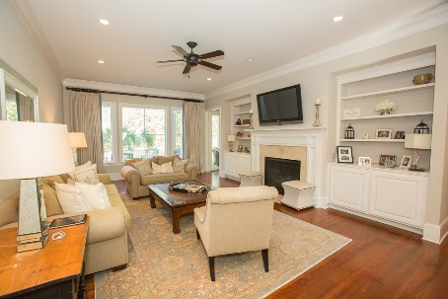
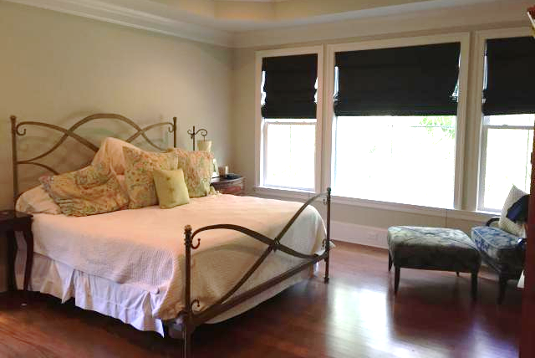
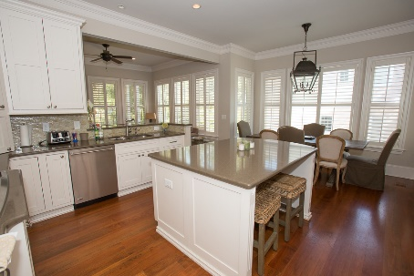
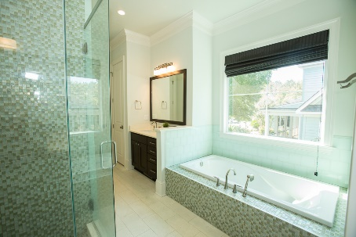
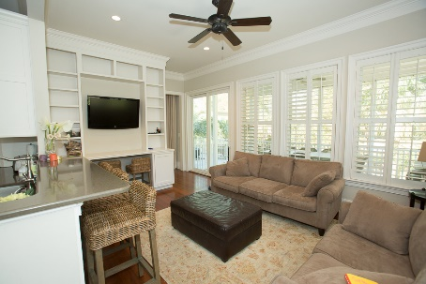
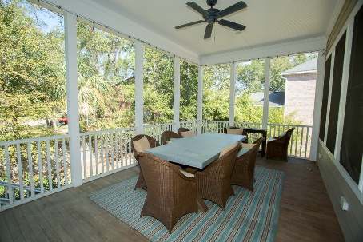


MUST SEE! BEAUTIFUL HOME ON JAMES ISLAND!!
768 Whispering Marsh Drive
Stiles Point Plantation · Charleston
MLS# 16027471 · $848,000
Fabulous opportunity to own in an sought after subdivision, close to town.
6 bedoom/4.5 bath functional house with great style and too many extras to mention. Kitchen features eat in kitchen, large island, inset cabinets and GE monogram appliances that leads to first floor laundry, master bedroom on first floor leading to spa like master bath with glass shower, his/her walk in closets, library, formal dining, great room, laundry rooms on first and second floor. Upstairs boasts entertainment room, 4 bedrooms complete with walk in closets, each that share a jack and jill bath. A separate guest room and another full bath just down the hall. 3 car garage with storage for all your memories and toys. Beautiful gas lanterns outside. Amazing neighborhood, families enjoy the park and events throughout the year.
Michael Dew
O (843) 870-7000
M (843) 870-7000
michaeledew@gmail.com
www.michaeldewrealestate.com
AgentOwned Charleston Group
902 Savannah Hwy
Charleston, SC 29407
Real Estate ● Mortgage
Insurance ● Business Brokerage

