Slide 1
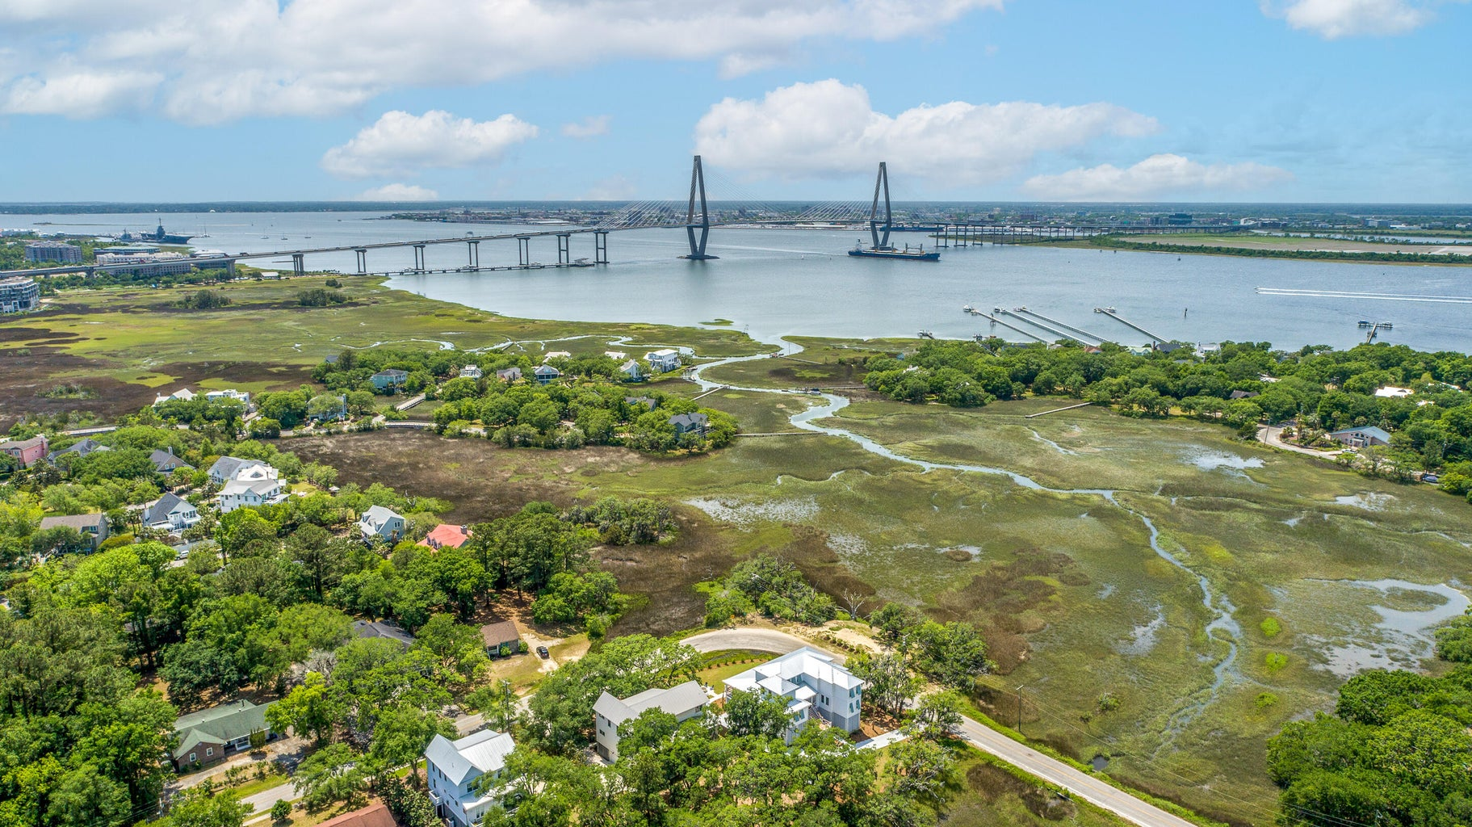

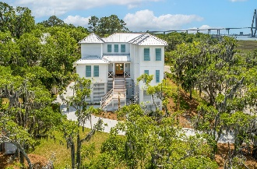
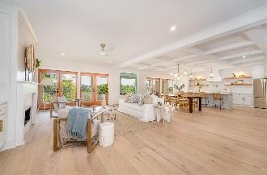
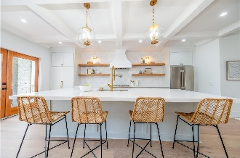
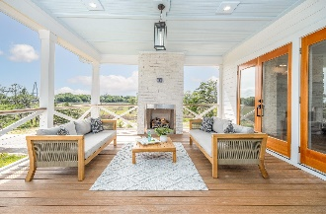
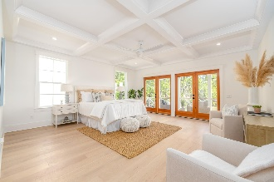
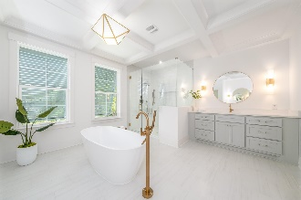
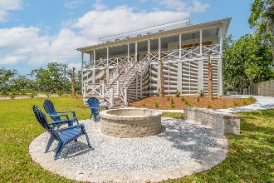
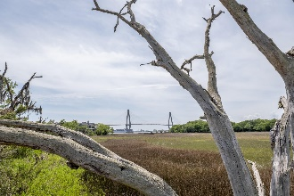

Fantastic Bridge and Marsh Views!
MAJOR PRICE REDUCTION!
768 3rd Street
Scanlonville | Mount Pleasant, SC 29464 | MLS# 23009502 | $4,195,000
768 3rd St is a thoughtful and meticulously designed custom home featuring sweeping views of the Arthur Ravenel Bridge. This 5 Br 5.5 bath home offers marsh views on three sides. The spacious home holds 4655 sf of heated space and almost 1000 sf of beautiful porch living. The rear porch extends the length of the home to enjoy water, marsh and bridge views.
The large living room boasts a fireplace with built in shelves and cabinetry. Off the kitchen and living area you will find an entertaining bar, as well as a coffee bar /additional serving area. The entire space hosts many sets of doors to capture the breeze and the wonderful views. The second floor hosts 4 more bedrooms each one with its very own en-suite bath. Many of these bedrooms have views of the bridge and could make a wonderful office if needed.
The front yard is dreamy with beautiful majestic oaks and marsh views. The rear yard design features a fire pit and has a pre-approved pool plan and patio design if one desires a pool.
Just a brisk walk away you will find the David Simmons Jr. community dock as well as the Remley's Point boat landing. Just down the road you can entertain joining the ION Club for amenities and tennis. This location is incredible, 5 minutes to downtown, about 20 to the beach and 20 min drive to the CHS International Airport. This new home has many architectural details and features. This is lowcountry living at its finest. Welcome home Charleston!
Take a video tour: https://youtu.be/-5cj195LP0Y
Cami Gilsenan
843-437-7538 camila.gilsenan@carolinaone.com
Carolina One Real Estate
1101 St. Thomas Island Dr.
Charleston, SC 29492

