Slide 1
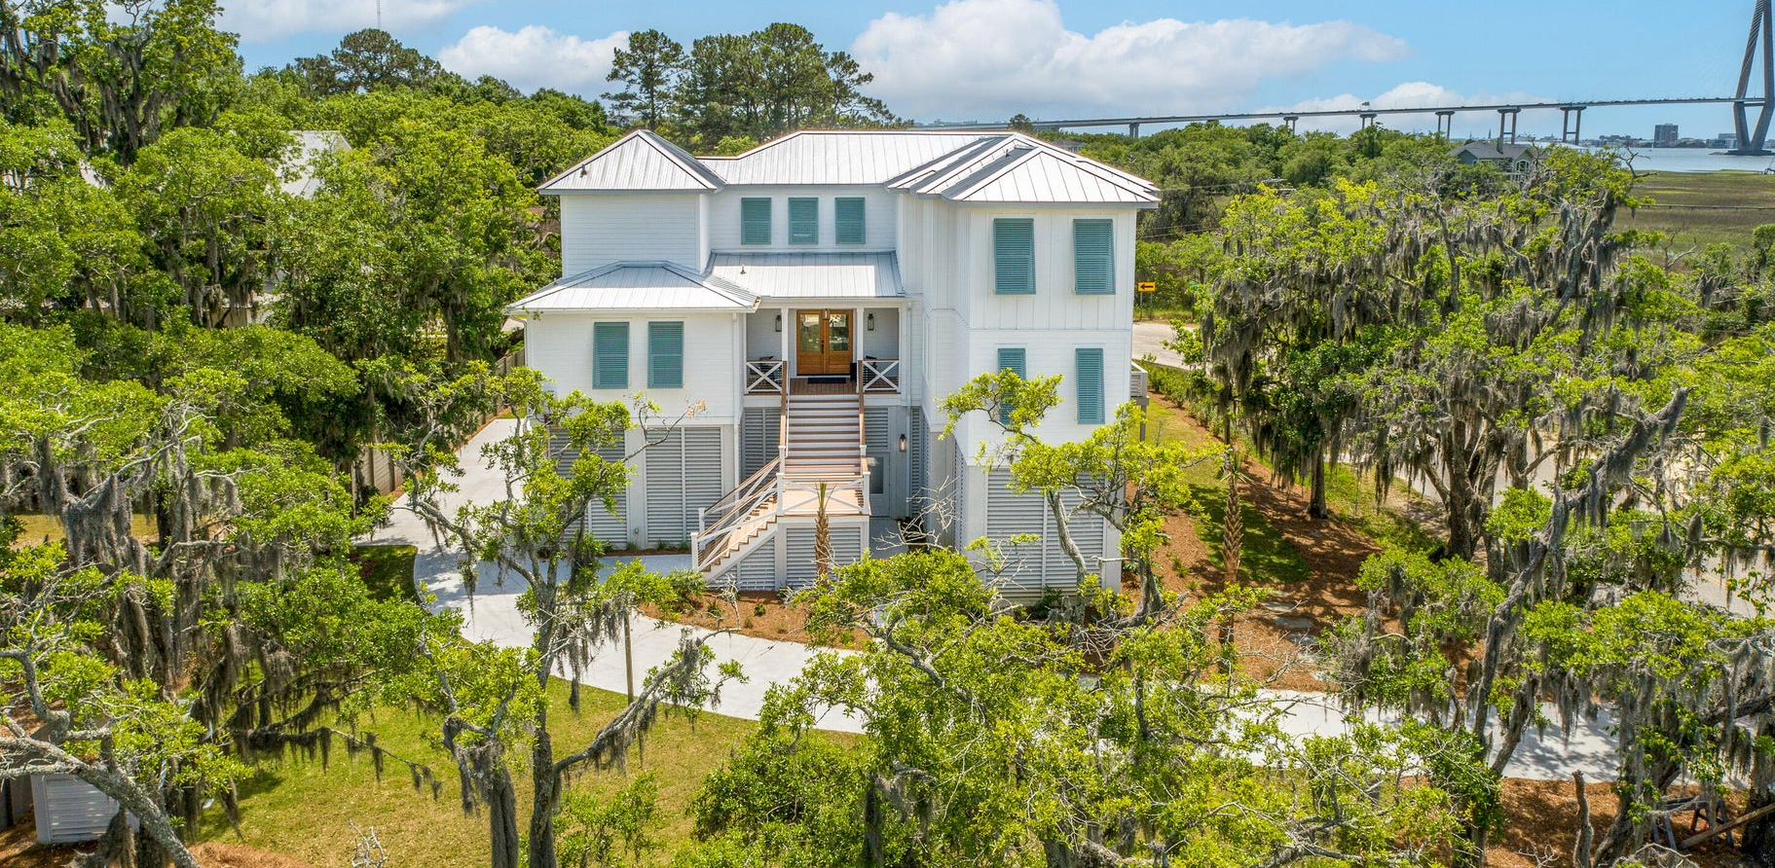

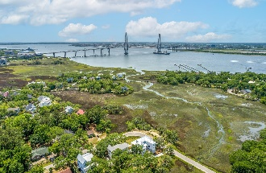
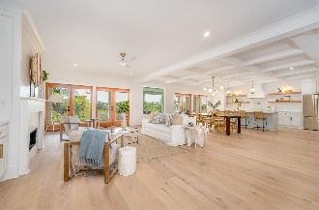
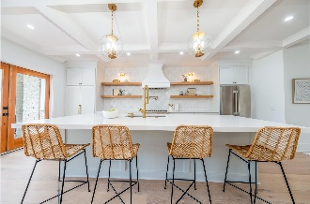
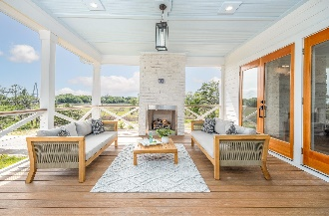
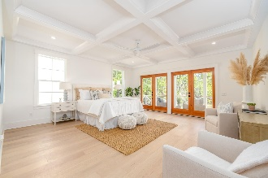
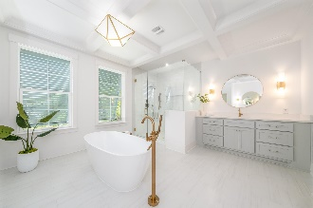
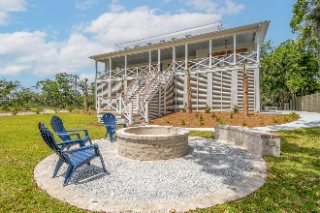
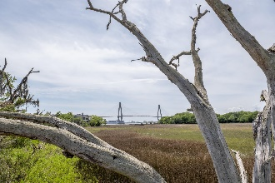

Fantastic Bridge and Marsh Views!
OPEN HOUSE
SUN JULY 23rd 12-3
768 3rd Street
Scanlonville | Mount Pleasant, SC 29464 | MLS# 23009502 | $3,995,000
768 3rd St is a thoughtful and meticulously designed home featuring sweeping views of the Arthur Ravenel Bridge. This 5 Br 5.5 bath home offers marsh views on three sides. The spacious home holds 4655 sf of heated space and almost 1000 sf of beautiful porch living. The back porch extends the length of the home to enjoy the beauty of Charleston. Notice the custom fireplace for those chilly nights. Step inside and be amazed at what this brand new home offers. The primary suite is located on the first floor and features a very large sitting area and private entrance to the porch. The primary bath features two large dual vanities and his and hers closets as well as a linen closet. The kitchen is stunning with herringbone marble backsplash, quartz countertops and Thermador appliances You will notice there is a walk in pantry as well as an appliance cabinet. The open concept carries to the dining and living room spaces. The large living room boasts a fireplace with built in shelves and cabinetry. Off the kitchen and living area you will find an entertaining bar, as well as a coffee bar /additional serving area. The entire space hosts many sets of doors to capture the breeze and the wonderful views. On this floor you will notice the large laundry room equipped with a large washer and dryer package. You can even add a middle island for folding and projects. You can take the elevator up to the second floor which opens to a large flex room, play room or media room. The second floor hosts 4 more bedrooms each one with its very own en-suite bath. Many of these bedrooms have views of the bridge and could make a wonderful office if needed. The garage is huge and creates living spaces to enjoy ping pong, pool, gardening space etc.. endless possibilities! The elevator takes you to all levels of living from the garage. The front yard is dreamy with beautiful majestic oaks and marsh views. The rear yard design features a fire pit and has a pre-approved pool plan and patio design if one desires a pool. The pool plans can be found in the documents page. This plan can be modified to fit your design and your budget. Just a brisk walk away you will find the David Simmons Jr. community dock as well as the Remley's Point boat landing. Just down the road you can entertain joining the ION Club for amenities and tennis. This location is incredible, 5 minutes to downtown, about 20 to the beach and 20 min drive to the CHS International Airport. This new home has many architectural details and features. This is lowcountry living at its finest. See attached floor plan and a pool plan if desired. Welcome home Charleston!
Take a video tour: https://youtu.be/-5cj195LP0Y
Cami Gilsenan
843-437-7538 camila.gilsenan@carolinaone.com
Carolina One Real Estate
1101 St. Thomas Island Dr.
Charleston, SC 29492

