Slide 1
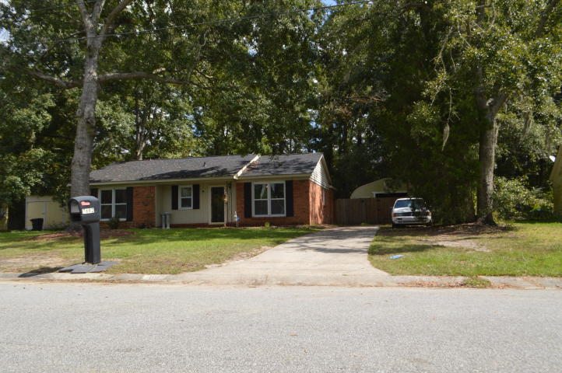
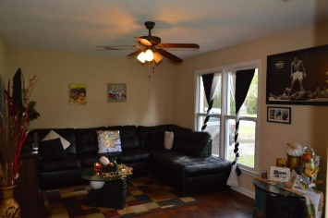
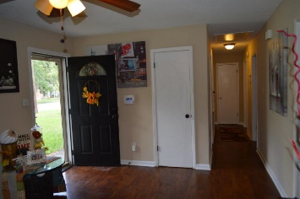
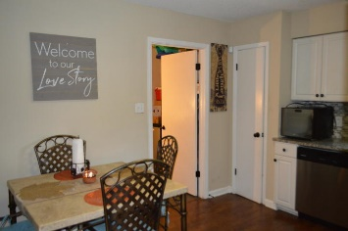
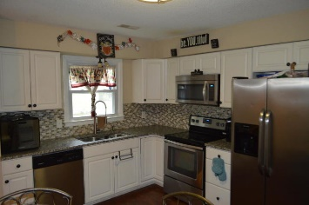
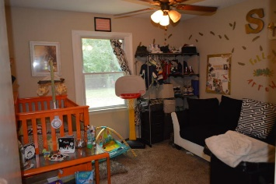
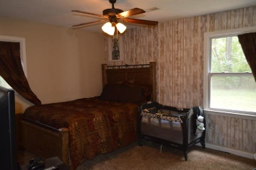
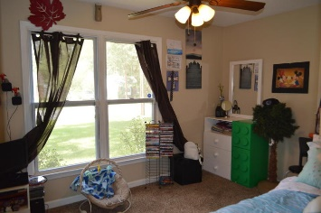
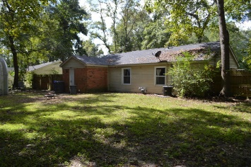


7692 Midwood Drive Pepperhill ~ North Charleston, SC 29420 MLS# 18027127 ~ $164,500
Open House Lunch ~ Friday, Oct 3 from 11 - 1
Handyman Special… Bring your hard hats!
$2,500 Price Reduction
+ $500 Agent Bonus!
This amazing home is nestled in the heart of North Charleston and close to Boeing, Bosch, the Joint AFB, shopping and restaurants, this charming home sits close to a dead end for extra privacy. Kitchen boasts stainless steel appliances and granite counter tops with eat in kitchen. Freshly painted in 2018. Roof, windows, A/C, were updated in 2015. Back yard is fully fenced and also has a huge garage/workshop to excite any garage enthusiast, or just give you extra storage space. Low maintenance with plenty of storage and backyard space!
Brooke Madsen (843) 834-1241
brookemadsen.realtor@gmail.com | www.brookemadsen.realtor
HomeGate Real Estate | 4000 S Faber Place Dr Ste 300 | Charleston, SC 29405

