Slide 1
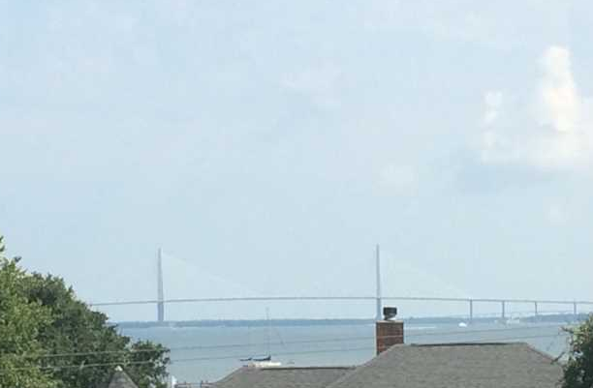
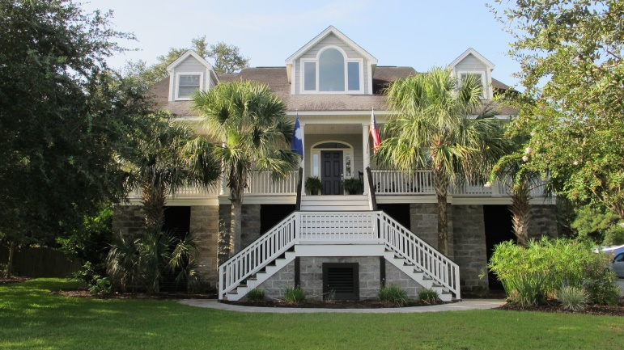
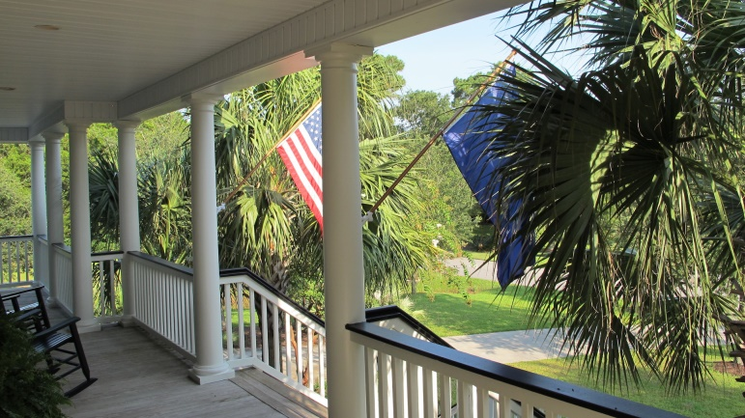
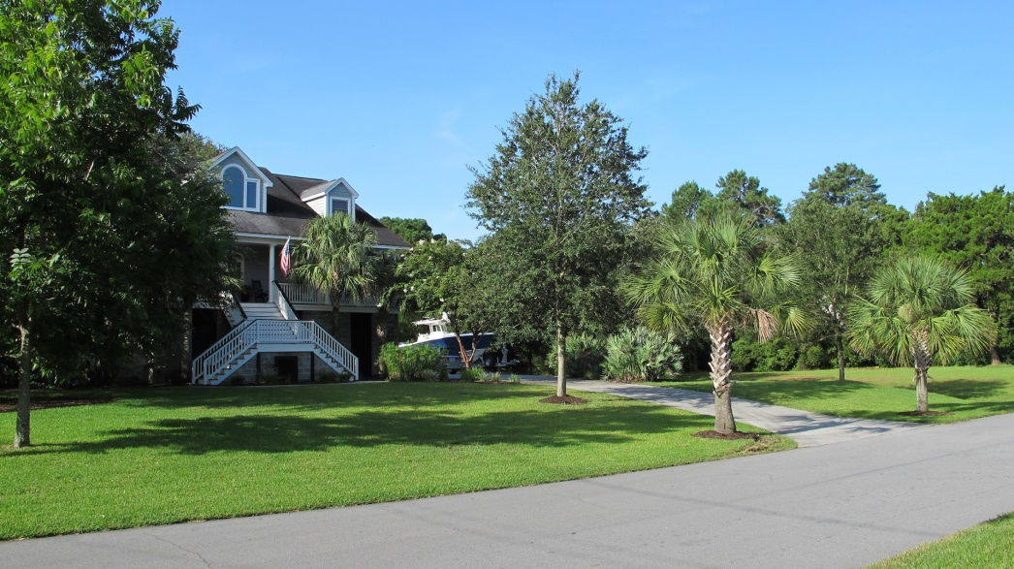

769 Clearview Drive
Charleston ~ MLS# 1422042 ~ $748,500
This is a James Island Gem. Across the street from the harbor. Custom built in 2003 on approximately 1.5ac with a salt water in-ground pool, privacy fence, and landscape lighting. Located in the heart of James Island. Designed with an abundance of elegant crown molding, bead board, chair railing and more. A traditional style home providing a spacious family room adorned by a rich red brick fireplace with gas logs. Built-in cabinetry and plantation shutters adds to the charm of this delightful room. Beautiful wood flooring enhance this open floor plan. The comfortable eat-in-kitchen enjoys a nice pantry, custom cabinetry, Granite counter tops trimmed in a Travatine back splash, stainless steel appliances and a quaint workspace built-in. Be sure to check out the spacious laundry room. The quality and care that was taken to build this home is evident. In ceiling speakers, recessed can lighting throughout and an automated lighting system. All brand new energy efficient pool equipment. Warm summer days can be enjoyed around the in-ground pool while you cookout with family and friends. The enormous shadowing oak in back yard provides a pleasant shade for a swing or picnic area. The master, located on the first floor living space, enjoys an oversized shower with multiple shower heads, 2 walk-in closets, and double cultured marble sinks. The top floors add 3 bedrooms and 2 full baths plus a bonus area for toys or workspace. All bedrooms include walk-in closets. Need extra space? This home has it. In addition to the 2 car garage there's extra storage space for a boat or a 3rd vehicle plus a separate a work shop. The driveway was also extended for extra parking. Home was just painted 8/1/14. This is truly a rare find.
Jonathan Vroon
(843) 514-3114
jvroon@southernlivingre.com
www.southernlivingre.com
Southern Living Real Estate 2249 Salt Wind Way, Mt. Pleasant, SC 29466

