Slide 1
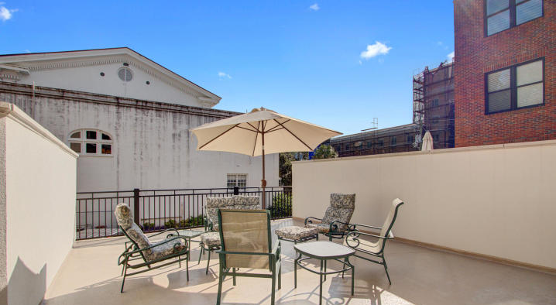
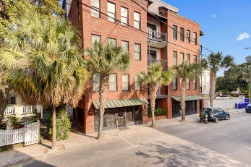
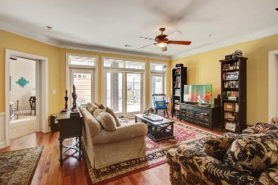
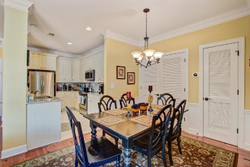
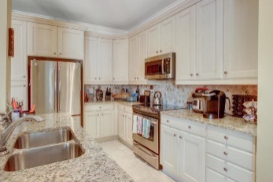
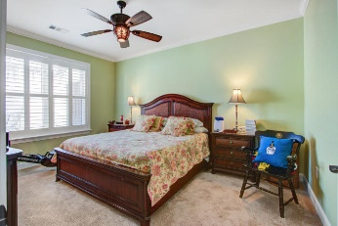
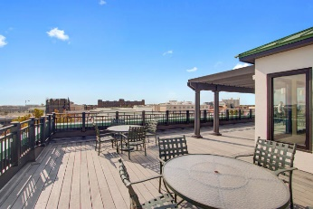
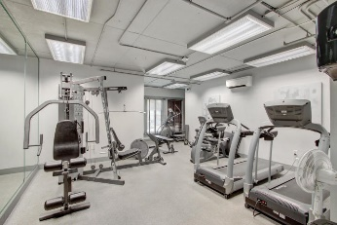
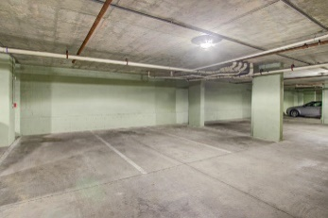


Heart of Downtown Charleston Condo
New Price!
76 Society St #13
George And Society
Charleston
MLS# 20027667
$770,000
This turn key luxury condo, located in the heart of downtown Charleston, is a short walk to many of the best restaurants and shops the city has to offer. After parking in the building's garage feel secure as you take the elevator to the floor of your unit. As one enters experience the open floor plan featuring 2 BR's 2.5 BA's, stainless appliances and granite countertops in the kitchen and baths. The master bath has dual vanity, walk in shower and garden jacuzzi tub. This freshly painted condo is one of the few units in the complex offering a patio (approx 655 sq. ft) off the living room giving the owner added room to entertain.
Amenities include a secure lobby with key pad entry, ground level patio for grilling, and a rooftop deck providing expansive views of the city and harbor.
Carey Budds
843-475-1505
cdft73@aol.com
Jerry Wise
843-442-7633
jerrywise03@gmail.com
ERA Wilder Realty, 125-F Wappoo Creek Dr, Charleston, SC 29412

