Slide 1
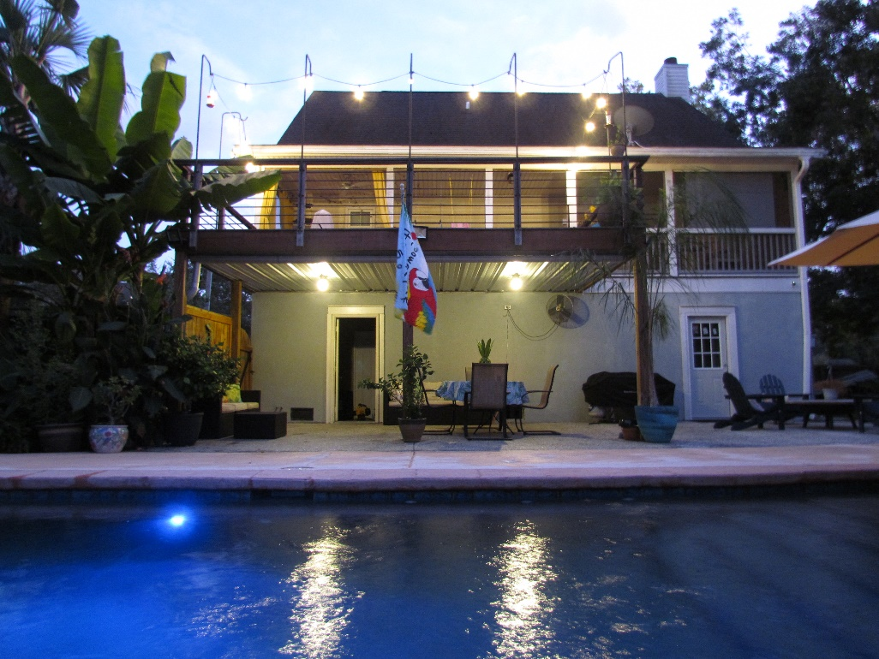
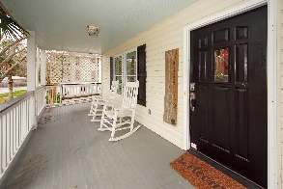
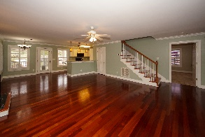
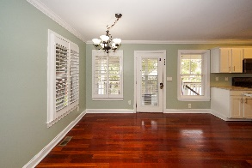
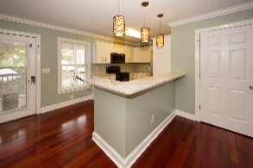
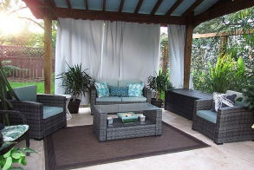
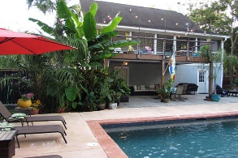
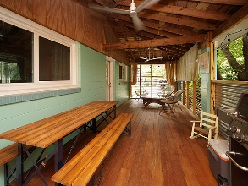
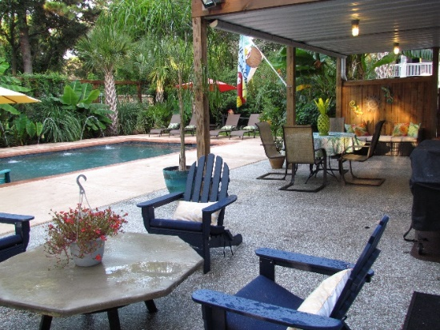
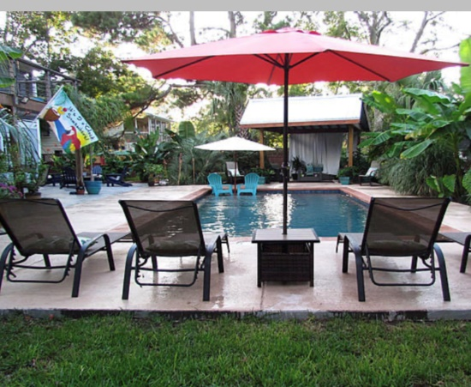
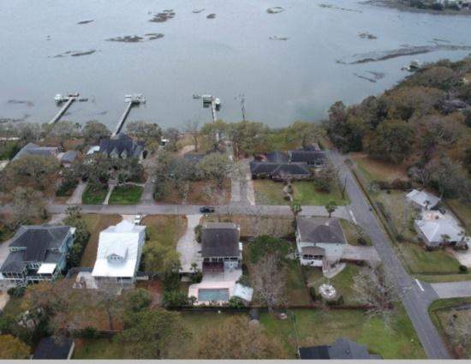


Price Reduced!
Enjoy Your Backyard Oasis
770 Grimsley Drive
Lighthouse Point ~ Charleston, SC 29412
MLS# 20007959 ~ $591,000
Enjoy your own private oasis with water views and no HOA's. 2 porches to enjoy your outside time and watch the porpoise's. Tiger wood deck outside while Brazilian Cherry floors inside-which include an open floor plan. The kitchen has granite counter tops. gas stove and kitchen breakfast bar. All bedrooms are spacious and have a private full bath. Minutes to downtown!
AgentOwned Charleston Group
902 Savannah Hwy
Charleston, SC 29407-7802
Lisa Deaton 843-224-7878
lisamdeaton@comcast.net
www.agentownedrealty.com

