Slide 1
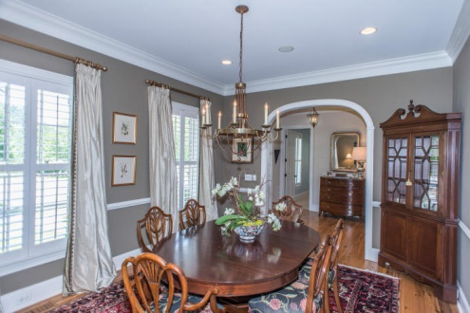
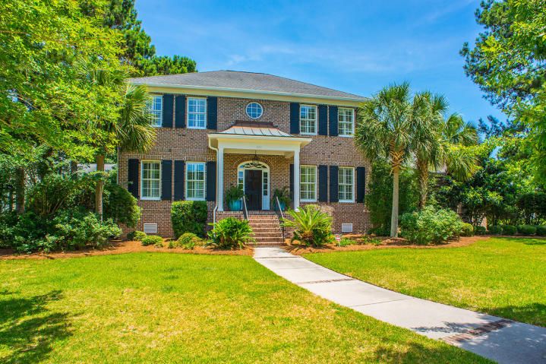
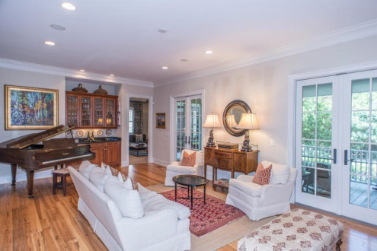
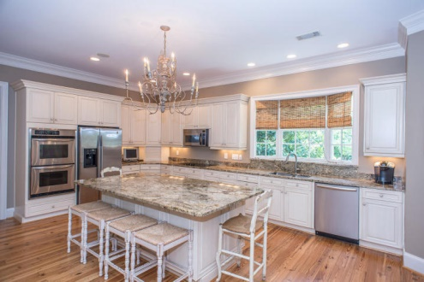
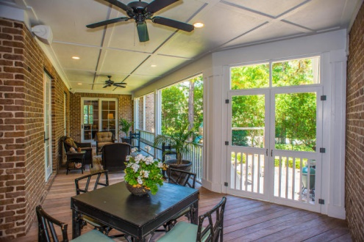
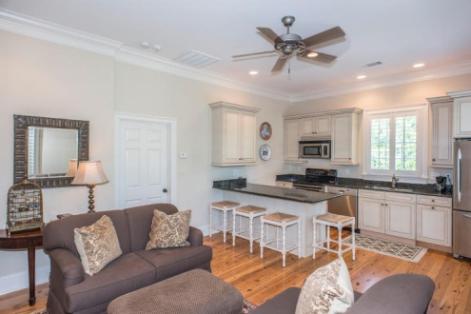
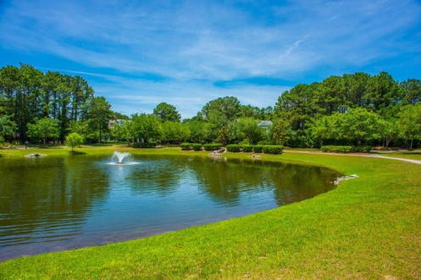
Exclusive Listing in Olde Park
Custom Finishes · Beautiful Kitchen · Separate In-Law Suite
$1,475,000
5 Bedroom
5/2 Bath
4,451 Sq Ft
770 Olde Central Way
Olde Park
Mount Pleasant, SC
MLS# 15014145
Beautiful custom built home located in Mt. Pleasant's premier Olde Park subdivision.
This spacious 5 bedroom, 5.2 bath home features a separate 1 bedroom mother in law suite/apartment, formal living and dining, eat in kitchen, family room, and playroom.
Downstairs also features a bedroom that could be configured as a dual master. Upstairs features 3 bedrooms and 3 baths. The rear of the home boast a private screened in porch opening to the backyard.
THE MOTHER IN LAW SUITE/APARTMENT has a separate entrance and features a full kitchen, living area with fireplace, bedroom and bath.
Frank Thornhill
Realtor®
(843) 224-7997
frank@thornhillpropertiesllc.com
Places LLC
400 Hibben St., Suite 200
Mt Pleasant, SC 29464
www.scplaces.com

