Slide 1
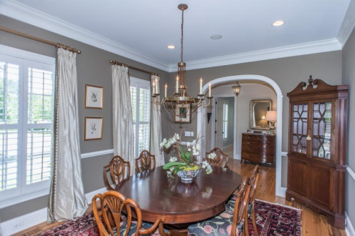
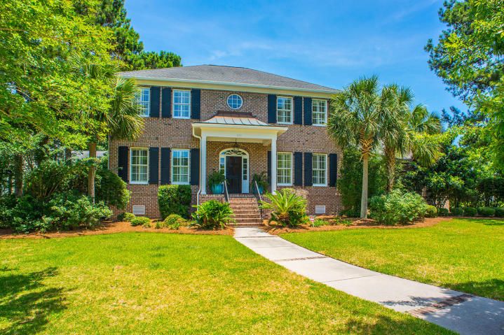
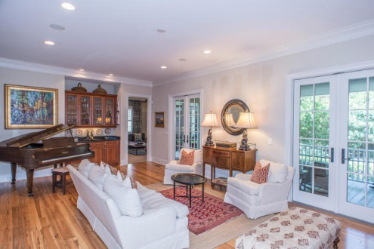
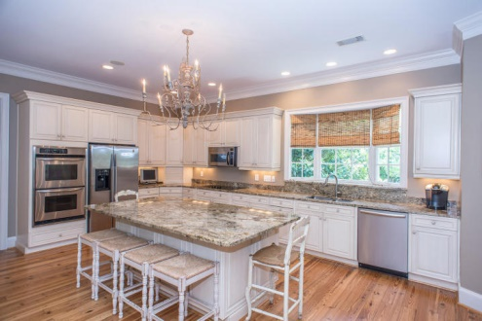
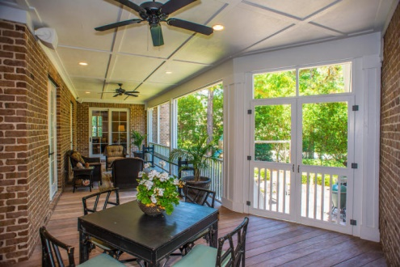
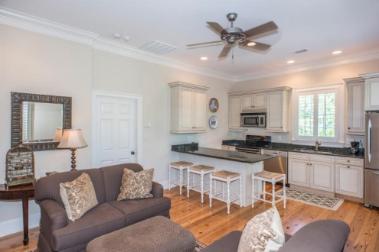
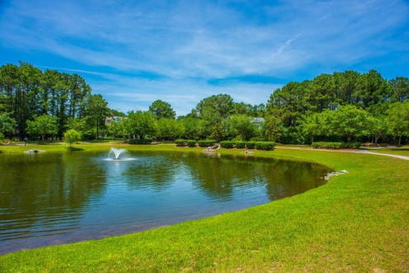

Luxury Living in Olde Park
Custom Finishes · Beautiful Kitchen · Separate In-Law Suite
$1,525,000
5 Bedroom
5/2 Bath
4,451 Sq Ft
770 Olde Central Way
Olde Park
Mount Pleasant, SC
MLS# 15014145
Beautiful custom-built home located in Mount Pleasant's premier Olde Park subdivision.
This spacious home features a separate 1 bedroom mother-in-law suite/apartment, 5 bedrooms, 5.2 baths, formal living and dining rooms, eat-in kitchen, family room, and playroom.
Downstairs also features a bedroom that could easily be configured as a dual master. Upstairs features 3 bedrooms and 3 baths. The rear of the home boast a private screened-in porch opening to the backyard.
THE MOTHER IN LAW SUITE/APARTMENT has a separate entrance and features a full kitchen, living area with fireplace, bedroom and bath.
Frank Thornhill, Realtor®
(843) 224-7997
fthornhill@hanlandevelopment.com
www.hanlangroup.com
Hanlan Consulting and Development
241-243 East Bay St · Charleston, SC 29401

