Slide 1
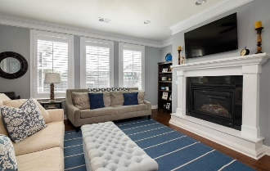
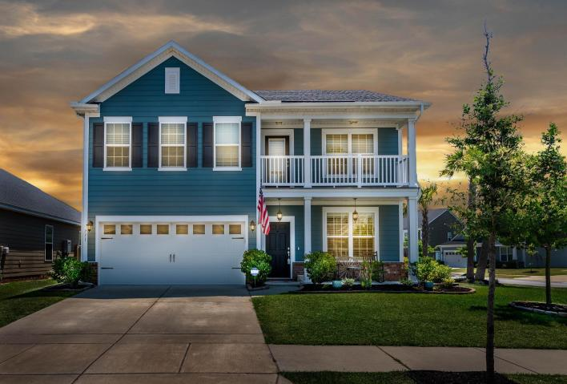
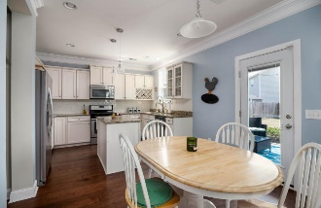
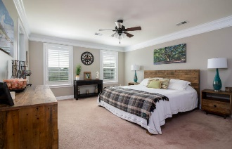
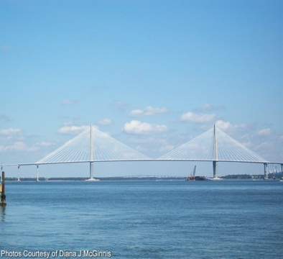
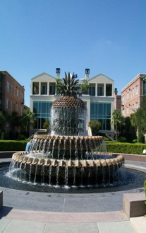
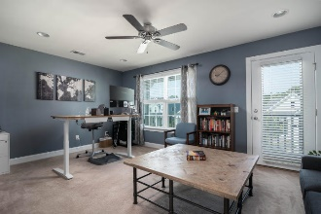
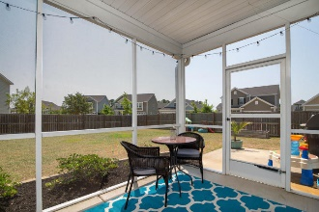
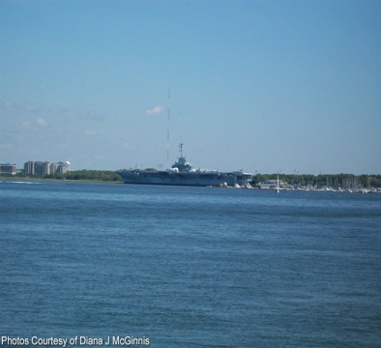
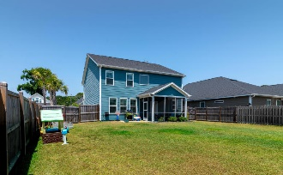


771 Goodlet Circle
Seaside Plantation · Charleston, SC 29412 · MLS# 19016051 · $469,000
$450,000
OPEN HOUSE
Saturday, June 22nd 11:00 - 1:00
This two-story, 2,364 square foot home is positioned on a corner lot in the highly desired community of Seaside Plantation. It is the Madison floor plan and doesn't require flood insurance! The exterior of this home is similar to a Charleston Single style with its double porches, but offers the functionality of an attached 2 car garage. Gutters have been added to this home and the yard is fully fenced with a 6' wooden privacy fence. Speaking of the yard - it's one of the largest in the neighborhood since this home sits on a corner lot! Entering from the garage, you're greeted with a wonderful drop zone with hooks and cubbies. The downstairs kitchen, family room, dining room, powder room and mud room are all showcased with a beautiful 5'' plank, hand scraped hardwood floor. All other bathrooms and laundry room offer attractive 18x18 tile flooring. The kitchen is appointed with granite counter tops, stainless steel appliances, gas range, vented microwave, dishwasher, beautiful staggered cabinets with the roll out trays on the bottom set of cabinets and this home also features a reverse osmosis drinking water system. A beautiful subway tiled back splash was added in 2019. The laundry room has plenty of room for storage with 42'' cabinets above the washer/dryer space. Also included downstairs is a formal dining room, large family room with a beautiful gas fireplace and spacious eat-in kitchen. Wood plantation shutters are installed throughout the downstairs as well. This beautiful homes offers 3 nice sized bedrooms all located upstairs and each features a walk-in closet! The master suite offers a separate shower and tub with double vanities plus a HUGE walk-in closet. The original loft has been walled in and French doors added to allow for a separate space that can be used as an office, study, playroom, craft room...the possibilities are endless AND this room has access to the upstairs porch. At construction, the builder paid close attention to the options and upgrades added to this home so it is nicely appointed with Double Crown Molding, recessed lighting in the kitchen, family room and loft, a screen porch with a large patio off to the side and a gas line for grilling. Close to Folly Beach and Down town. Come check out your new home today! This one will not last long!
$450,000
Rodney Hancock
(843) 437-1347
rodneyhancock08@gmail.com
mortgageprofessionalsonline.com
AgentOwned Charleston Group
902 Savannah Hwy
Charleston, SC 29407
Real Estate ● Mortgage
Insurance ● Business Brokerage

