Slide 1
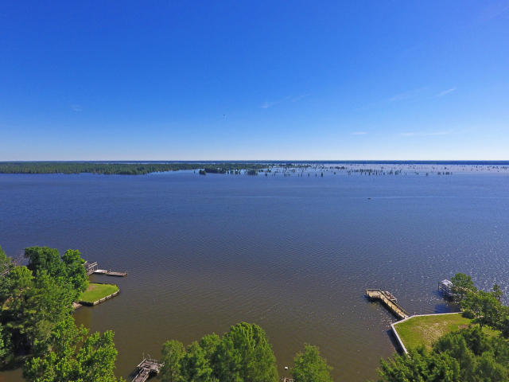
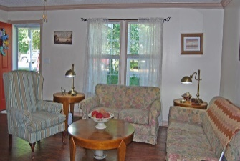
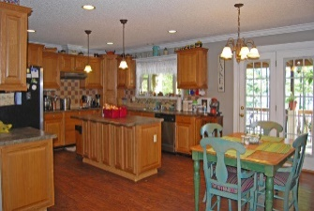
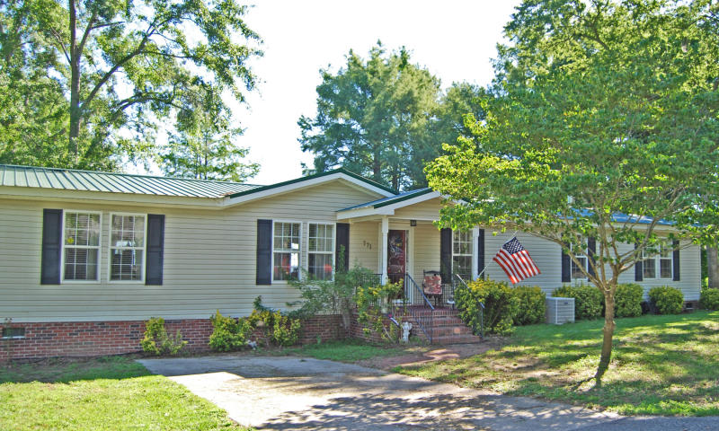
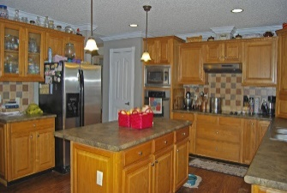
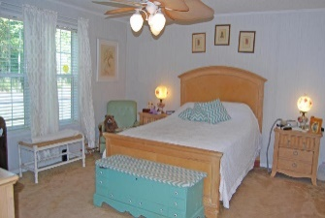
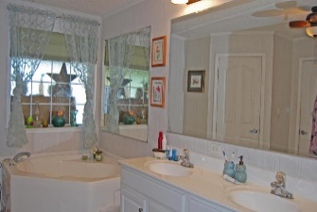
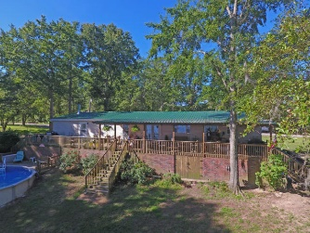
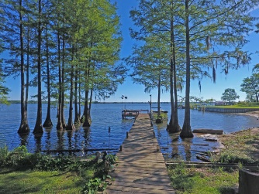
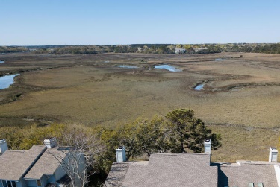
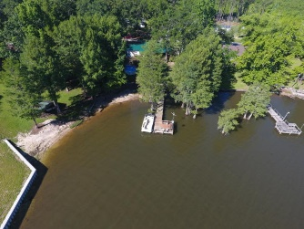


Ready for the Lake Life?
This is it.
771 Stumphole
Elloree, SC 29047
Recently Reduced to $249,900
This home sits on Big Water of Lake Marion only 1 hour from Charleston by car and 6 hours by boat. Make this is your vacation home or your full time home.
The home has a 12x80 rear porch over looking the lake and the 26' pool. Enjoy sunrises on the lake while drinking your morning coffee. Seen by appointment only.
Lake Homes Realty, LLC
Elloree, SC 29047
www.SCLakeLife.com
Kristie Anderson
(803) 387-9459
kristie@sclakelife.com

