Slide 1

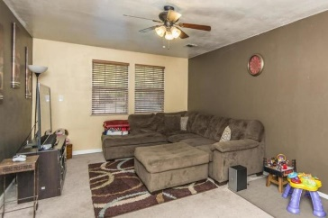
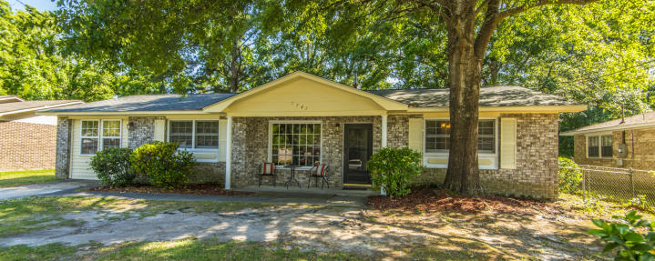
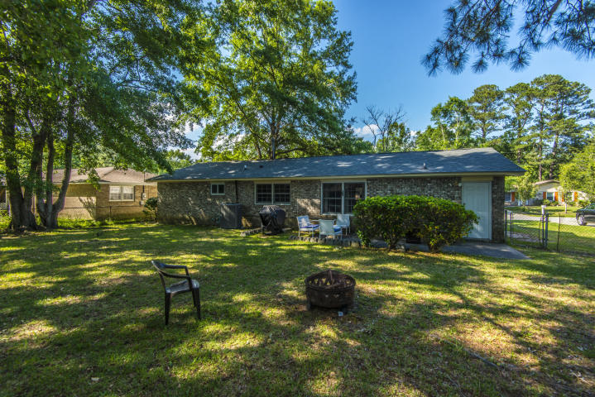
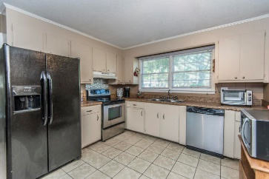
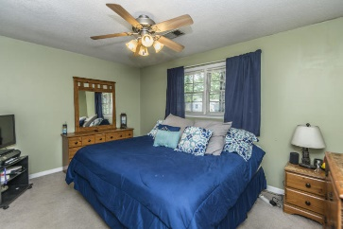
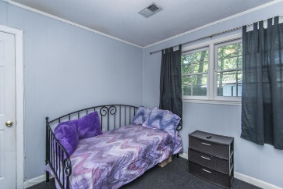
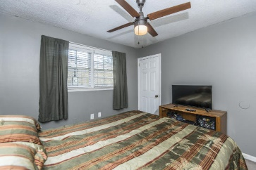
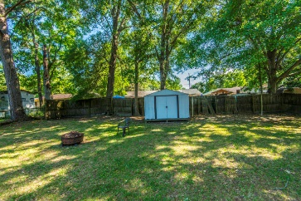

Great Home Great Price
Forest Hills
North Charleston
7743 Jadewood Drive
Desirable 3 Bedroom, 1 and half Bath Brick Ranch in established Forest Hills subdivision. Roof, HVAC (with all new ductwork) and main waterline pipe replaced less than 5 years ago! Minutes from the Air Force Base, Boeing, Mercedes plant and Bosch! Formal Living Room or Office as soon as you enter the home leads to an Open Kitchen and Eat In Dining Room and then to the Large Family Room perfect for TV watching and just relaxing! 3 nice sized bedrooms, Hall Bath and Half Bath in the 3rd bedroom! Enclosed backyard with Patio perfect for enjoying the spring weather! Convenient to so much!
MLS# 19013250
$167,900
3 Bed / 1½ Bath
Lisa O’Keefe
ABR, GRN, SFR
843-442-7968 C
lisa@theroettgerteam.com
The Roettger Team
Carolina One Real Estate | 195 W Coleman Blvd | Mt Pleasant, SC 29464

