Slide 1
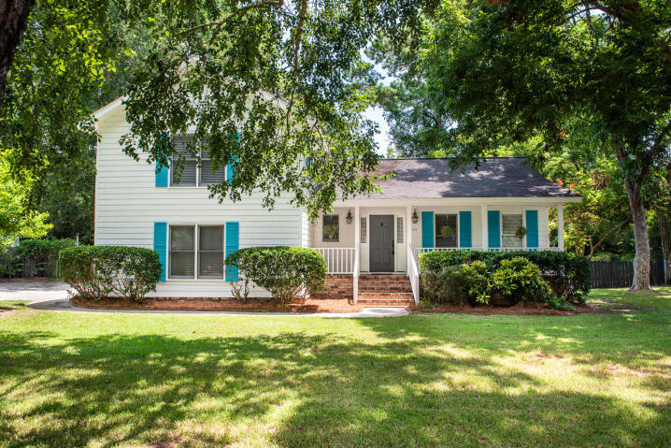
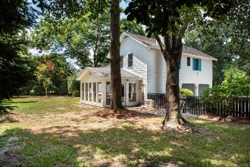
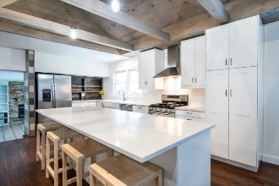
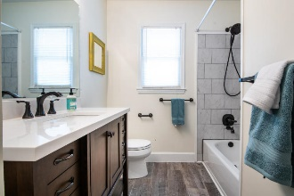
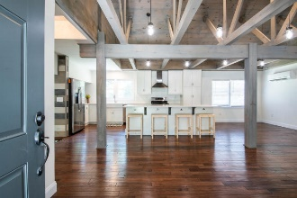
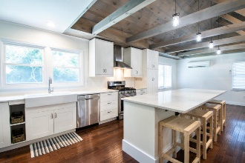
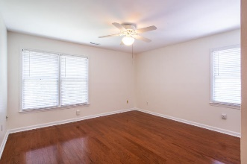
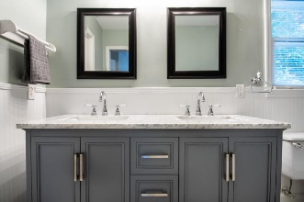
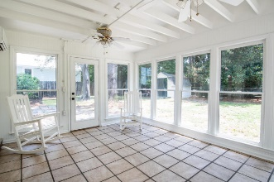


774 Chatter Road
Wakendaw :: Mount Pleasant, SC 29464
MLS# 19022558 :: $475,000
Wakendaw At Its Best…
Just Got Better!!
Reduced $15k
In Wakendaw
Join me for an Open House on Sunday from 2-4
Welcome home to Wakendaw Lakes! Come see this awesome home with a large fenced lot! Wonderful open floorplan, vaulted ceilings on the main level and many unique touches throughout the home. Cozy fireplace in family room for cold winter nights, and enclosed sunroom downstairs. Bedrooms are nice size. Close to shopping, medical facilities, restaurants, downtown Charleston, and 15 minutes to the beach. Brand new refrigerator and dishwasher, all kitchen appliances to convey, fresh Interior paint, new vanity in master bath, HVAC ductwork and new minisplit units in 2016! Large yard! Great for pets or enjoying outdoor sports and gardening! $2000 Lender credit is available and will be applied towards buyer's closing costs and prepaids if the buyer chooses to use the seller's preferred lender. This credit is in addition to any negotiated seller concessions.
Jeanie Acsell
M (843) 224-9589 | O (843) 884-1622
jean.acsell@carolinaone.com
Carolina One Real Estate | 628 Long Point Rd | Mt Pleasant, SC 29464-3032

