Slide 1
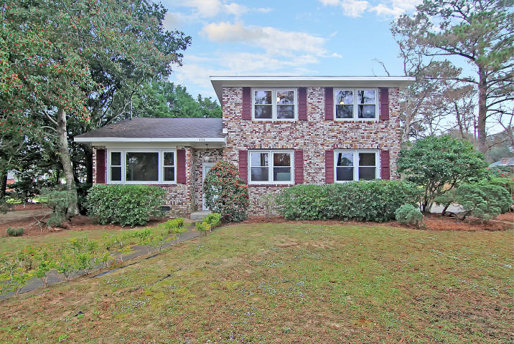
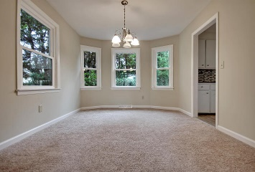
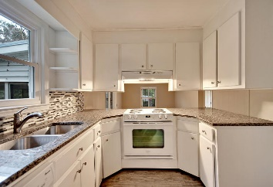
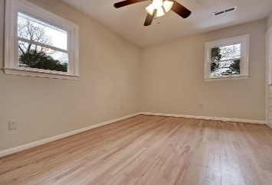
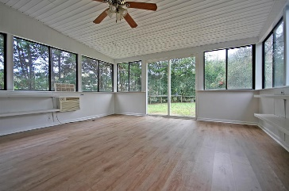
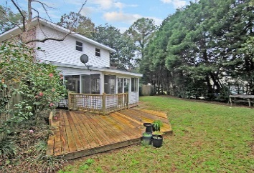


$7,500 PRICE REDUCTION!!!
775 Sparrow Street
Stiles Point
Charleston
MLS# 16000872
$367,500
Welcome Home to James Island!
This home is situated on .55 of an acre corner lot. This home offers a spacious family room with new carpet, a very spacious sunroom (not included in sqft) with new flooring perfect for entertaining.
The kitchen offers new flooring, a new dishwasher, new sink, new granite counter tops and a beautiful backsplash, spacious dining room and formal living room with new carpet.
The upstairs offers 3 spacious bedrooms with wood flooring. The converted garage has been used as the utility/laundry room. The seller will provide the buyer a 1 year home warranty.
Conveniently located to downtown Charleston, Folly Beach, schools, shopping and more! Age, sqft, regime fee, HOA fee, schools, schools info, acreage and taxes are approx. Buyer to verify.
Vel Thurber Everett
Broker/Owner
Mobile - (843) 297-0459
Office - (843) 576-2713
vel@theeverettgroup.net
Mason Thurber
Realtor
Mobile - (843) 709-5109
Office - (843) 576-2699
mason@theeverettgroup.net
RE/MAX Pro Realty, 9209 University Blvd, Charleston, SC 29406

