Slide 1
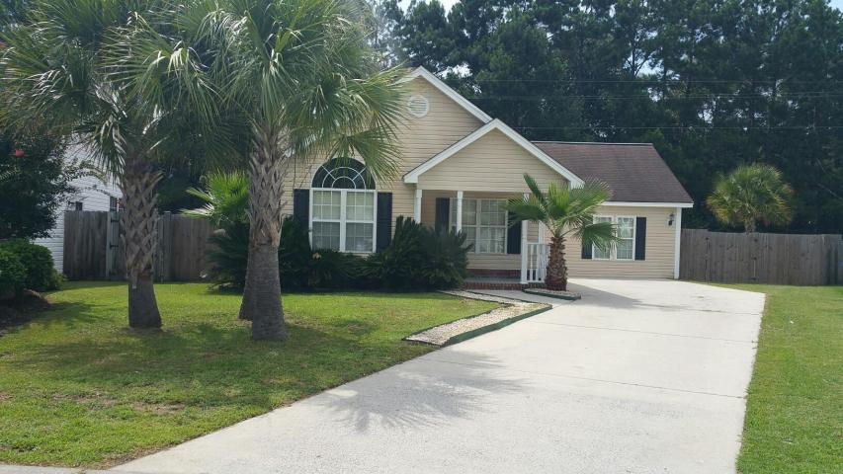
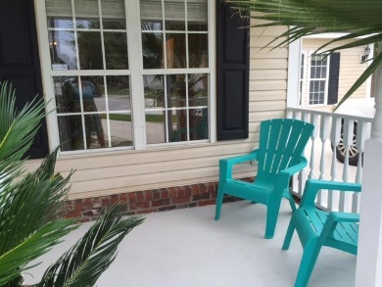
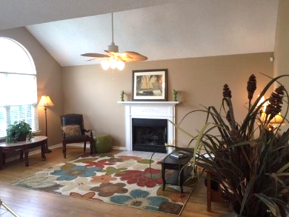
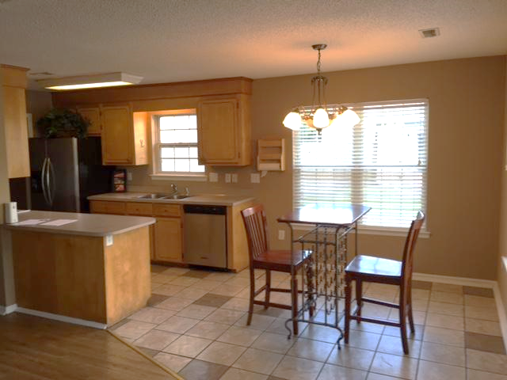
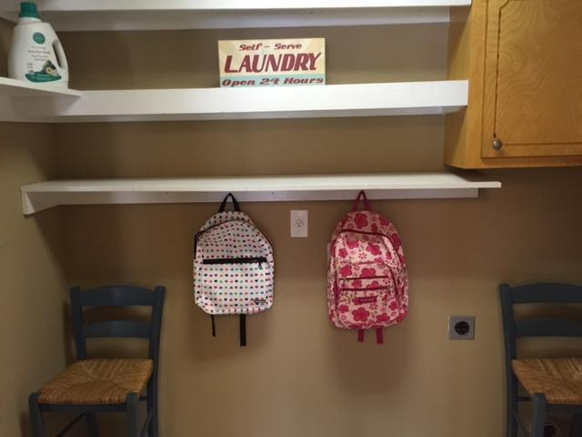
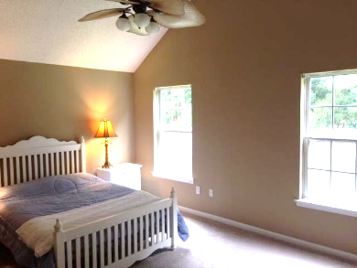
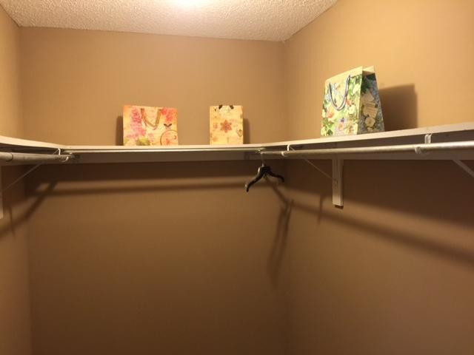
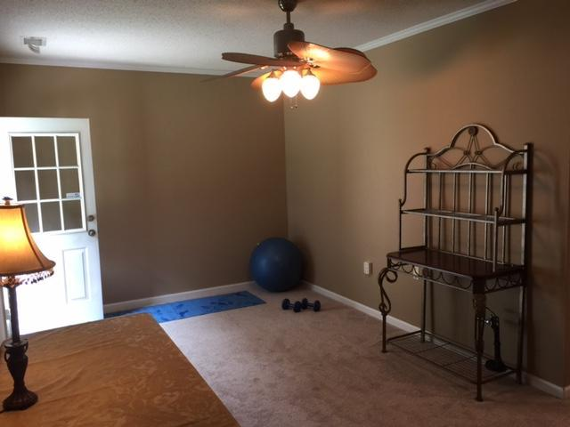
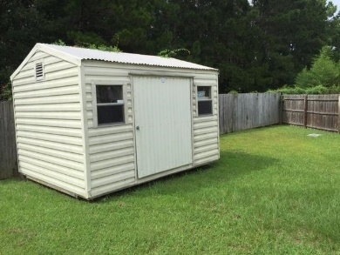


7760 Brookdale Blvd
Brookdale
North Charleston
MLS# 15019413
$179,000
4 Beds | 2 Baths
1,768 Square Feet
ONE STORY LIVING!
All NEW Carpet! All NEW paint! All ready for you! Right NOW!
Cul de sac beautifully landscaped lot! Four bedrooms, a living room with cozy gas fireplace & large family room, laundry room & NO STAIRS! Plenty of STORAGE. Welcome home front porch & back patio too. Huge FENCED yard. Newer TRANE dual fuel ac/heat unit. TANKLESS hot water heater. The storage/workshop shed in the back can convey with the home.
Home is covered by a YEAR LONG WARRANTY Covers appliances and water heater an HVAC. Location: 3 miles to Boeing 1.5 to Air Force Base!
Di Johnson
843-270-6448
dijohnsonsc@gmail.com
www.agentownedrealty.com
AgentOwned Premiere Group
100 Crowfield Blvd
Goose Creek, SC 29445

