Slide 1
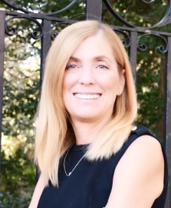
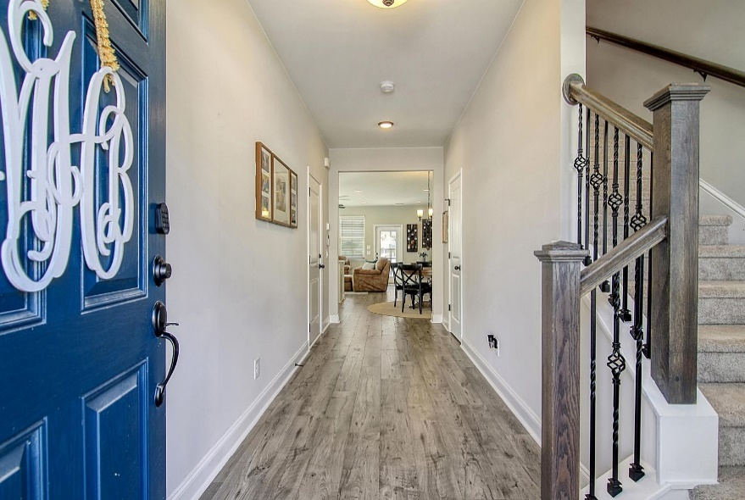
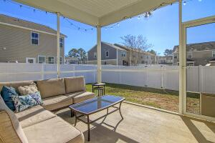
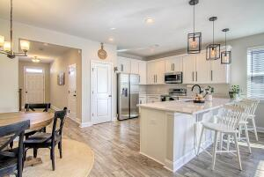
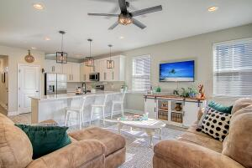
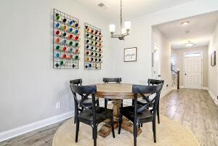
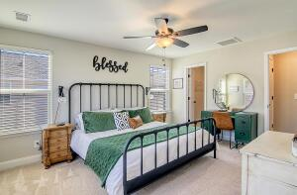
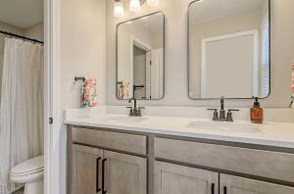

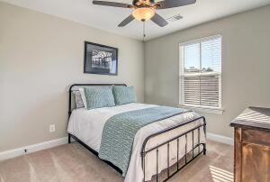
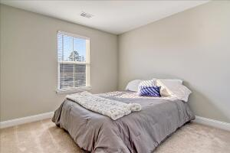
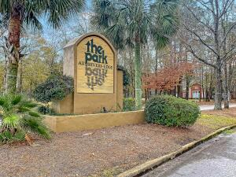
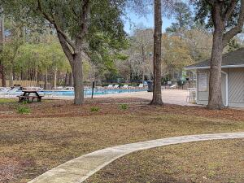
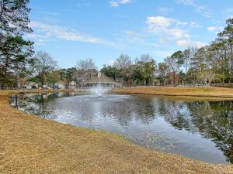
Open House Sunday January 29th 1:00 - 3:00
Debbie Cromer
ABR, RSPS, REALTOR, CRS
(843) 437-6342
debbie@debbiecromer.com
www.debbiecromer.com/
7760 Montview Road
North Charleston, SC 29418 | The Park at Rivers Edge | MLS# 22030819 | $358,500
Ask about the buy down and/or closing cost opportunity! Live the maintenance free lifestyle in this stunning end unit townhome features an open floor plan, beautifully appointed kitchen, relaxing screen porch, private fenced yard and a 1 car garage. Beautiful laminate flooring is seen throughout the main floor. Large gourmet kitchen with lots of 42 in white shaker cabinets, upgraded appliances, single bowl sink and Blanco Maple quartz countertops flows into the living and dining areas complete the downstairs living space. The main bedroom with en suite bath is upstairs. Two secondary bedrooms, a full hall bath and laundry room complete the upstairs. The Park at Rivers Edge is a gated community with many amenities available to the residents. Centrally located near Bosch, Boeing, Charleston Air Force Base, Trident Tech as well as many dining and shopping options.
Video tour: https://vimeo.com/782009464
Century 21 Properties Plus | 1090 Park West Blvd; Ste 103 | Mount Pleasant, SC 29466

