Slide 1
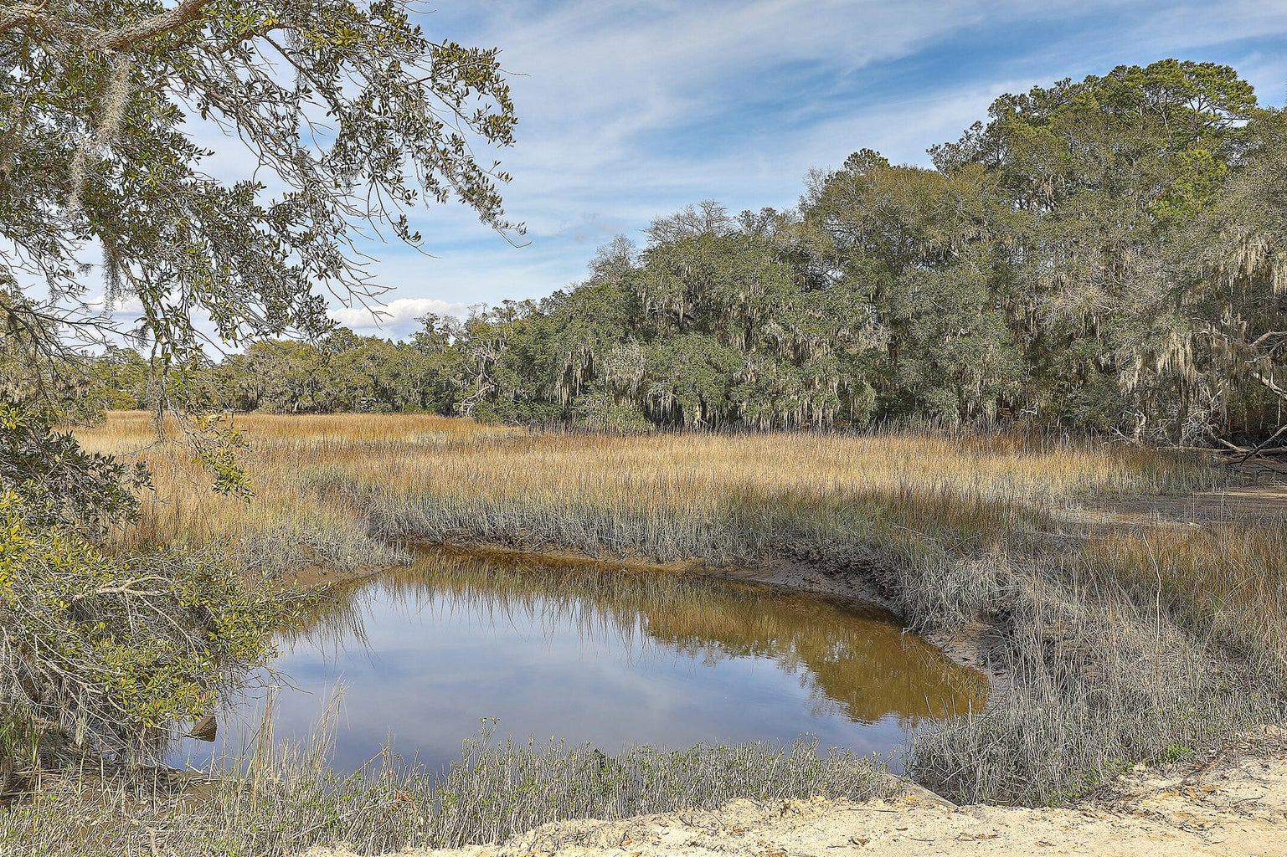

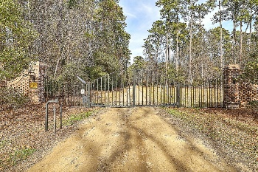
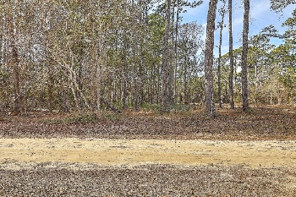
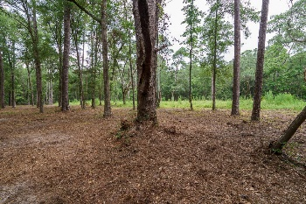
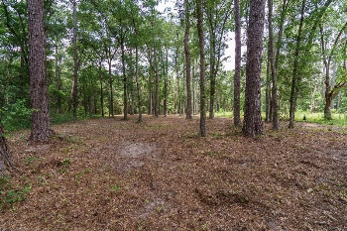
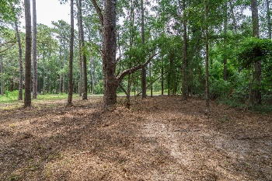

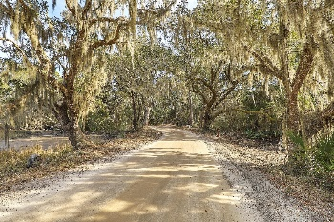
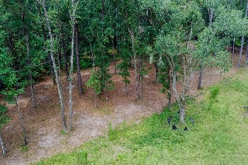
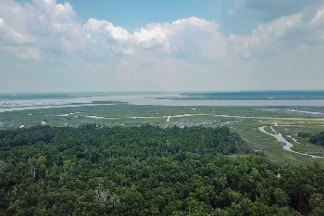
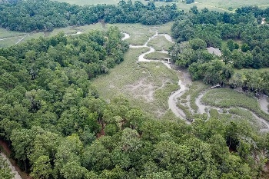
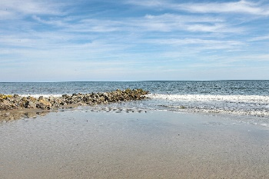
Joe Stalvey
843-460-2850
jstalvey@century21properties.com
joestalveyrealtor.com
Build Your Dream Home
on Edisto Island
7779 Chaplin Garden Lane
Jenkins Point Plantation | Edisto Island, SC 29438 | MLS# 23003081 | $74,500
Welcome to this higher ground vacant lot located within the secluded gated community of Jenkins Point Plantation. Septic Permit (see Documents) in hand. Edisto Beach is a short few minutes' drive, with its restaurants and shopping. Plus, you can enter the beach at any one of the 37-beach accesses for relaxation, swimming, sunning and fishing. After a day at the beach, return to the quietness of Jenkins Point Plantation. This property is within 10 minutes (+/-) of three public boat landings. This lot is ready for you to build and call Edisto your home. There are only 31 lots in this community. All information believed to be true and accurate. Buyer / Buyer Agent to verify as deemed necessary. BACK ON MARKET DUE TO BUYERS HAD A FAMILY ISSUE.
Century 21 Properties Plus | 140 N Main Street, Suite 101 | Summerville, SC 29483

