Slide 1
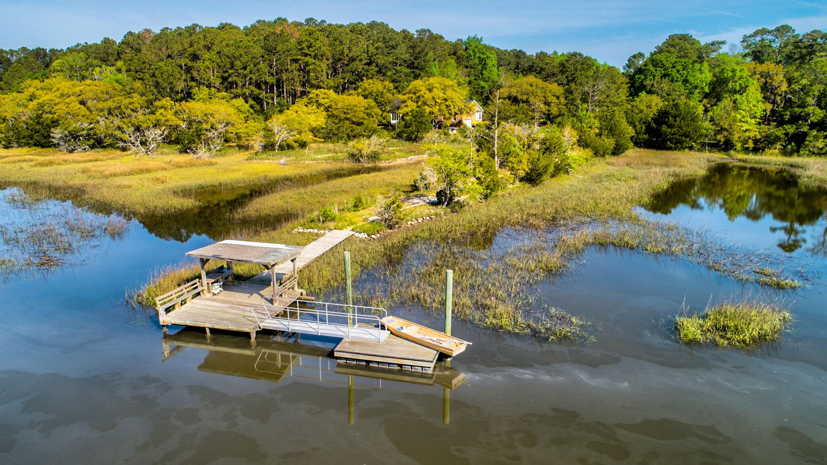
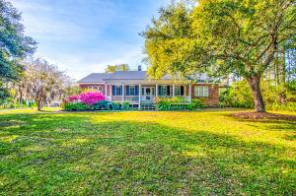
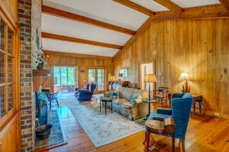
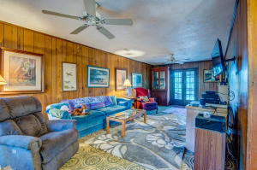
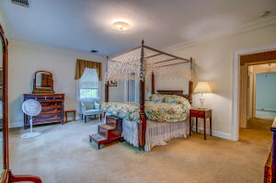
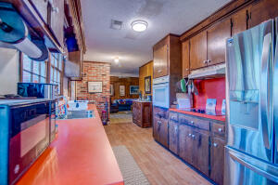
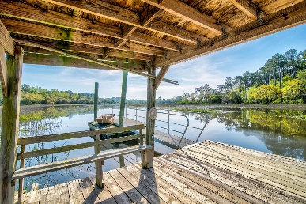


7787 Seafield Road
Yonges Island, SC 29449
MLS# 21010750 | $1,350,000
Extraordinary
Lowcountry
Estate
Extraordinary Lowcountry estate on 28 Acres w/ over 900ft of fabulous waterfront on Davidson Creek. This property has a short dock with a new floating dock coupled with a new aluminum ramp for boating, shrimping, crabbing, fishing & hunting. These are just a few of the activities to enjoy on this huge private estate. 7787 Seafield Rd offers beautiful views of the marsh & tidal creek & is just a short distance to Tom Point/McCloud Creek which is only minutes to the INTERCOASTAL WATERWAY. The main home which is a 3,183 sqft custom build that is 21.89 acres on tidal creek w/ planted pine trees. The second is a 1,094 sqft guest house on 6.8 plus acres w/ dock, freshwater pond, barn & 4 stall tractor shed. The 1 story custom built brick home offers a 1 car garage, patio, mud room w/ full bath, wet bar, hardwood floors throughout w/ carpet in the bedrooms. The den/family room has a HUGE brick wood burning fireplace w/ vaulted beamed ceilings & built in book cases. There is another wood burning fireplace in the living room, a separate dining room, 9 ft smooth ceilings throughout, his & her walk in closets & sitting area in the master bedroom, and tile flooring on the sunporch. The large kitchen has a creek view eat in area, washer & dryer w/ 2 pantries. The guest cottage offers new carpet in the den and new linoleum in the kitchen, the large den has a wood burning fireplace, eat in kitchen & huge screened in porch.
Video Tour: https://www.youtube.com/watch?v=nxA_EndcnvM
Drake Herrin
843-729-4692
dherrin@carolinaone.com
www.DrakeHerrin.com
Carolina One Real Estate
873 Orleans Road, Ste 102
Charleston, SC 29407-5753

