Slide 1
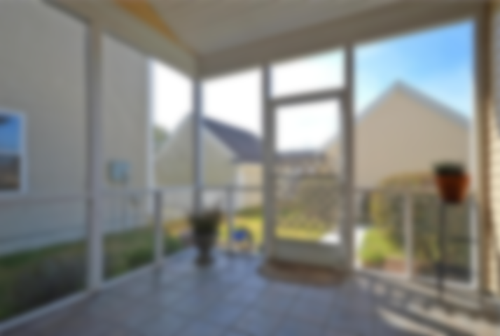
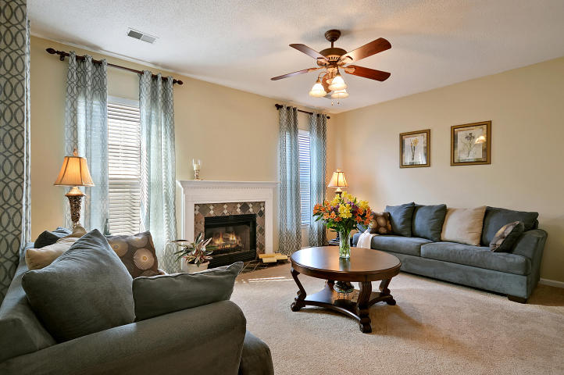
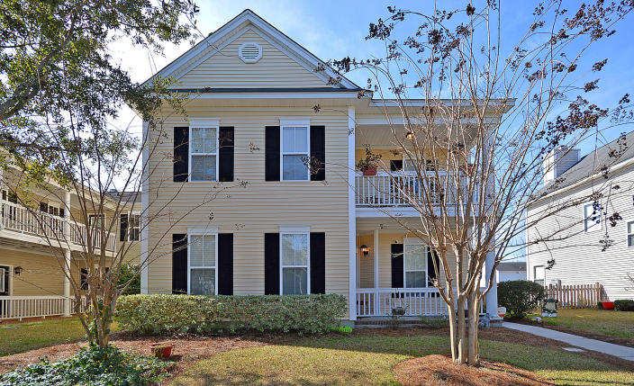
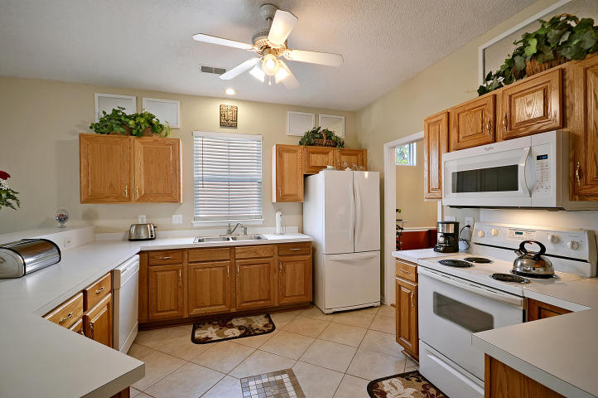
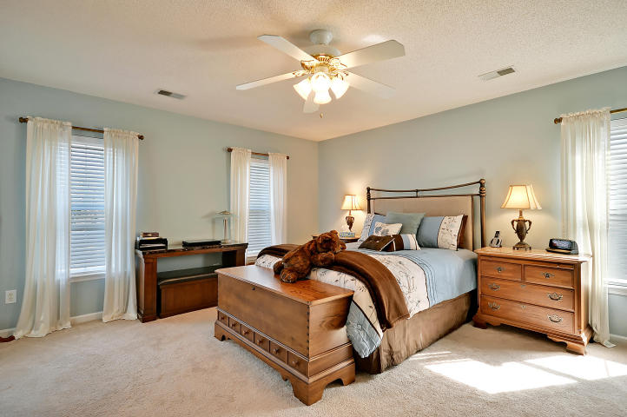
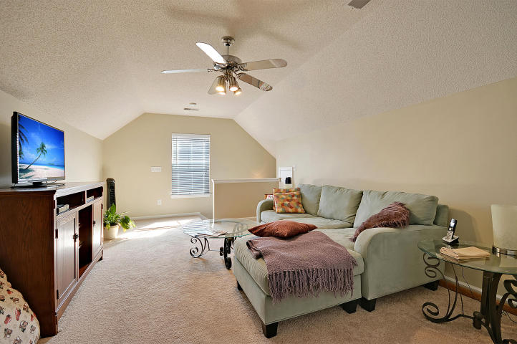
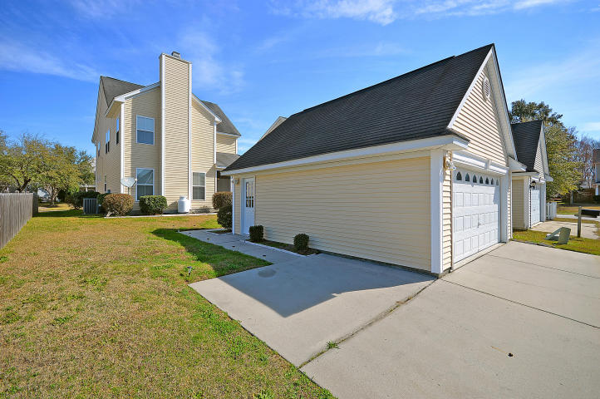
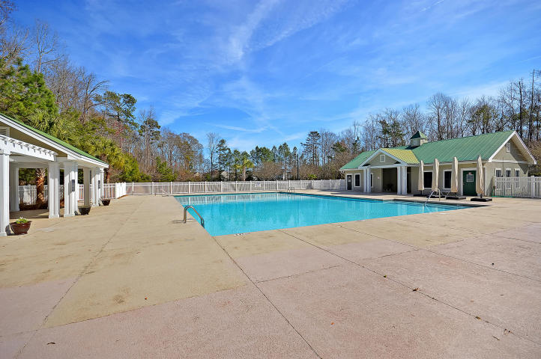

Absolute Bargain! Unbelievable Price!
77 Creekside Drive
Bridges of Summerville | Summerville
MLS# 17006426 | $244,900
4 Bedrooms ~ 3 Bathrooms
Priced low and firm for your pre-approved buyer who wants a great deal on the nicest house in Summerville. Hurry, it won’t last long at this low, low price. Do your buyer a favor and submit a squeaky-clean full-priced offer today and save yourself all the fun of a full-priced counter offer.
Chip Walsh
843-822-4663
chipwalsh@gmail.com
The Boulevard Company, LLC
35 Broad Street
Charleston, SC 29401
www.TeamWalshRealEstate.com

