Slide 1

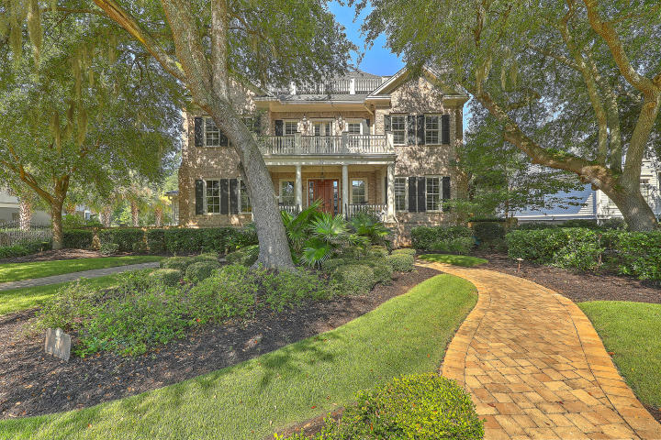
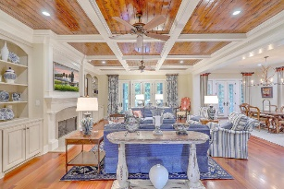
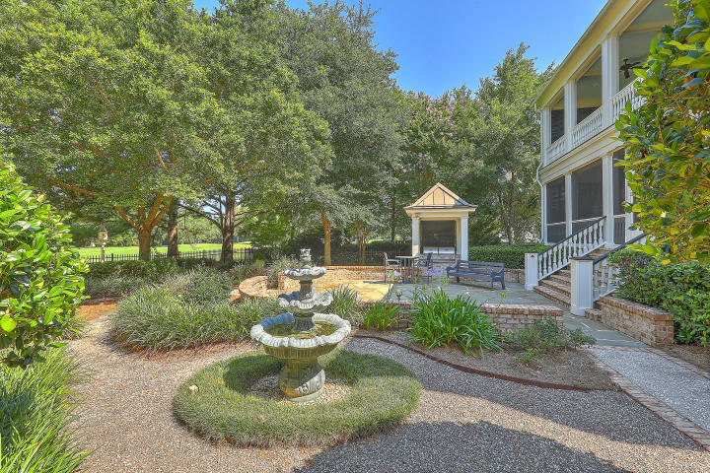
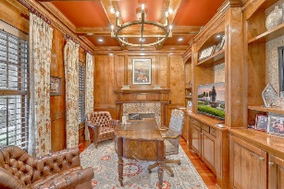
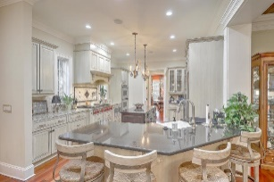
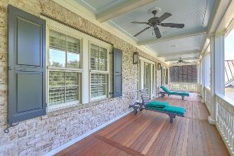
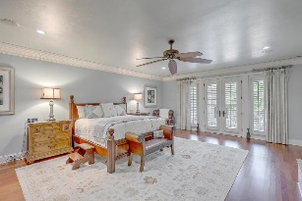
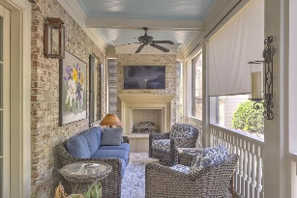
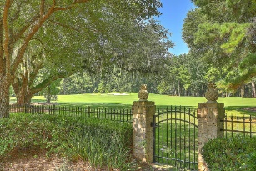
Just Listed!
77 Iron Bottom Lane
Daniel Island Park ~ Charleston, SC 29492 ~ MLS# 20020259 ~ $2,259,000
Grand Oaks and timeless architectural design welcome you home to 77 Iron Bottom. Located in Daniel Island Park, you are steps away from all that the country club has to offer. This custom built five-bedroom, six and a half bath home exudes livable luxury. Upon entering the first floor, the spacious foyer gives way to a handsome office on the left and a formal dining room complete with fireplace on the right. Through the foyer, the Brazilian cherry flooring and Brazilian cherry coffered ceiling greet you to the spacious living room boasting beautiful built-in shelving and a lovely fireplace. The open floor plan flows into the generous breakfast room and kitchen complete with granite countertops and top of the line appliances including a Wolf cooktop and Wolf/Subzero fridge.
The functional layout of the cooking space includes a wealth of storage and butler's pantry complete with a GE Monogram wine fridge.
The beautiful stairwell takes you to a large landing at the second floor styled with built-in shelves and window benches. This area provides you access to the master suite, a generous laundry room and 3 guest rooms each with their own full baths and walk-in closets. The master suite provides a tranquil getaway with custom painted ceiling, custom built-in shelving and a vast his and her closet. The exceptional soaking tub is the focal point of the en suite master bath that features gorgeous marble flooring and countertops along with a Roman shower.
The third floor provides the perfect space for favorite past times. Whether a media room, home gym or game room fit your personality, the space is ample and includes a full bath. An elevator is conveniently available to take you from floor to floor.
For additional hobbies, there is an impressive three-car garage and detached two-car garage upgraded with custom flooring, wainscoting and built-in storage. Above the two-car garage is a guest suite complete with full kitchen, bath and terrace overlooking the beautifully landscaped backyard.
The wide porches and piazzas of the main house make for the perfect setting to chase Lowcountry sunrises and sunsets with your morning coffee or evening cocktail. The outdoor living areas are a true extension of the home that sits on the 3rd Fairway of the Beresford Creek Course.
77 Iron Bottom is available with a full non-recallable Golf membership to the Daniel Island Club.
Buyer pays a one-time neighborhood enhancement fee of .5% x sales price to Daniel Island Community Fund at closing and an estoppel fee to the Daniel Island Property Owners Association, Inc. Property Disclosure and Community Fund Disclosure are attached. Daniel Island resale addendum is also attached and will be required on offer to purchase.
Kenneth Nix
kenneth@landsouthofcharleston.com
M (843) 222-2582 | O (843) 577-5263
Land South of Charleston, LLC | 180 E Bay St Ste 300 | Charleston, SC 29401

