Slide 1
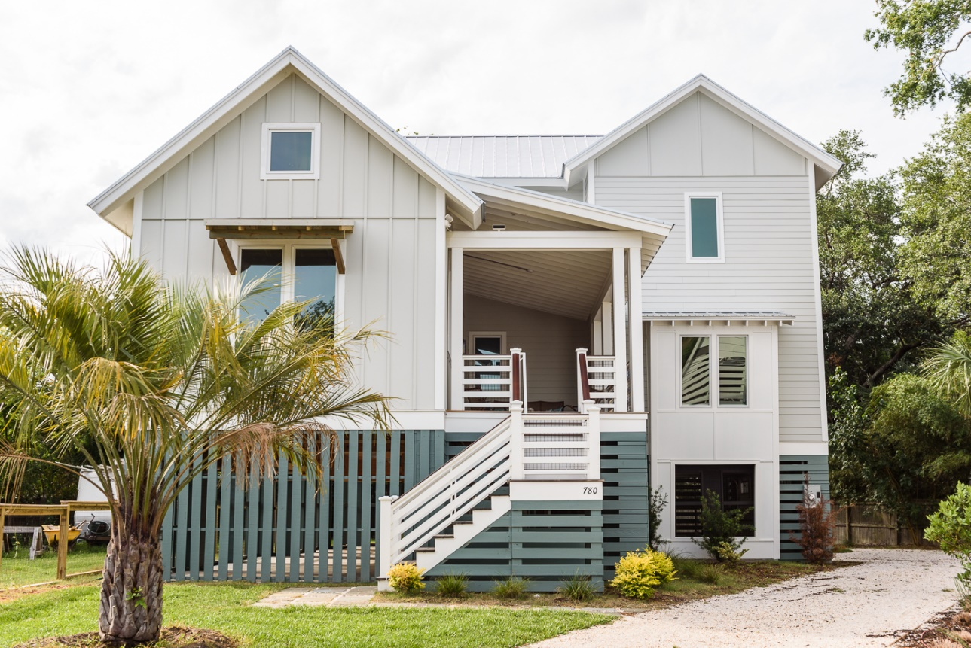
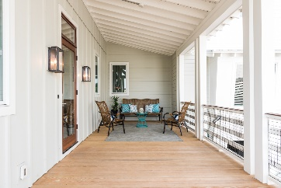
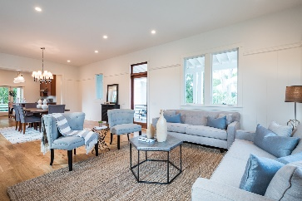
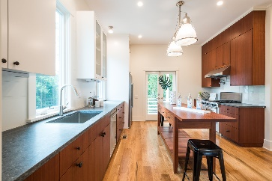
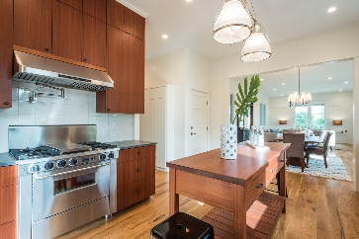
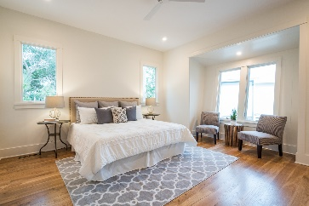
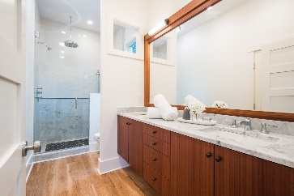
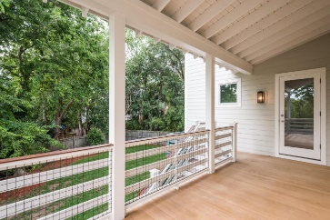


780 Gate Post Drive Old Village Landing Mount Pleasant, SC 29464 MLS# 16018177 $895,000
Just Reduced $50k!!
New Construction
Ready to go!
Another Ilderton Contractor's original! Located in one of the best spots in all of Mt. Pleasant, this custom built home offers an efficient floor plan w/master on first floor, large living/dining area, wood floors, pine shiplap walls, mahogany kitchen and master bath cabinets, stone tops in all wet areas, high-end stainless gas and electric appliances, two large covered porches for enjoying the seasonal climate and sea breezes that cool down the warmest of days. short walk or bike to public schools, (Mt Pleas. Academy & Moultrie Middle). Easy trips to downtown Chas., Sullivan's beaches, and bicycle to the old Pitt St Bridge, Alhambra Hall,(w/stunning views of the Chas. skyline and memorable sunsets) and around old village in a park-like setting. Come see today.
Cary Walker Office - (843) 884-1622
Mobile - (843) 345-7150
cwalker@carolinaone.com
www.carywalkerhomes.com
Carolina One Real Estate
628 Long Point Rd.
Mt Pleasant, SC 29464-3032

