Slide 1
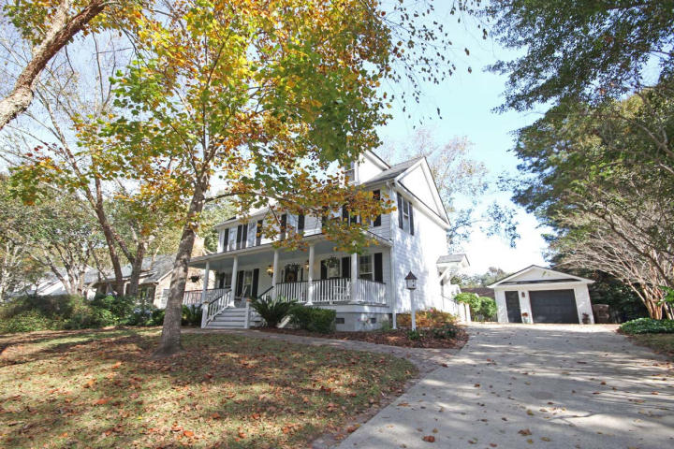
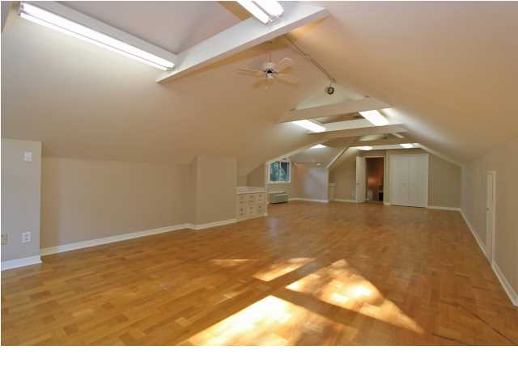
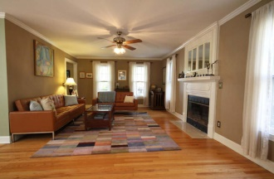
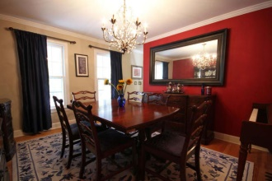
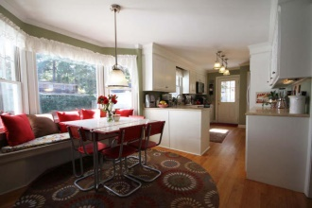
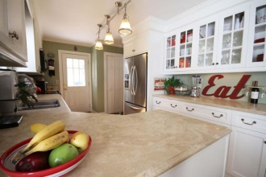
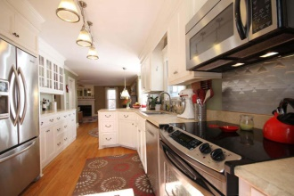
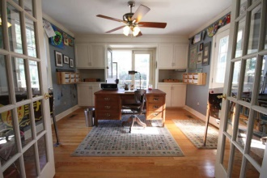
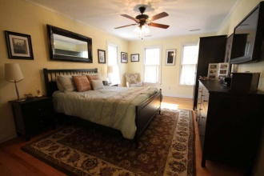
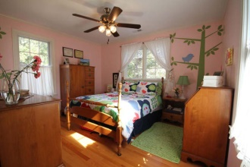
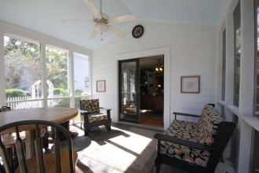
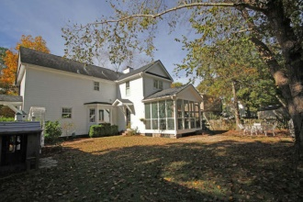

780 Milldenhall Road Mount Pleasant, SC 29464 ~ MLS# 14029253 ~ $480,000 4 Bedroom :: 2½ Bath :: 2,415sf
Pretty in Point Pleasant
See more at www.2161shellring.com
This is a lovely 4 bedroom house on a hill in Mt. Pleasant! Picturesque and practical this home features an updated kitchen, bright and roomy eat-in area with picture window and recently added sunroom and screened porch. The inviting front porch extends the length of the home and is the perfect place to enjoy the quiet outdoors. An added bonus is that the woods across the street will never be developed and the home enjoys that added quiet and privacy. Point Pleasant is a very desired Mt. Pleasant neighborhood, populated by handsome homes with close proximity to shopping, downtown, the interstates, beaches, and great schools. Come see it today! NO FLOOD INSURANCE.
Liisa Sewell Office - (843) 416-3037
Mobile - (843) 693-6027
lsewell@carolinaone.com
Carolina One Real Estate
195 W Coleman Blvd
Mt Pleasant, SC 29464

