Slide 1
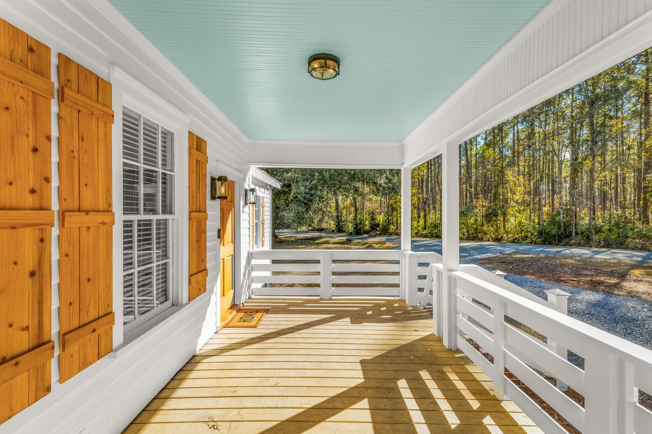
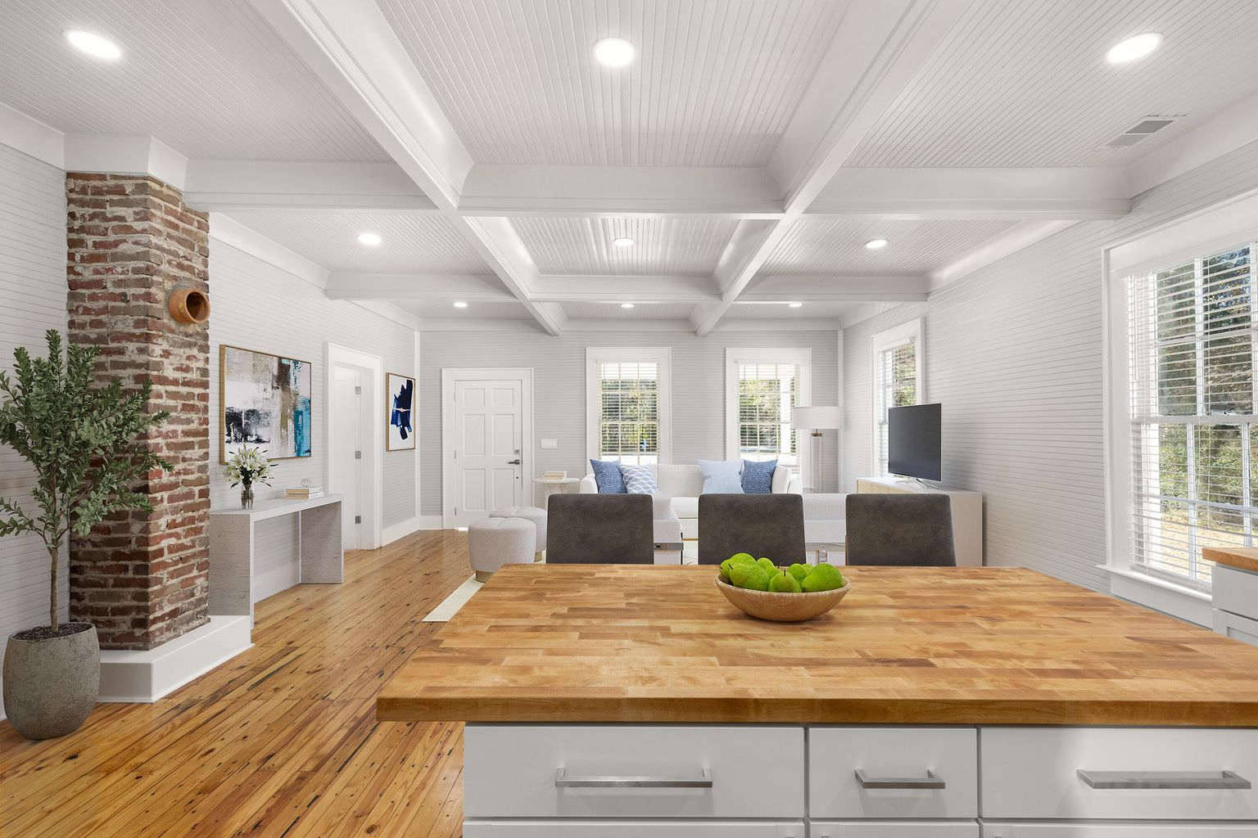
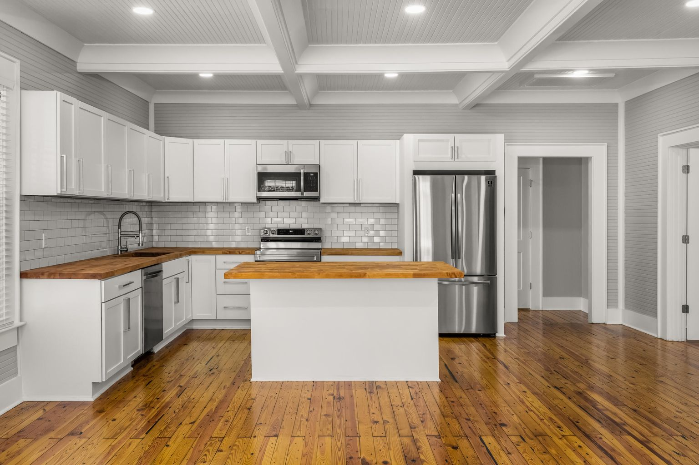
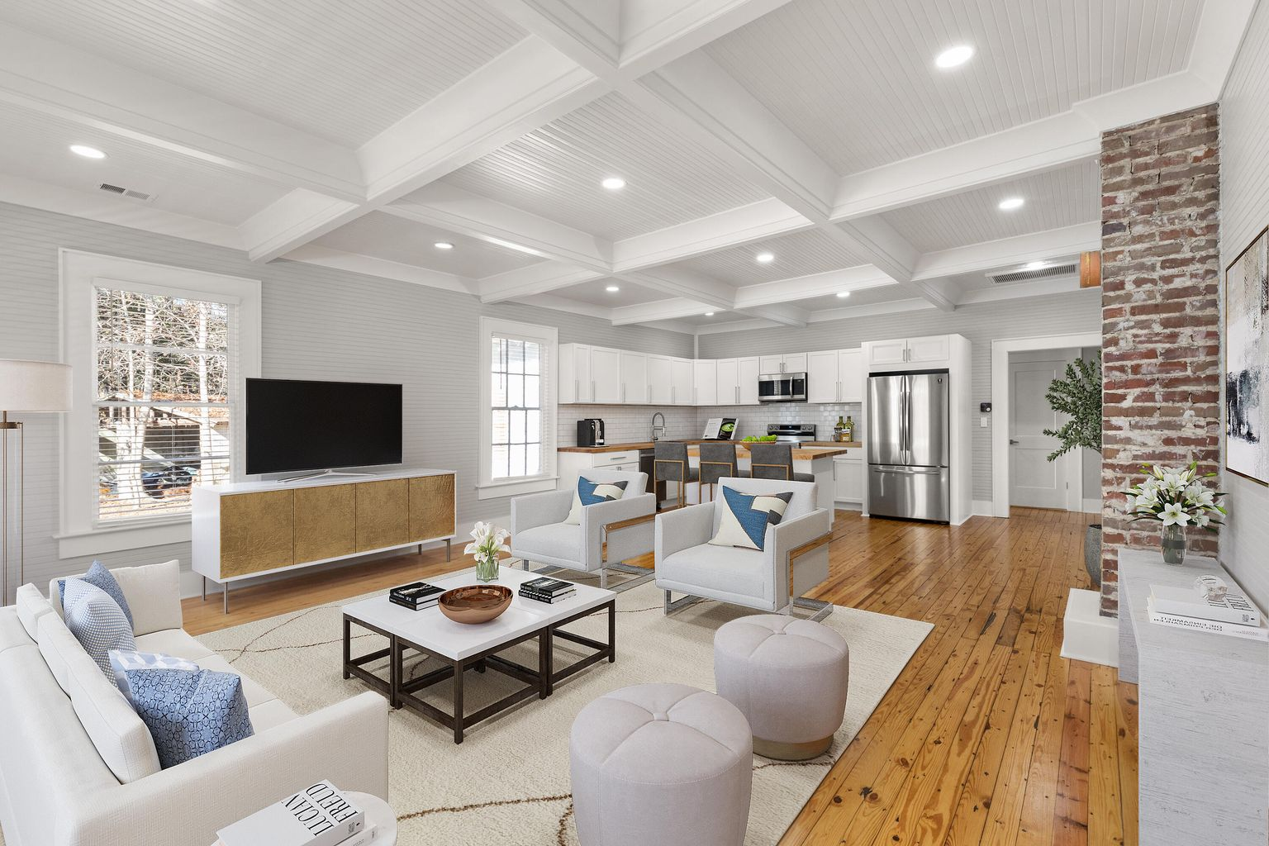
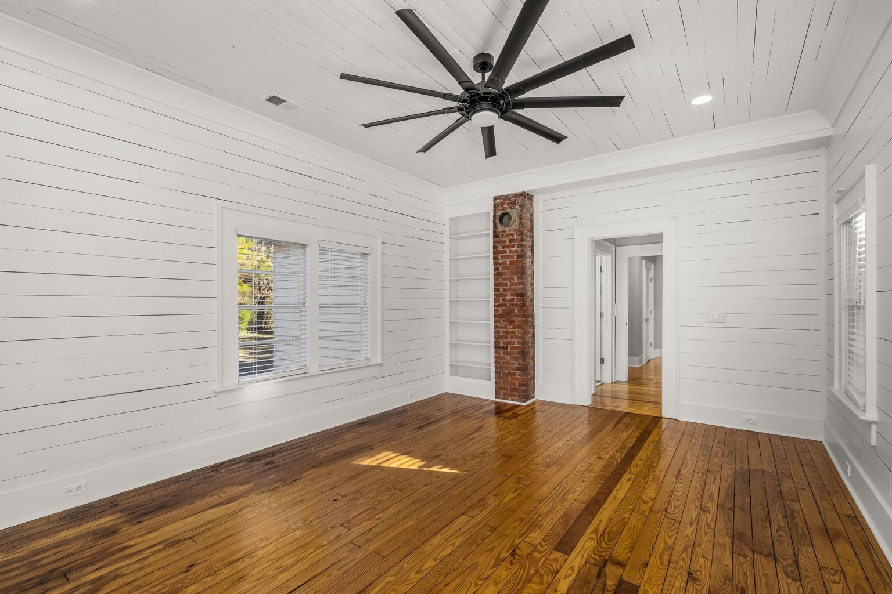

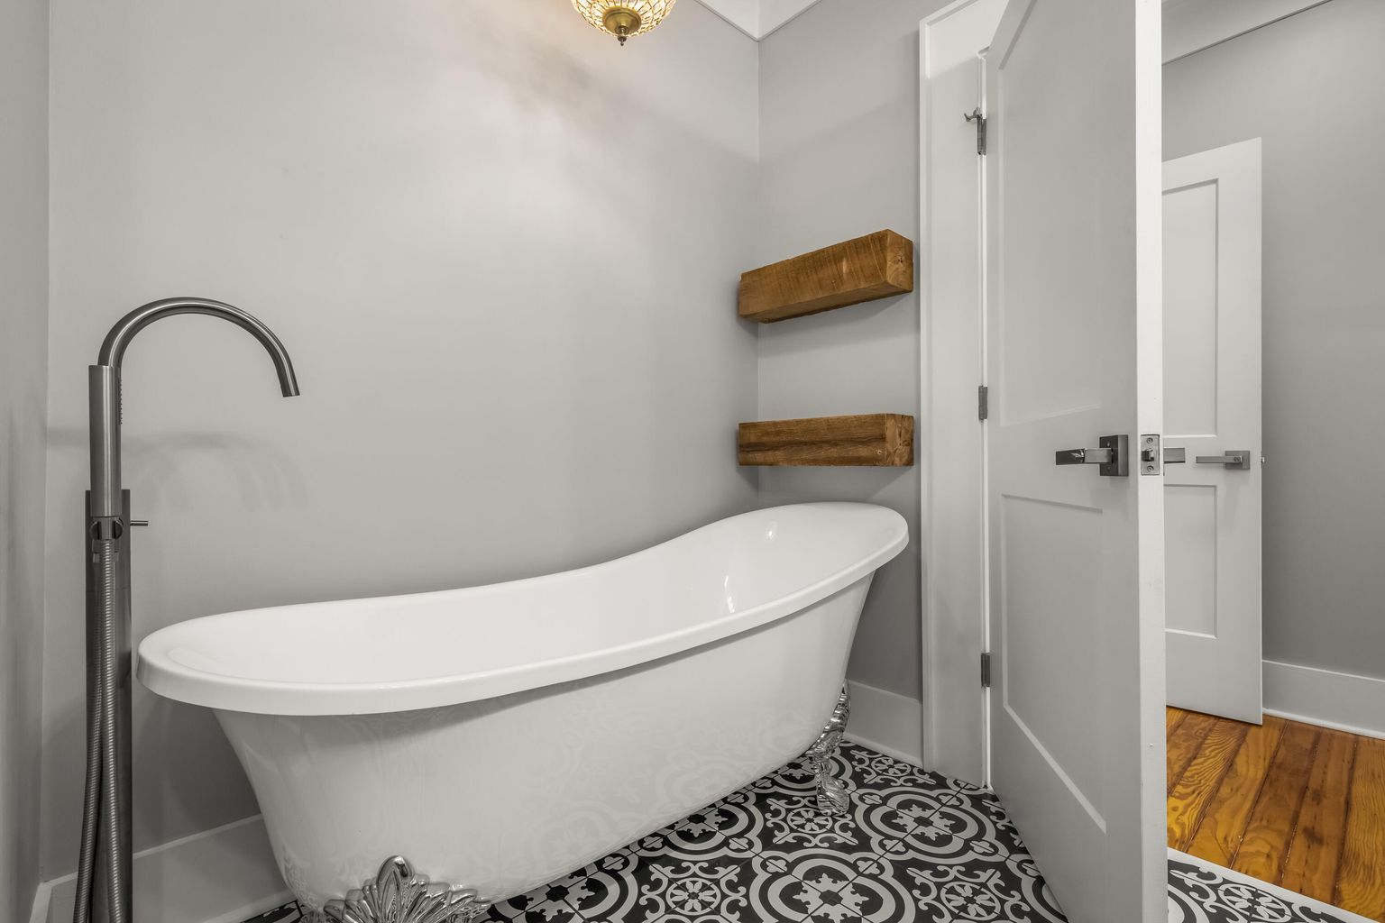
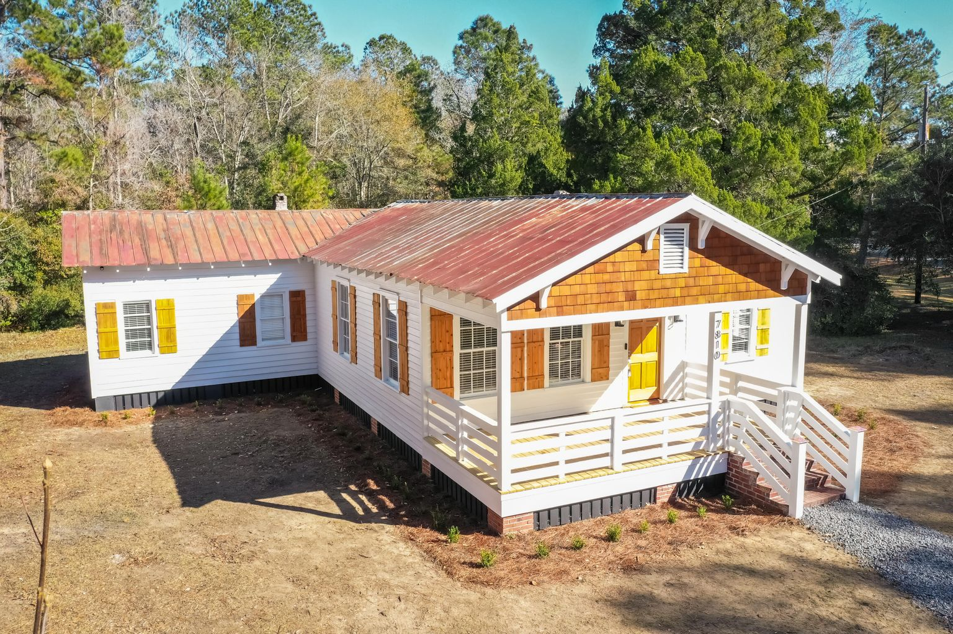
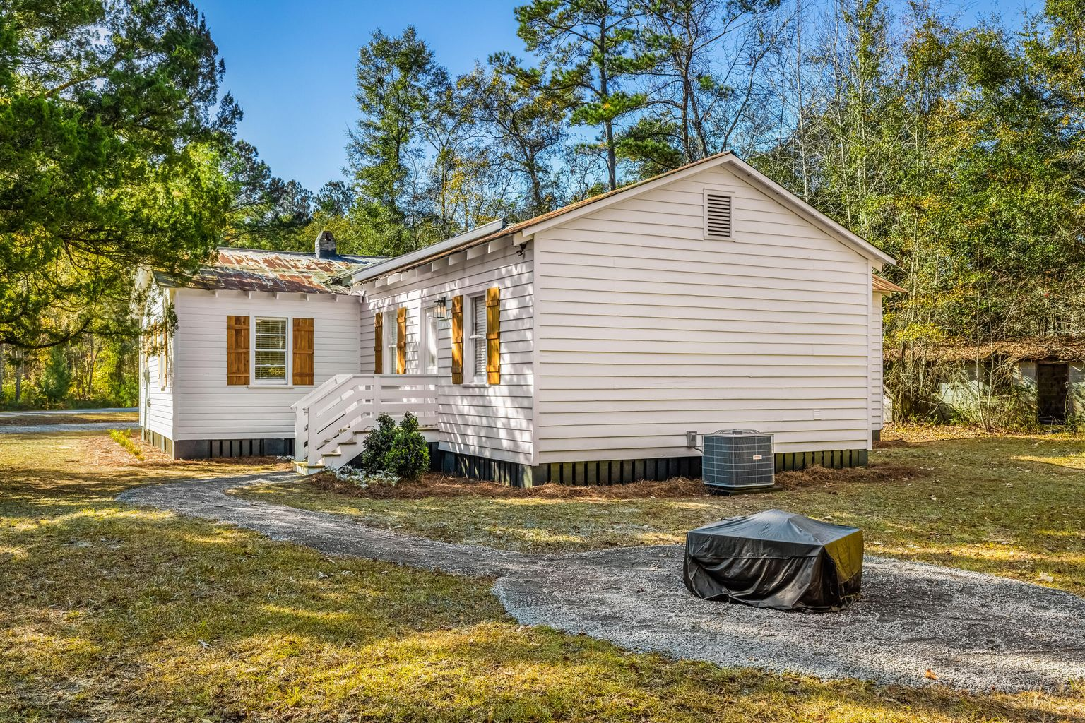
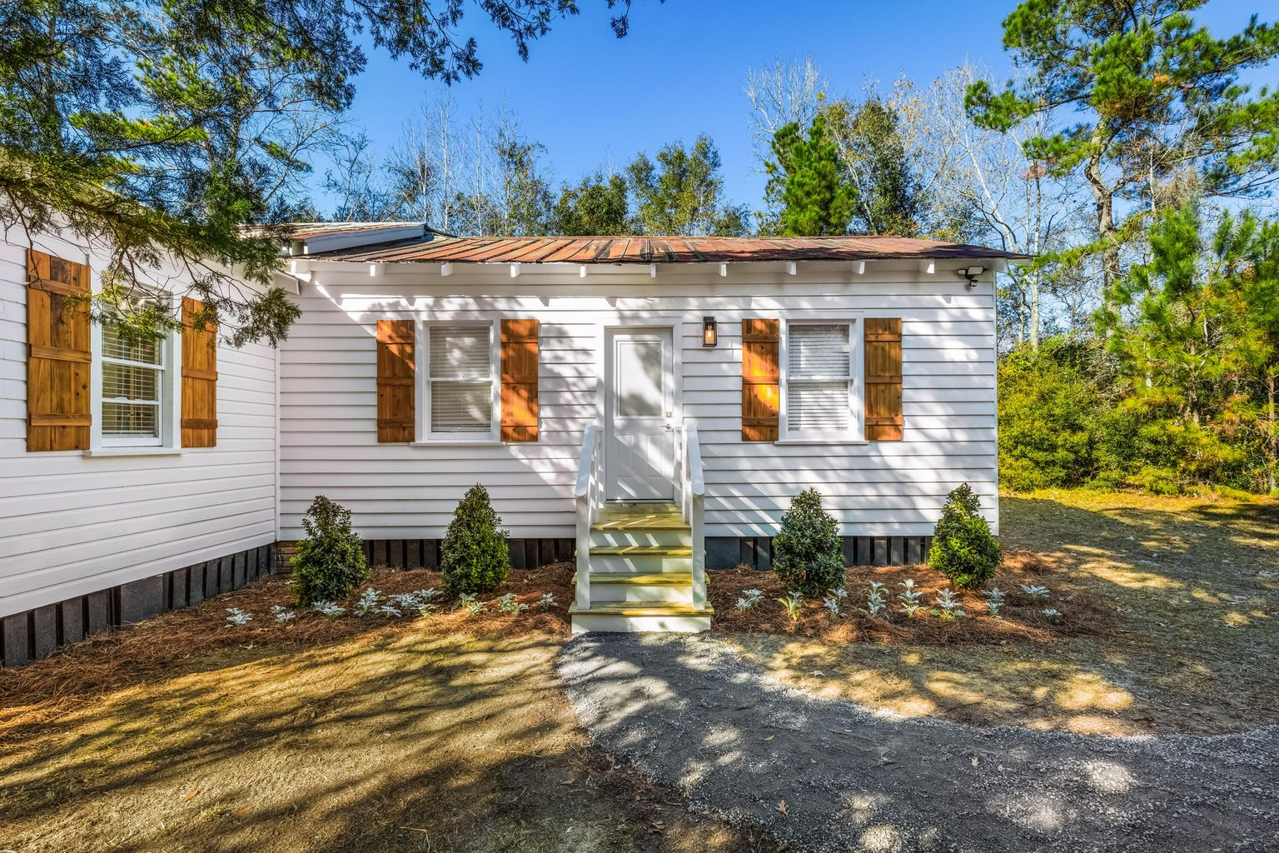
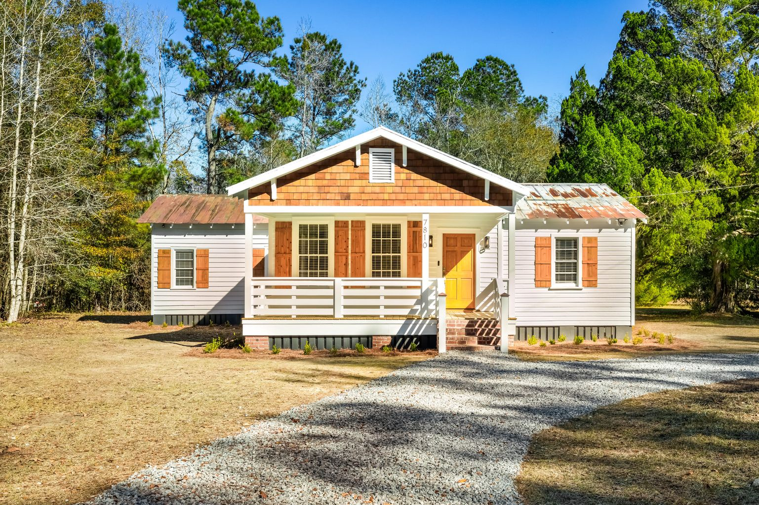


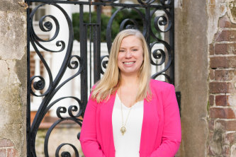
Welcome Home To Oakville Road!
7810 Oakville Road
Hollywood, SC 29449 · MLS# 21032510 · $549,900
Welcome home to Oakville Road! This impressive single-story home is situated across from 700+ acres owned by the Nature Conservancy and is located within a 20 minute drive to Edisto, 30 minutes to West Ashley and 45 minutes to both North Charleston and the peninsula. Your buyers get the best of both worlds with this privately situated property. For those with a love of history, this property originally served as a schoolhouse in the area. This stunning home infuses custom, high-end detail with the charm and original character of a 1940’s cottage. Some notable features of this property include:
4 bedrooms, 2.5 bathrooms, 1,800 sq ft, .85 of an acre
No HOA
X Flood Zone, no flood insurance required
Original heart pine floors and beadboard are continuous throughout the home
9+ foot coffered ceilings in living room
7 inch crown molding and baseboards throughout the home.
New HVAC, plumbing and electrical
Tankless water heater
Roof has been inspected and was repaired where necessary
Large kitchen island has room for seating with butcher block countertops & top of the line, stainless steel, Samsung appliances (includes upgraded refrigerator), a push button disposal and a commercial faucet
Luxurious owner’s suite which features its own en suite bathroom, complete with a mirrored double vanity with quartz countertops, custom tile, a clawfoot tub, an oversized shower and a massive, custom walk-in closet with separate space for a stackable washer and dryer
Keller Williams Realty Charleston West Ashley
1180 Sam Rittenberg Ste 105
Charleston, SC 29407
This peaceful property has it all and is an absolute must see.
Celeste Jones
Realtor
843-345-9387
welcomingyouhomecharleston@gmail.com

