Slide 1
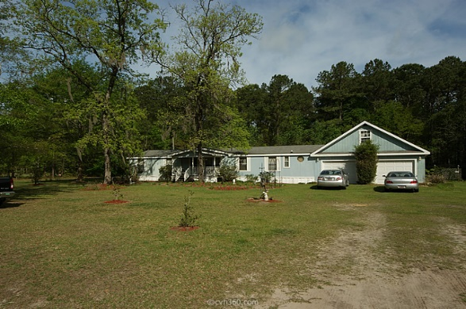
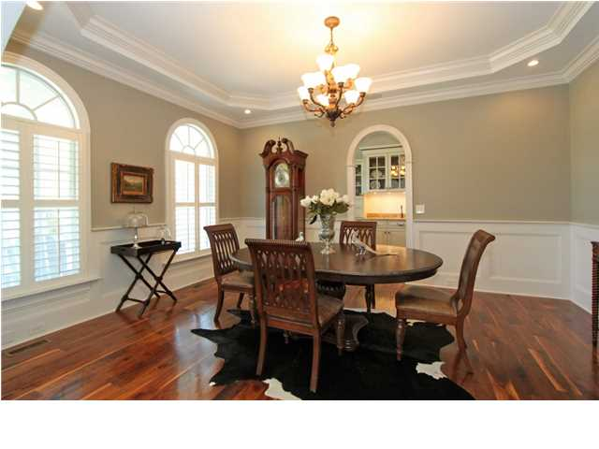
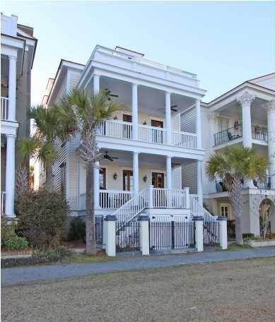
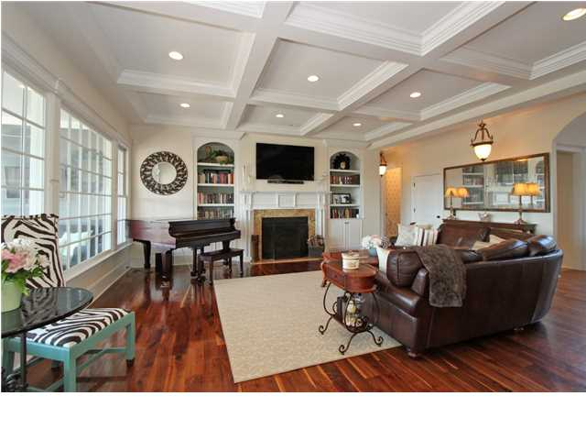
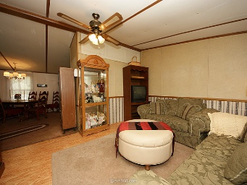
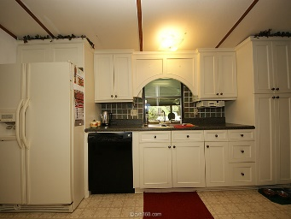
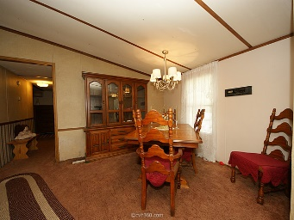
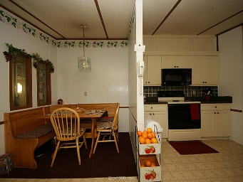
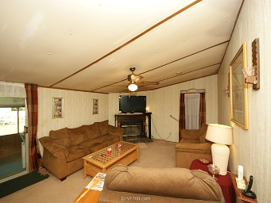
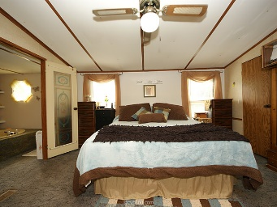
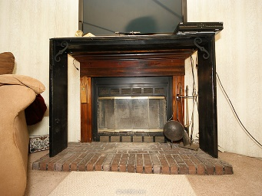
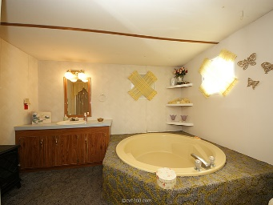
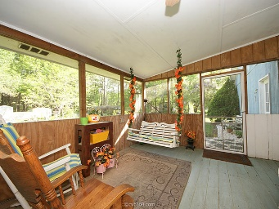
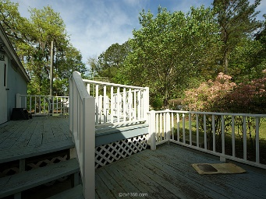
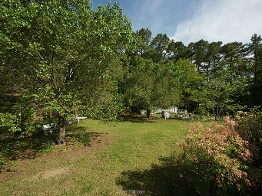
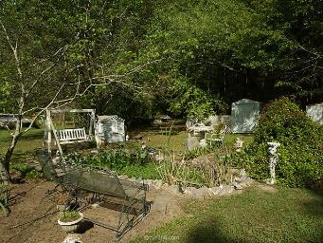
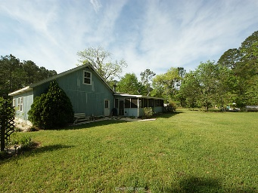


7838 Highway 164
Hollywood, SC 29449
MLS# 15009377
$165,000
3.86 Acres
4 Bedroom | 2 Bath
1,800 square feet
Land, gardening, nature, tranquility. Truly a must see!! This 4 bedroom, 2 bath 1800 square feet mobile home, which sits on 3.86 acres of land, feature 3/4 inch plywood on all floors throughout home. Kitchen has custom built cabinets with built-in breakfast nook/ kitchen table. Enjoy the beautiful Charleston evenings on your own spacious screen in porch, perfect for entertaining friends. The 2 acres of cleared land feature mature fruit trees, a Kai pond, two small grape vineyard, two decks and space to accommodate horses for all the horse enthusiast. This beautiful home has a 26x26 two car garage with an unfinished room above garage. Do not let this one get away!!!
2nd Row Beach Home with Great Views
Gary A Gooden
Office - (843) 556-5800
Mobile - (843) 566-6733
gargoo@hotmail.com
http://gary.onehomesearch.net
Carolina One Real Estate
873 Orleans Road, Ste 102
Charleston, SC 29407-5753

