Slide 1
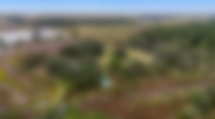
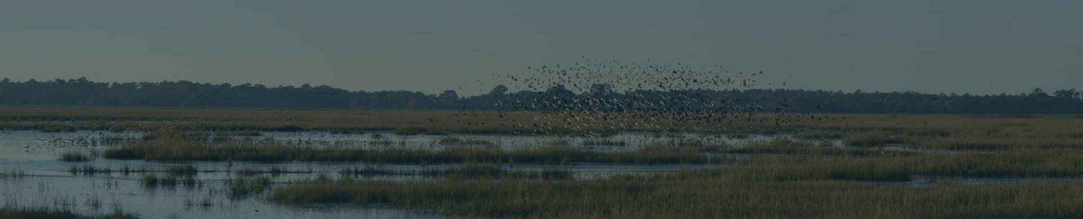

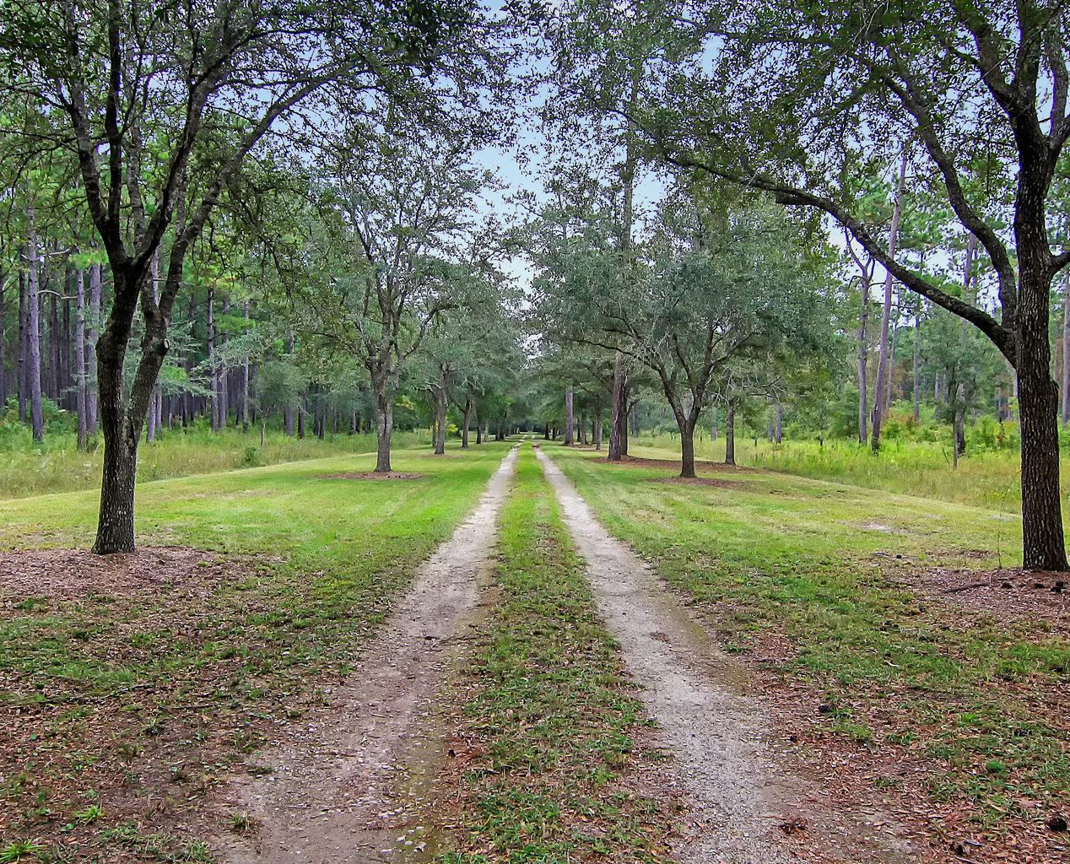
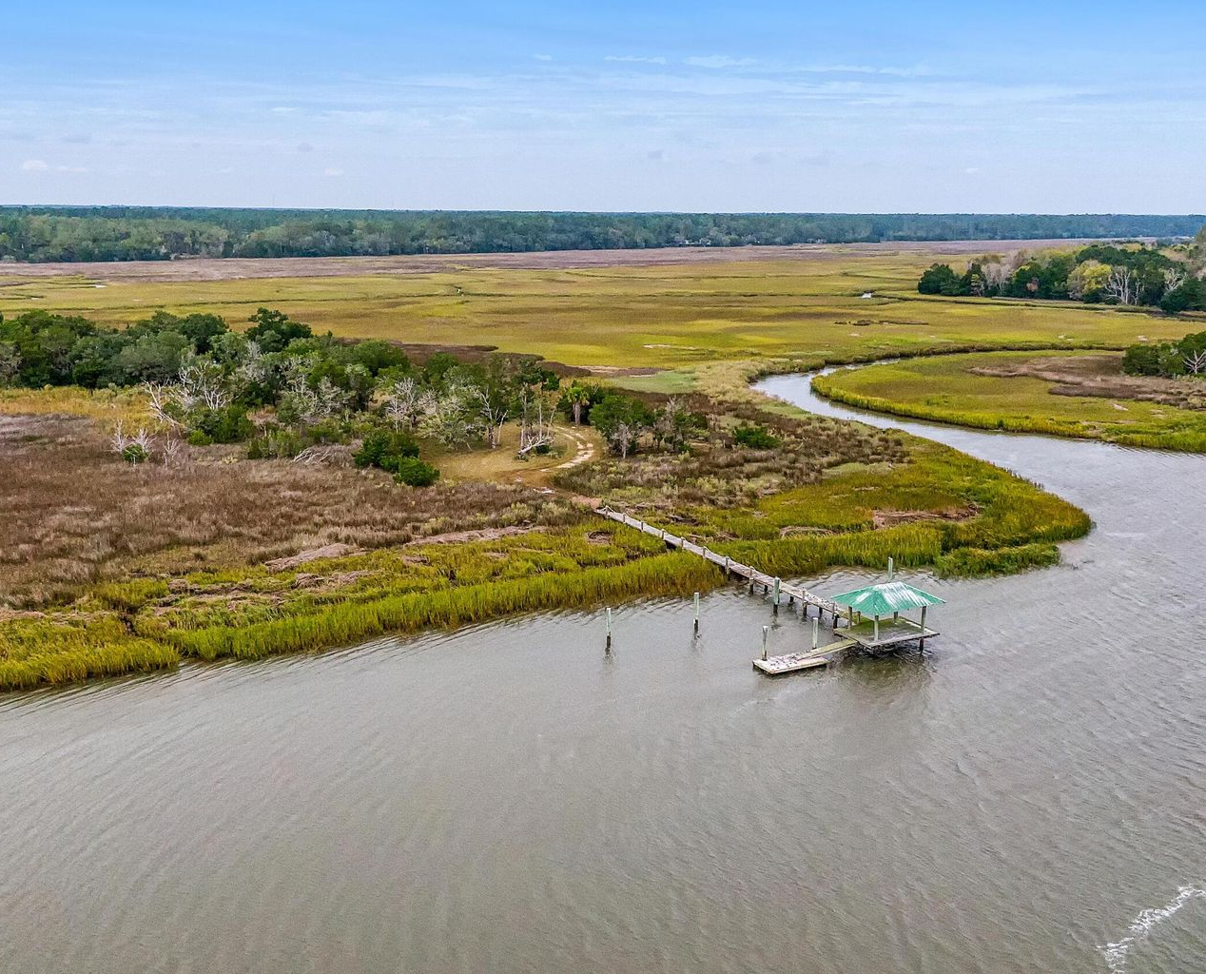
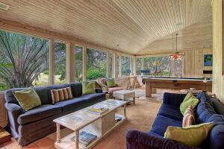
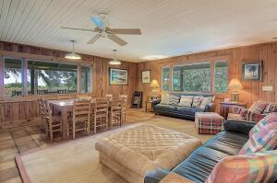
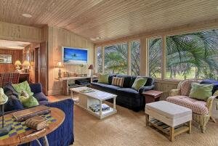
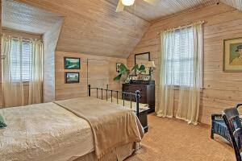
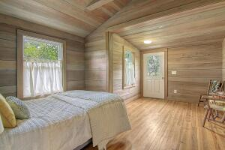
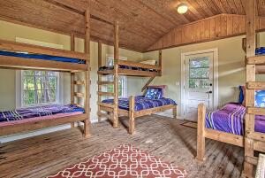
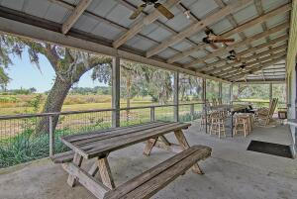
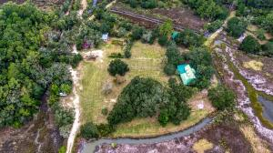
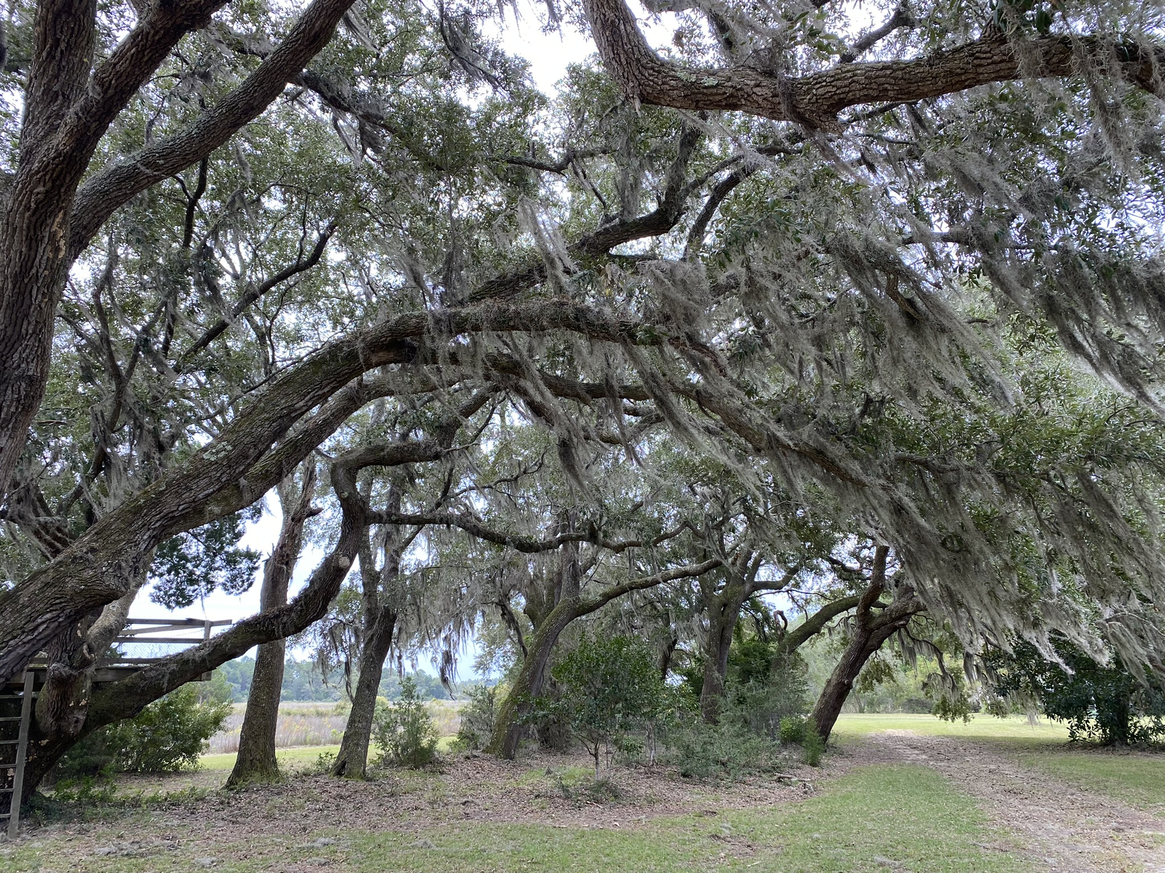
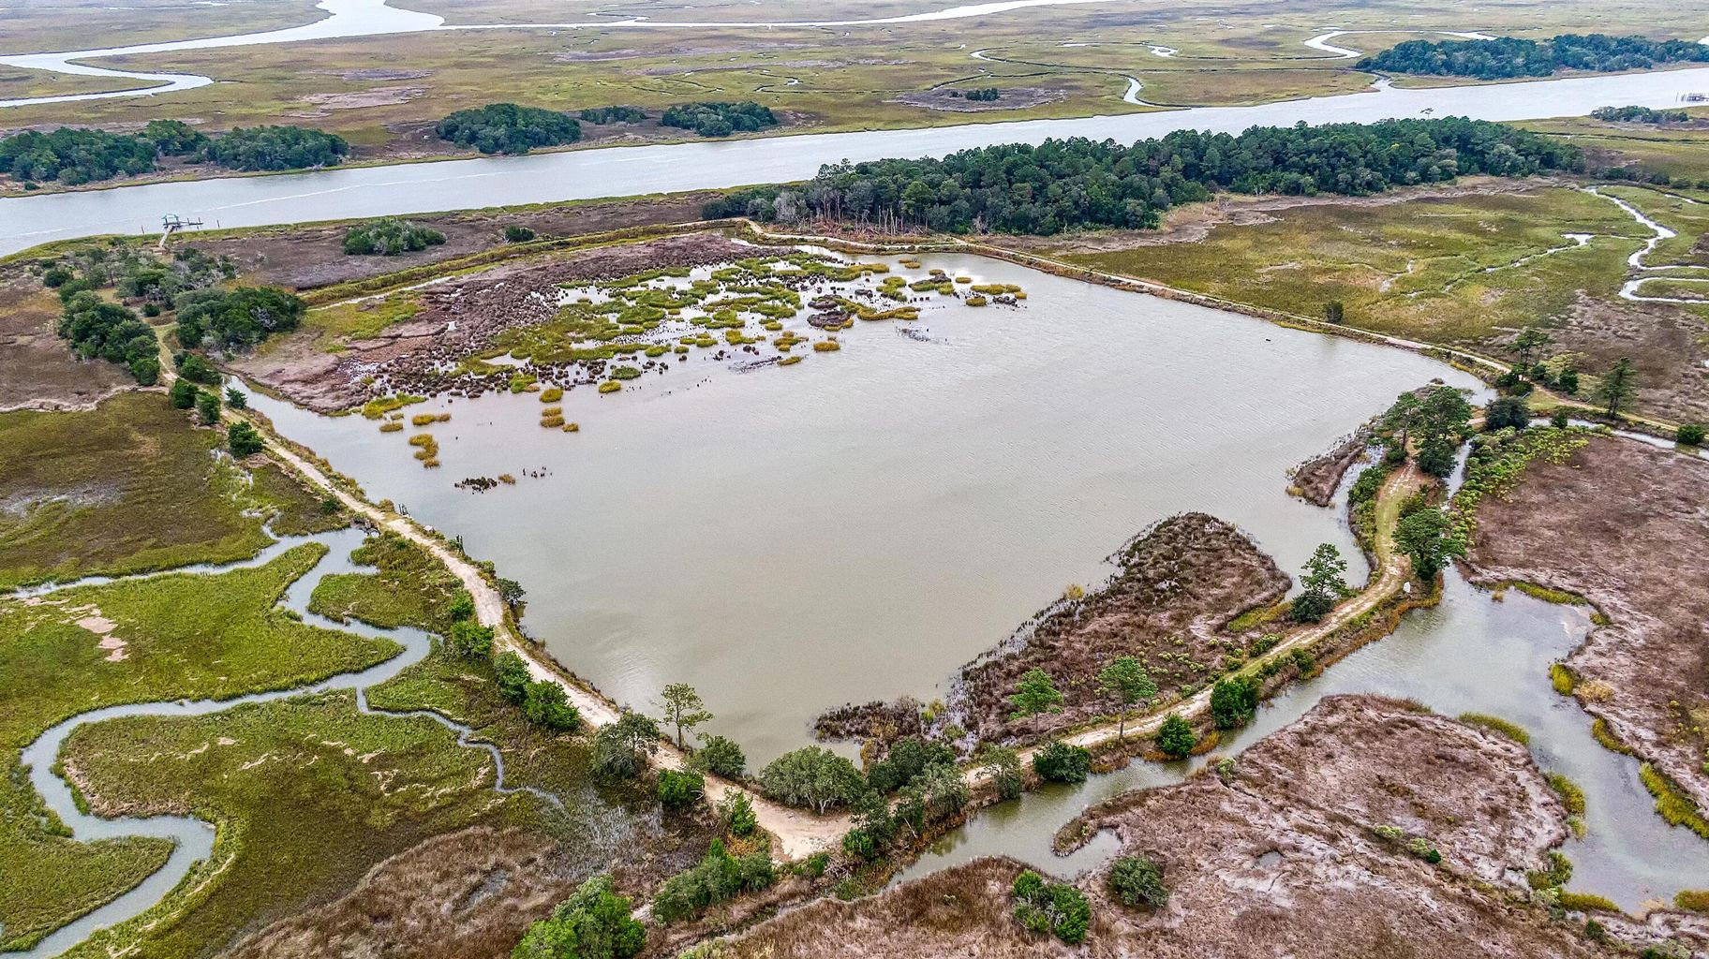
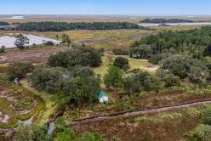
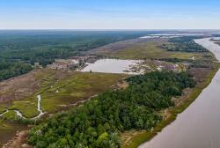
DOUGLAS CUTTING
(843) 534-3911
dcutting2@gmail.com
bluewingproperties.com
783 Dupre Road
McClellanville, SC 29458
MLS# 22026689 ~ $5,100,000
Sitting on the doorstep of Cape Romain National Wildlife Refuge, and wedged between the Francis Marion National Forest and Intracoastal Waterway, Windfall is a place that defines the importance of location. On the outskirts of the old McClellanville village, 40 minutes north of Mount Pleasant and less than a half hour south of Georgetown, this 161-acre getaway has provided decades of family memories on land and water – from dock time to deer stand, pig-pickings to quiet solitude around a fire, screen porch to boat rides, and plenty more. The property has a comfortable four-bedroom cottage, two small guest cabins, a managed brackish pond (think fish, oysters, crabs, ducks), dock on the Intracoastal, mature pine woods, small fields, and countless live oaks. As coastal places go, Windfall is rare gem. Peaceful, wild, and just minutes north of heavy traffic – very few saltwater 'farms' like this come to market. *Protected by a D.U. Conservation Easement with generous allowances.

