Slide 1
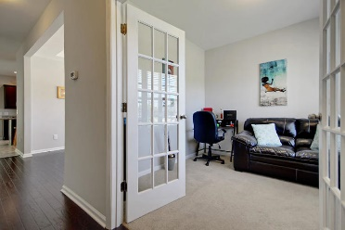
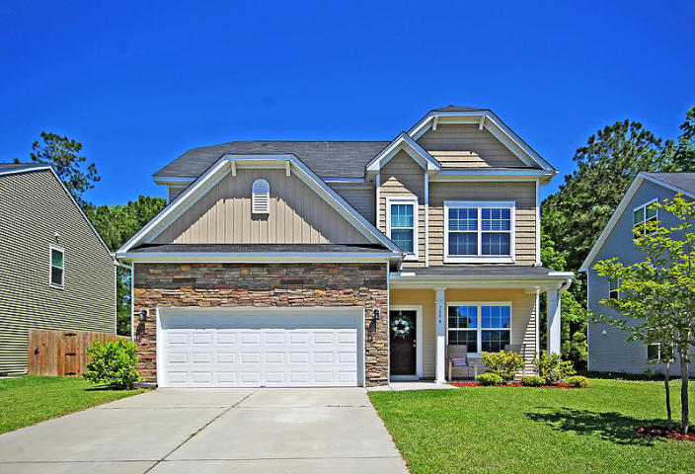
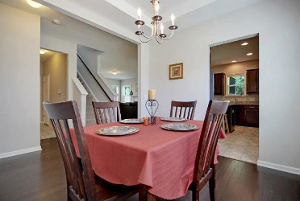
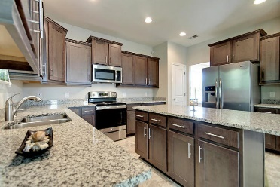
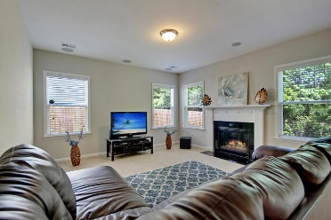
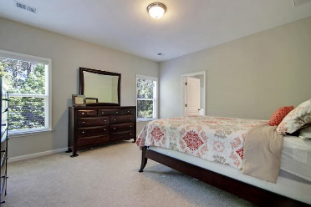
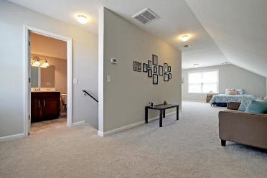
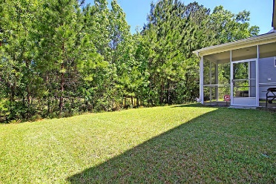
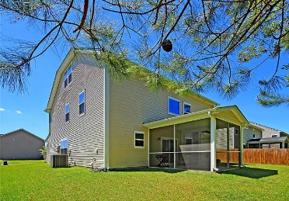

7854 Expedition Drive Colony North · North Charleston MLS# 19011750 · $265,000
Gorgeous Listing
Great Home with MIL or Teen Suite!
STUNNING 4 bed, 3.5 bath home with PRIVATE backyard that backs to woods. This home has WONDERFUL CURB APPEAL with stately stone accents, landscaped front yard and covered front porch perfect for rocking chairs. Upon entering the home you are greeted with handsome floors and an abundance of natural light. The office/flex room is to the right and continuing in is the dining room. The CHEF INSPIRED GOURMET KITCHEN and is open to the family room and features GRANITE COUNTER TOPS, STAINLESS STEEL APPLIANCES, gorgeous wood cabinets, big island, and pantry. The family room is large and has surround sound and a fireplace. The master bedroom suite is on the second floor and has a SPA-LIKE ensuite bath with FRAMELESS GLASS SHOWER, RELAXING SOAKING TUB, dual sink vanity, and HUGE walk-in closet.
The second floor oversized loft is great for a second living area or media room. Finishing off the second floor are two additional bedrooms, a full bath with dual sinks, and laundry room. The third floor is a living area separate sitting area, bedroom area, and private bath and is perfect for a MIL SUITE/TEEN SUITE/or guest room! Finishing off this great home is a private backyard that backs to woods and you can enjoy this from the screen porch while having a cup off coffee in the morning or relaxing with a good book in the afternoon. Colony North centrally located to Boeing, military bases, Bosch, beaches, shopping and easy access to all that Charleston has to offer.
This home HAS IT ALL-see today it will not last!
Stan Huff
843-670-2835 stan.huff@agentowned.com
Jill Marcacci
843-297-5590 jill@agentowned.com
www.agentownedrealty.com
AgentOwned Realty Co. Preferred Group, Inc. | 824 Johnnie Dodds Blvd | Mt Pleasant, SC 29464

