Slide 1
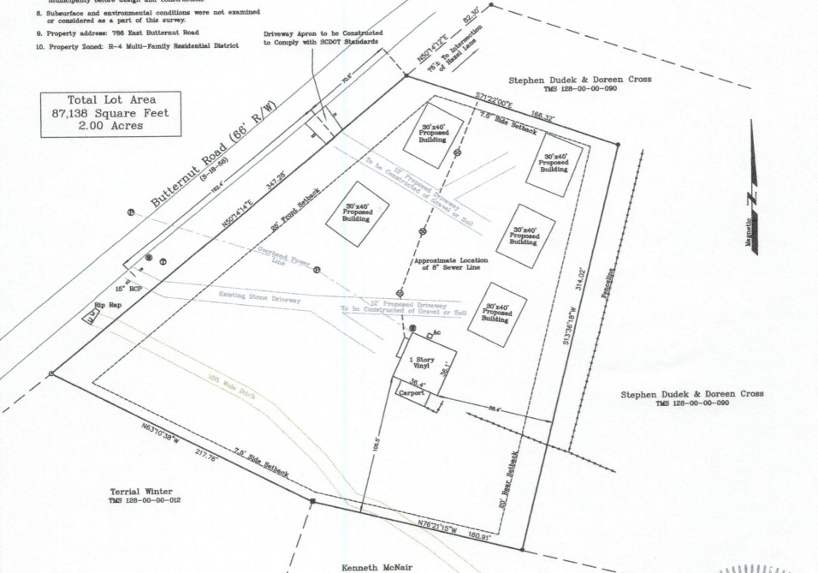
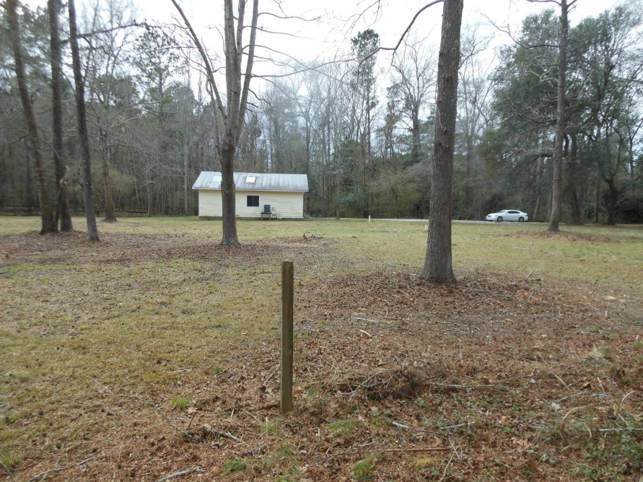
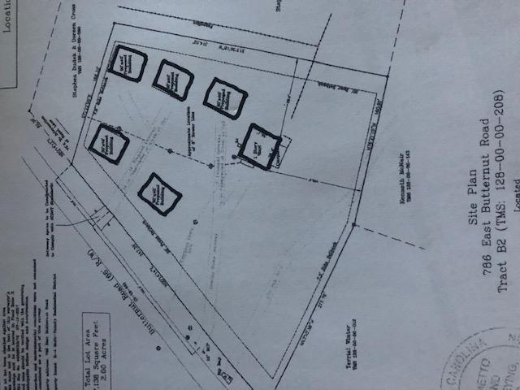
Existing Home + 2 Acres
$249,000
Zoned R-4 (13 units/acre) Sewer & Water at the Site
$40,000
Price Reduction!
100 W Butternut Road ~ MLS# 20004023 ~ $379,000 (0.85Acres)
Summerville | 786 E Butternut Road | MLS# 20002116
Site plan above shows 6 single family homes…no paved road required…only gravel driveways as shown (could be more single family detached or attached units).
Live for Free! Build a home to live in and have several other homes for rental income with up to 6 total homes and owner occupant can get FHA financing with a loan amount up to $751.900 (2 to 4 units).
There is an existing home on the property that can rent for $1,200 to $1,300 per month, which should cover the monthly payment for the entire property.
The existing home is currently having some work being done on the interior and exterior to make the home “move-in ready” and qualify for VA & FHA financing. Property also will qualify for USDA 100% financing! No down payment required. Flood Zone X (no flood insurance required).
Rick Willis
843-327-3017 Rick@RickWillis.com The Group, LLC

