Slide 1
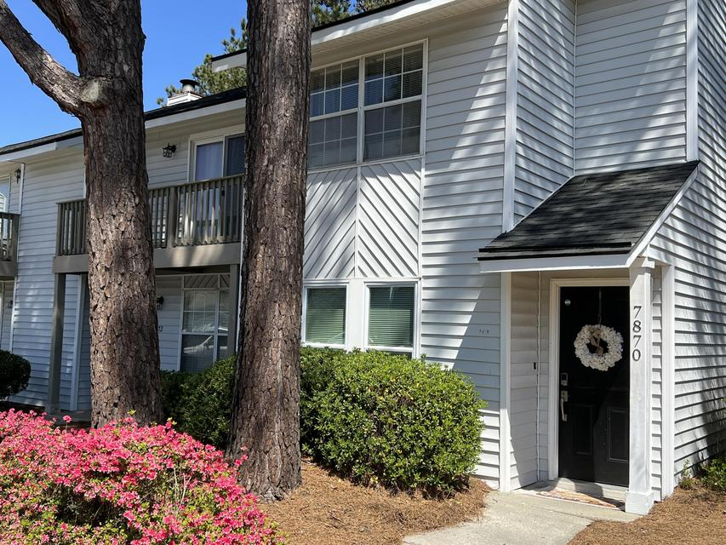
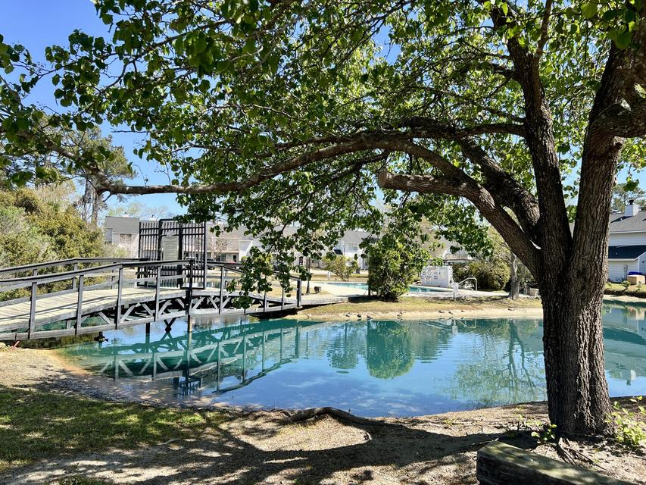
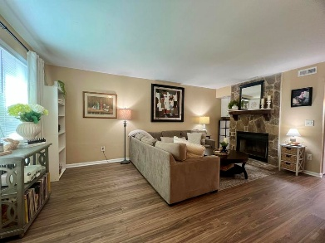
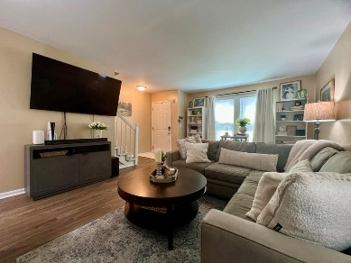
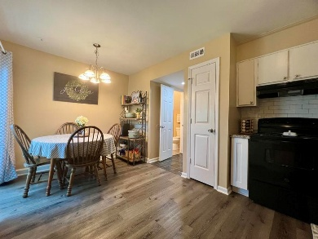
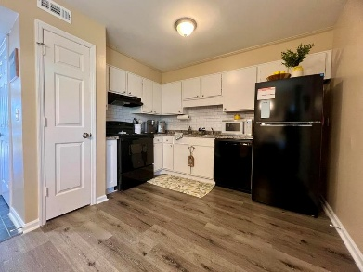
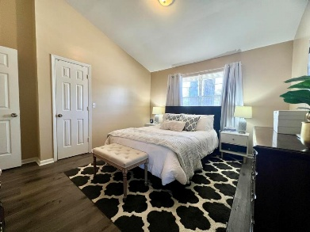
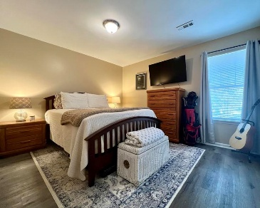
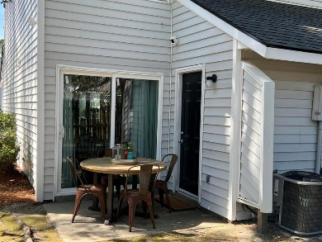
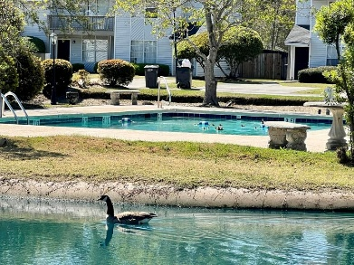


7870 Nummie Court
Motivated Seller! No More Polybutylene Water Pipes!
Fireside | North Charleston, SC 29418
MLS# 26006087 | $215,000
When location, value, and price align, you get 7870 Nummie Court! This charming 2-bedroom, 1.5-bath end-unit townhome is move-in ready and waiting for you! Step inside to a bright open living room featuring luxury vinyl plank flooring, a fresh coat of paint and is centered around a stone wood-burning fireplace. The eat-in kitchen provides ample cabinet space, all major appliances, and a new sliding glass door leading to the patio and backyard--perfect for relaxing or entertaining guests. Downstairs also features a convenient half bath and a generous utility room with washer and dryer, plus additional access to the patio. Upstairs, the primary bedroom has a vaulted ceiling, creating a bright and airy atmosphere. A second spacious bedroom and a full bathroom complete the upper level.
Peace of mind updates include: New Roof, New Water Heater, New Garbage Disposal, ALL NEW PEX PIPING, and New Ductwork. Enjoy low HOA dues that include community pool access, yearly termite inspections, exterior maintenance, all landscaping, and annual pressure washing--providing truly low-maintenance living. Situated just off Dorchester Road, you're only minutes from Charleston International Airport, Bosch, Boeing, shopping, dining, and everything the area has to offer. Whether you're a first-time homebuyer or an investor searching for your next rental property, this is an excellent opportunity you don't want to miss. Schedule your showing today!
Kelly Rozier
(843) 209-3129
kellywrozier@gmail.com
Brand Name Real Estate
4 Carriage Lane Suite 106
Charleston, SC 29407

