Slide 1
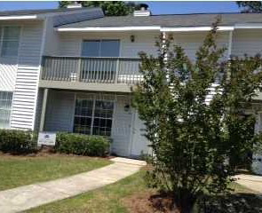
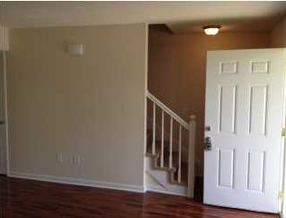
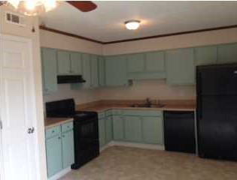
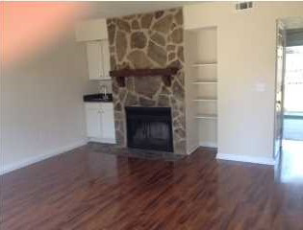


Reduced + New Agent Bonus!
7878 Nummie Ct
Fireside
North Charleston, SC
MLS# 1412362
Reduced to $65,900
$1,50 Bonus to Agent
with Closing by Sept. 30th, 2014
Extensively renovated 2BR/2BA townhouse in Fireside. Everything has been updated in this townhome, Brand New Home.......NEW A/C Close by 09/30/14 $$$1500 bonus to selling agent!!! Must See! The kitchen has new updated cabinets, countertops, flooring, nickel lighting, and appliances. There's also new carpet, paint, hot water heater, NEW cherry wood flooring in the living room, and much more. More than 30K in recent upgrades. The open floor plan is enhanced by vaulted ceilings and a patio adds to the spacious feel of the home. There is a wood burning fireplace in the living/family room. A wooden privacy fence completely surrounds the back yard and several fruit trees are on the property. Low utilities and taxes. Minutes to Joint Base Charleston, Bosch, Boeing and the Naval Weapons Station. Owner has not lived in this property, no disclosure.
Stephen Woodard
Mobile - (843) 327-1600
CharlestonYacht@gmail.com
www.charlestonhome4you.com
Brand Name Real Estate
4 Carriage Lane Suite 106
Charleston, SC 29407

