Slide 1
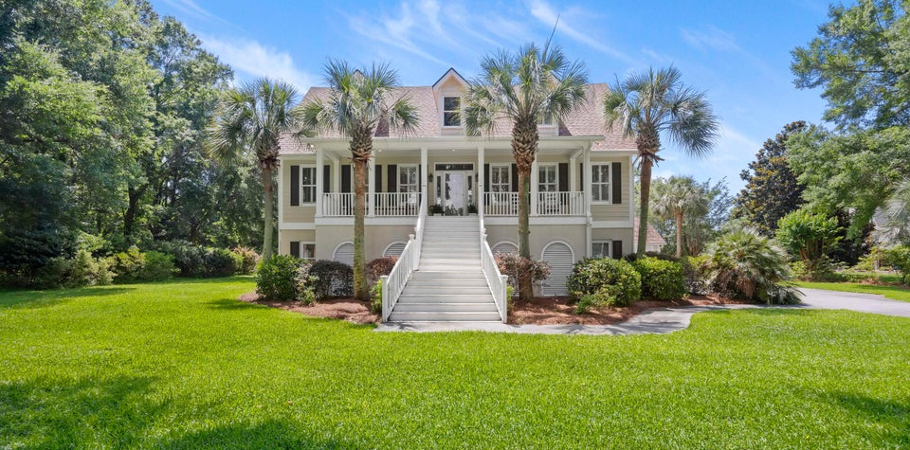
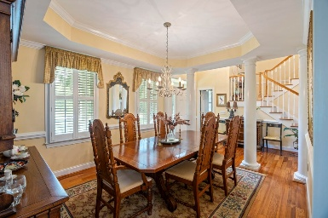
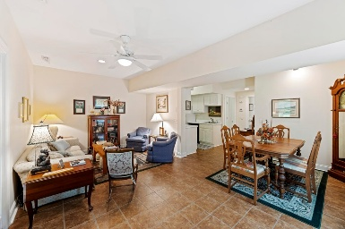
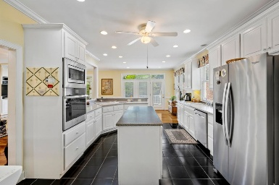
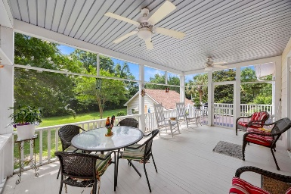
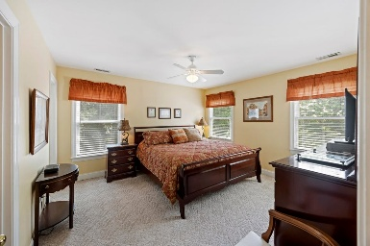
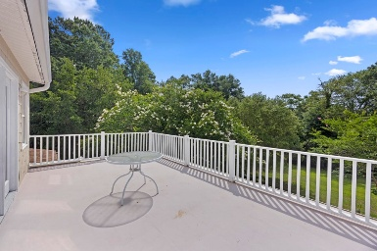
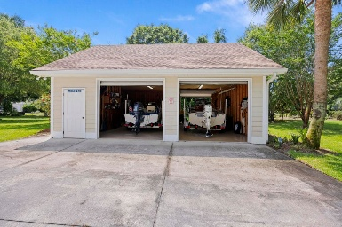
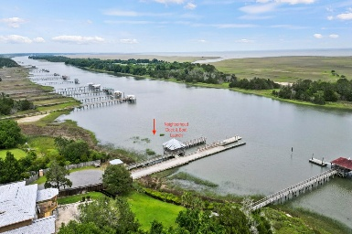

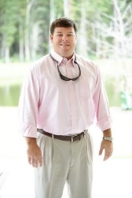
7879 Gull Bay Drive
Bulls Bay Overlook | Awendaw, SC 29429
MLS# 25015489 | $1,250,000
Back on The Market in Awendaw!!
**Welcome to 7879 Gull Bay Drive!** Discover unparalleled coastal living in this meticulously maintained, custom-built Hilton Googe design, one-owner elevated home, nestled on a sprawling one-acre lot within the prestigious gated community of Bulls Bay Overlook. Step inside to appreciate the refined details: soaring 9-foot ceilings, elegant chair rails, ceiling fans in every room, 2nd master bedroom & multi purpose room with deck upstairs, abundant storage throughout and gleaming hardwood floors flow through the main living areas, complemented by plush carpeting in select bedrooms and stylish tile in the bathrooms. Enjoy watching the boats go by in the Intracoastal Waterway from views from the patio and Lowcountry breeze on the expansive screened porch, flanked by spacious decks perfect for outdoor entertaining. Inside, a cozy fireplace anchors the family room, adjacent to a formal dining room. The main-level master suite provides ultimate convenience and mother in law suite/apartment on the ground floor. The well-appointed kitchen features stainless steel appliances, durable Corian countertops, a functional kitchen island, and a convenient wet bar. A dedicated laundry room adds to the home's practicality. Peace of mind comes standard with a recently replaced roof (1 year old), water softener, in-ground propane tank, gutter guards on the front of the house and a powerful 26k watt Gernerac whole-house generator. Lush Rainbird lawn irrigation keeps the grounds vibrant. Storage abounds with a 3-car attached garage complete with a workshop, plus a detached 2-car garage with drive through, 1/2 bath, refrigerator, outside shower and featuring an unfinished room above. Bulls Bay Overlook, a secluded community of only 34 homesites, offers unmatched natural beauty. Bordering the Francis Marion National Forest and the Cape Romain National Wildlife Preserve, residents enjoy access to walking trails, a charming park, and a private neighborhood dock and boat launch on the Intracoastal Waterway. **Seize the opportunity to own a piece of paradise!**
TAKE A VIRTUAL TOUR
Drake Herrin
843-729-4692
dherrin@carolinaone.com
www.DrakeHerrin.com
Carolina One Real Estate
873 Orleans Road, Ste 102
Charleston, SC 29407-5753

