Slide 1
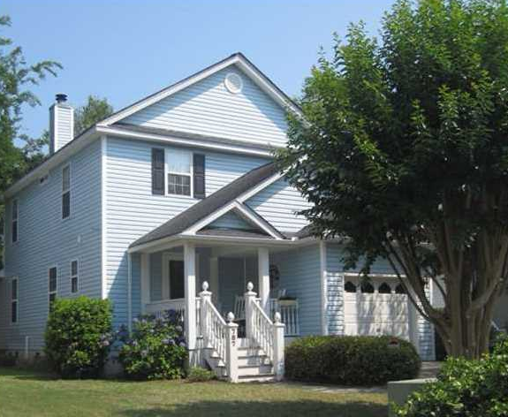
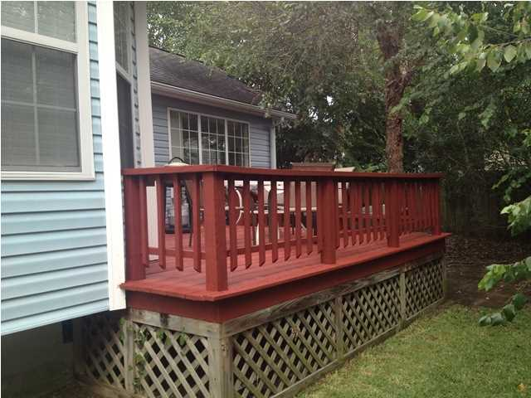
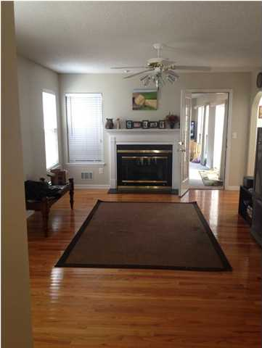
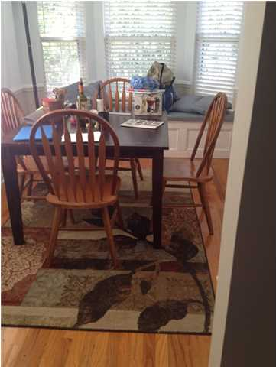
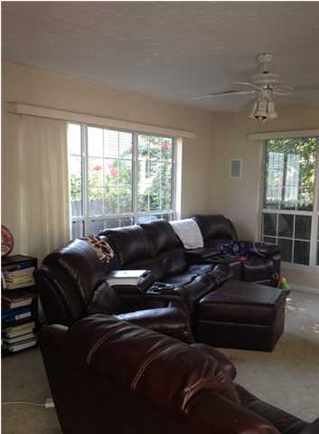
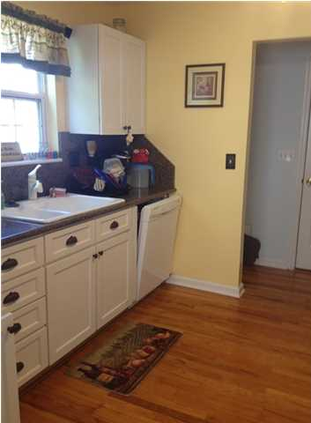
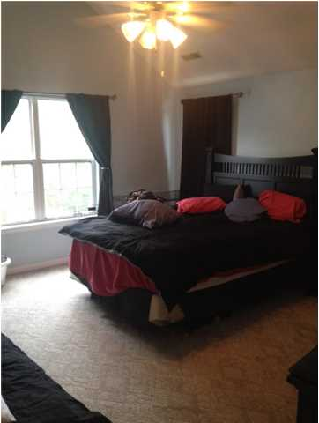
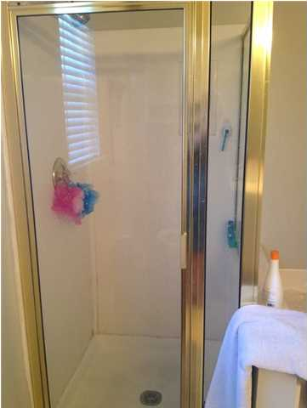


Just Listed!
787 Shell Sand Cir
Harbor Oaks
Charleston
MLS# 1419544
$284,000
3 Bedrooms 2½ Baths 1,800 sf
This is a Great James Island home in the best location for being very close to downtown. 15 minutes from Folly Beach also. This is a very peaceful, small, one street neighborhood, so no through traffic. This home has an open plan, large living room with an added room that will probably be where most of the living is done. Lots of sunlight and a large deck on back. Perfect family layout or entertaining with ease. Enough yard to enjoy yet not find overwhelming to care for. The dining room has a bay window with custom made cushions and pillows and storage beneath. The dining room overlooks the back deck. The kitchen is updated with granite counters. The upstairs host a large master bedroom with vaulted ceilings, dual closets, next to a large master bathroom equipped with a shower and a garden tub! The two additional bedrooms are also upstairs. This is a must see for this area. . Attic has been encapsulated for better energy savings. Heat pump has been replaced.
Jan Miller
janmimsmiller@gmail.com 843-345-9719 {M}
ERA Wilder Realty, 125-F Wappoo Creek, Charleston, SC 29412

