Slide 1
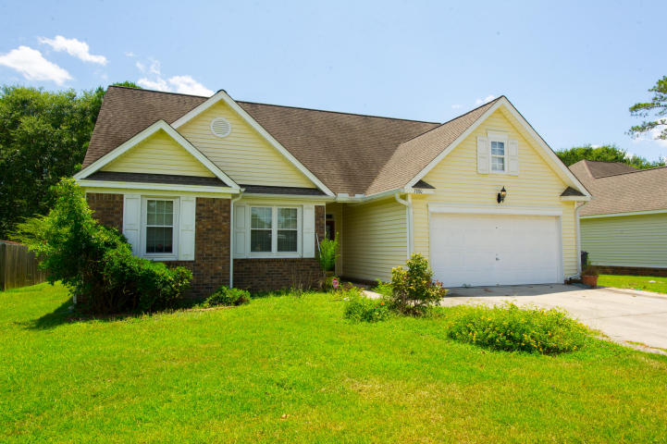
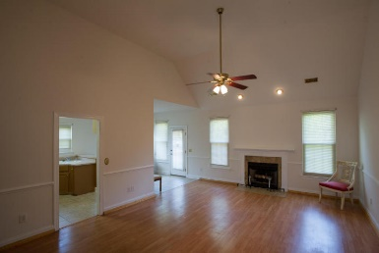
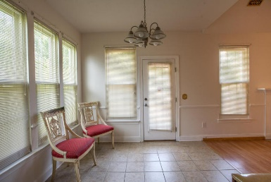
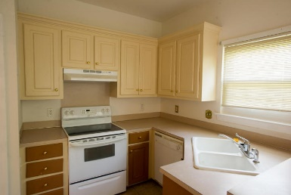
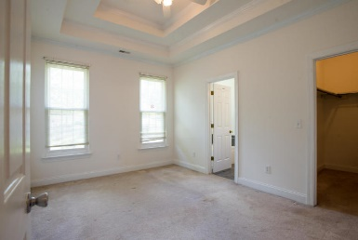
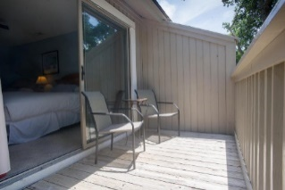
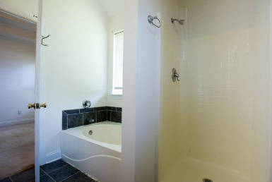
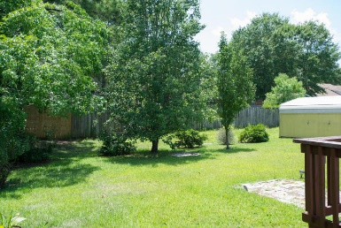
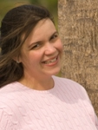

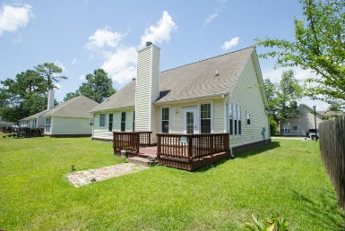
7880 High Maple Circle
Summerfield ~ North Charleston, SC 29418
MLS# 16018377 ~ $180,000
OPEN HOUSE SUNDAY 2-4
This home has wonderful potential. It is centrally located in a lovely section of North Charleston just past the air force base and is convenient to the airport, Tanger outlets and only a short drive into Charleston and the beaches. This one story cottage has been freshly painted and boasts one of the largest lots in the neighborhood. It comes complete with high ceilings in the family room which give it that open/airy feel and a fireplace for coziness in the winter months. The master bedroom is a nice size with a huge walk in closet and a large master bathroom with double sinks and a separate shower and garden tub. Just next to the master is a large laundry room. There is a 2 car garage along with a very large extra storage shed in the back yard. Don't miss this one! It wont last long.
Carey Nikonchuk
(843) 276-1701 M
cnikonchuk@gmail.com
www.palmettoproperty.net

