Slide 1
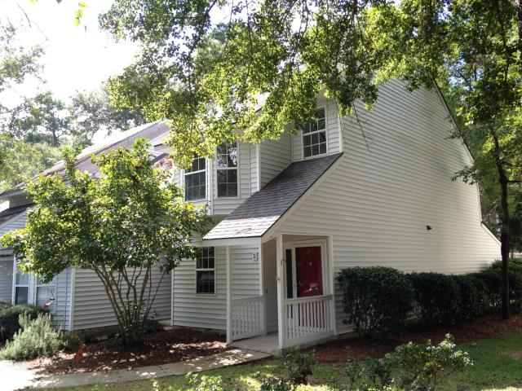
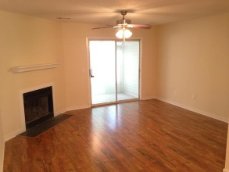
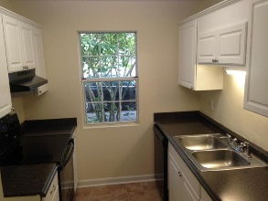
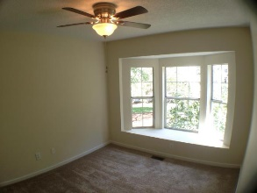
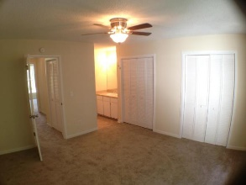
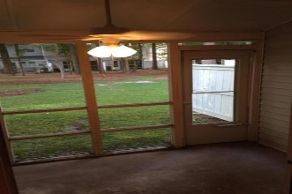
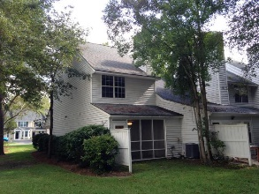
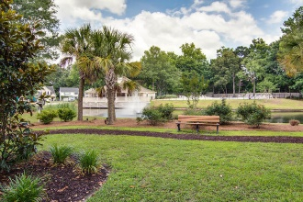
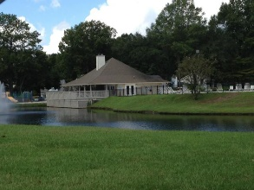
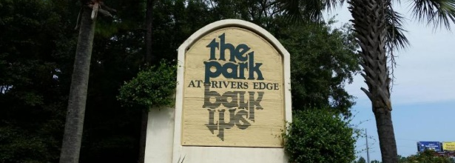
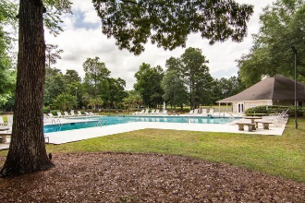
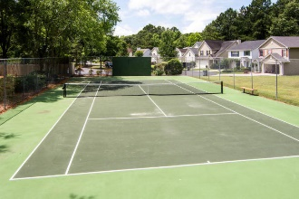

Renovated Top To Bottom!!
Open House Saturday 12-3 Refreshments Provided
7881-E Skillmaster Court
The Park at Rivers Edge :: North Charleston :: MLS# 15023949 :: $99,950
This END UNIT townhouse is ready to move in. Updates include new plumbing, new electrical, new flooring throughout, New Kitchen Cabinets, new counter tops, Brand New Whirlpool smooth top range and dishwasher, new bathroom vanities and toilets and fixtures, new ductwork, new outlets, switches, hinges, handles, ceiling fans, everything. The HVAC is 2011, the roof is 2010. The Park at Rivers Edge offers secure guard-gated neighborhood with community pool, tennis courts, baseball field, walking trails and sidewalks, playground, and wonderfully maintained landscaping and grounds, all for a small HOA fee of $115/month. It’s a beautiful place and an excellent price. This townhouse is like new and priced much lower than the new construction units. Priced to sell!
Scott Baskin
843-324-4139 M | 843-972-2400 O scott.r.baskin@gmail.com | www.scottbaskin.com
RE/MAX Advanced Realty
311 Johnnie Dodds Blvd
Mt Pleasant, SC 29464

