Slide 1
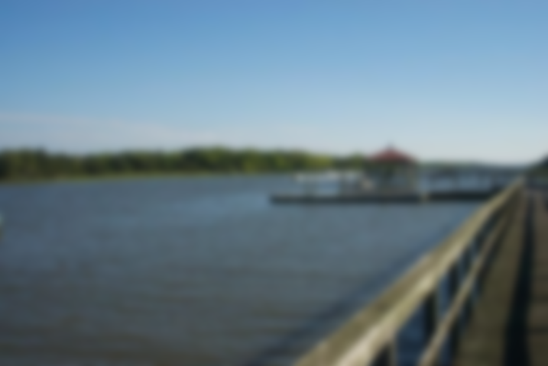
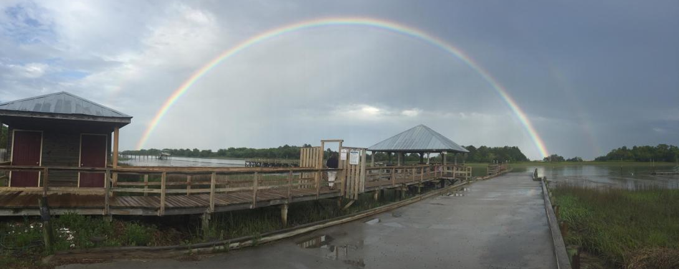
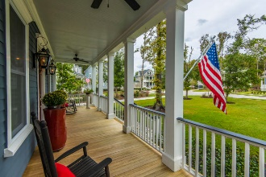
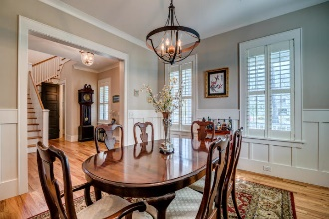
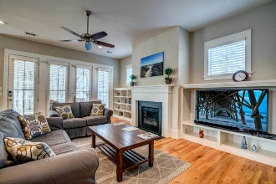
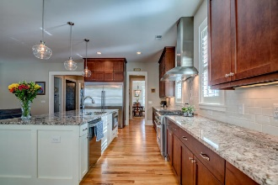
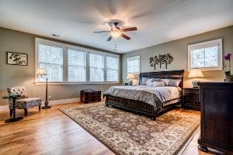
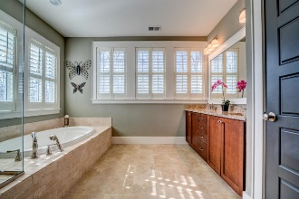
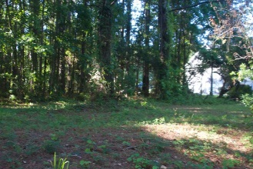
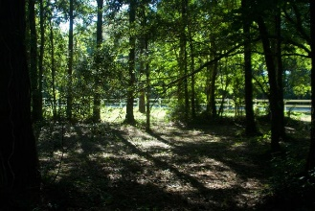
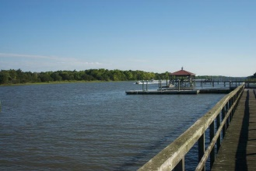
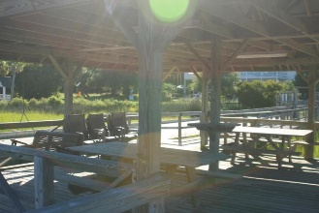
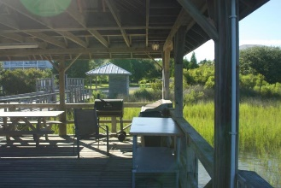
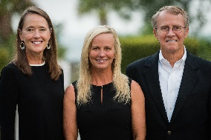

7888 Gull Bay Drive Bulls Bay Overlook | Awendaw, SC 29429 MLS# 18024463 | $170,000
Gated Community on Intracoastal Waterway
Minutes from Mt. Pleasant
Build your dream home on this beautiful wooded lot with over an acre of land to spread out! Located in a gated community on the Intracoastal Waterway, Bulls Bay Overlook is highly prized for its privacy and serenity in a classic Lowcountry setting. Outdoor enthusiasts will love the away-from-it-all feel with opportunities for fishing, hunting and bird watching at every turn. With it's own neighborhood dock & boat launch, you can cruise the waters of the Intracoastal Waterway, Bull's Bay & the Atlantic as often as you like. With close proximity to Bull's Bay Golf Club, one of the area's most highly sought-after private golf clubs, Francis Marion National Forrest and Cape Romain Wildlife Refuge, this property offers everything one could desire in outdoor recreation. Septic permit is in hand, so come build your dream home in the quiet coastal town of Awendaw, while still being only minutes to the conveniences of Mount Pleasant and the world-class shopping and dining of historic downtown Charleston.
Asking $1,200,000
MLS# 17023051
3,692 SqFt
4 Bed/3½ Baths
Short Drive to Historic Downtown Charleston & Beaches
Don Dawson 843-514-0452 ddawson@carolinaone.com Carolina One Real Estate • 2713 Highway 17 North • Mount Pleasant, SC 29466
www.TeamDawsonSC.com

