Slide 1
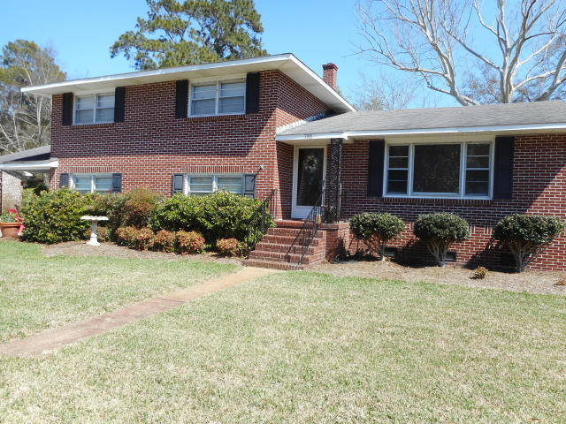
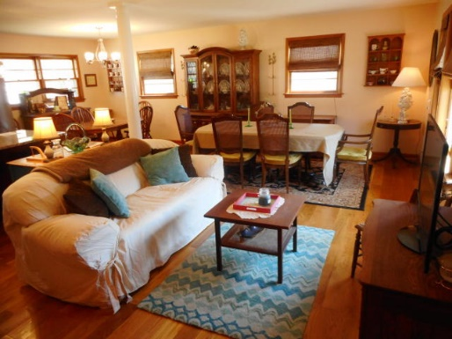
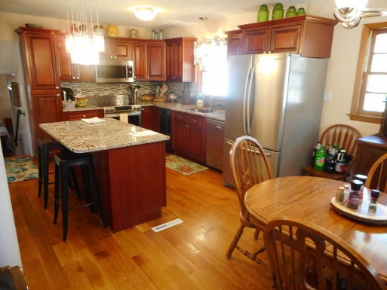
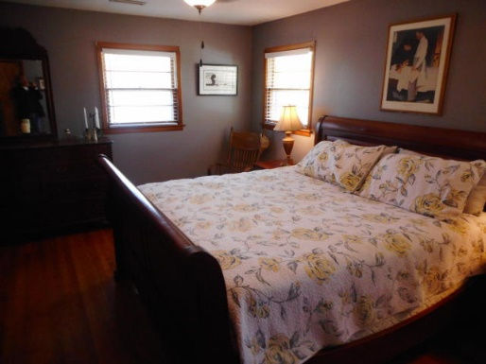
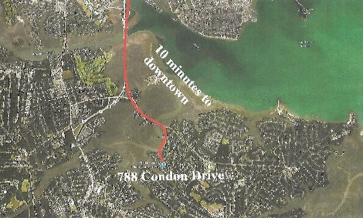

William S. Smith, Broker Hartnett Realty Co., Inc. 1156 Bowman Road, Suite 200 Mt. Pleasant, SC 29464 wssmith@hartnettrealty.com 843-906-5620
Battery Point – 10 Minutes From Downtown
788 Condon Drive
Battery Point ~ Charleston, SC 29412 ~ MLS# 18006731 ~ $595,000
Located in the popular, family-oriented Battery Point sub-division on James Island, this brick home is ten minutes from downtown via the nearby Connector. New oak hardwood flooring on open main level; updated kitchen has granite countertops and center island, stainless appliances and double oven; new deck, arbor and wooden fencing; 2nd story of garage has been finished as heated and cooled entertainment/game room providing an additional 384 sq. ft. of living space (which is not included in the 2239 sq. ft.)

