Slide 1
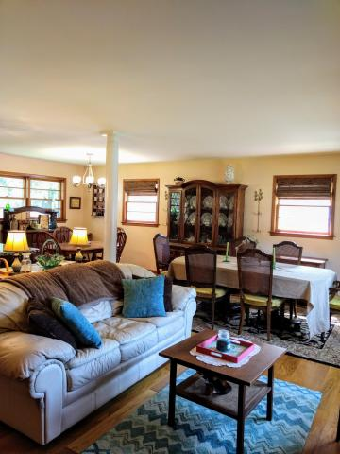
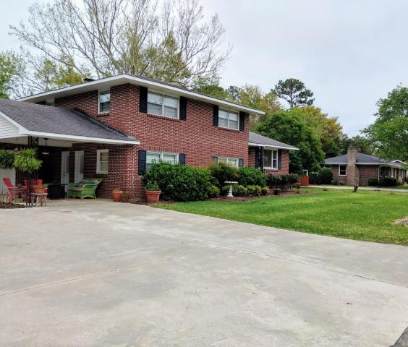
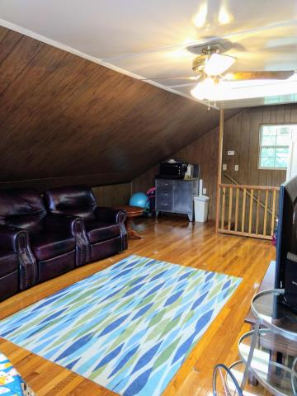
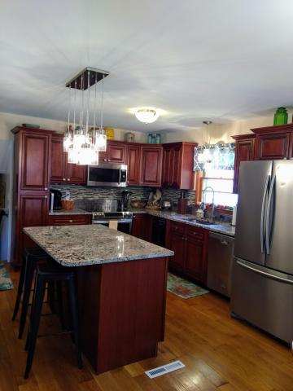
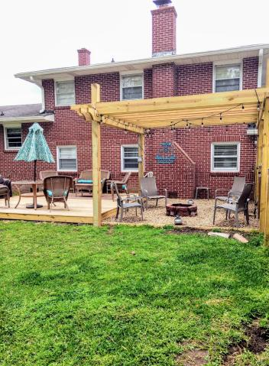
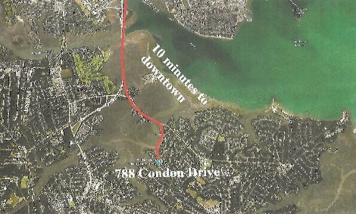
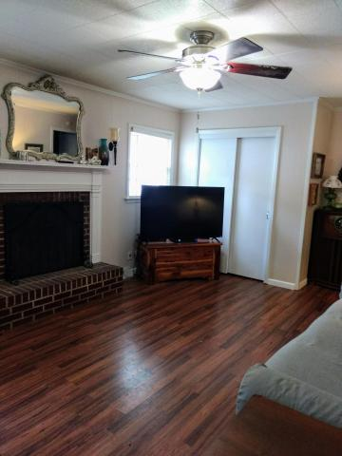
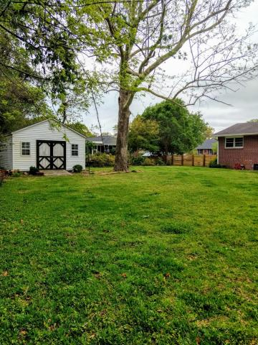

William S. Smith, Broker wssmith@hartnettrealty.com 843-906-5620
Hot New Property
in Battery Point
788 Condon Drive
Battery Point ~ Charleston, SC 29412
MLS# 18006731 ~ $545,000
4 Bedrooms/2 Baths/No HOA/10 minutes from downtown.
New hardwood flooring/updated kitchen/wooden-fenced enclosed backyard and more
1156 Bowman Road, Suite 200 Mt. Pleasant, SC 29464

