Slide 1
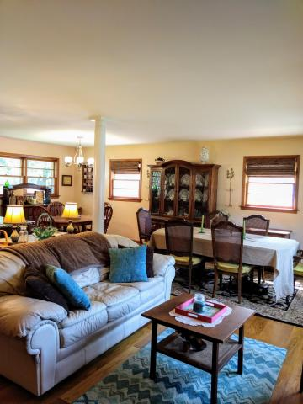
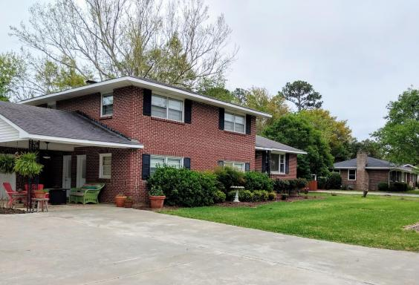
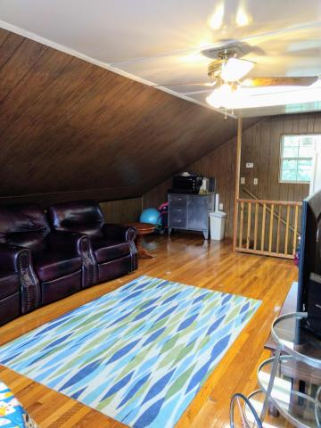
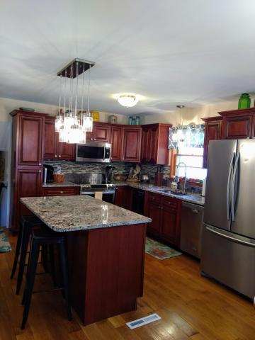
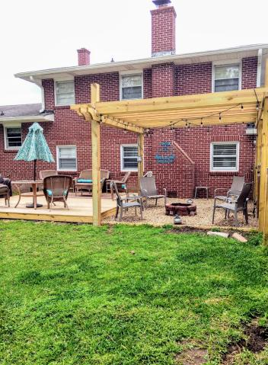
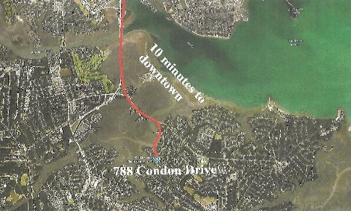
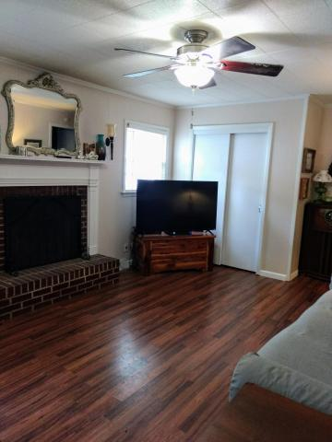
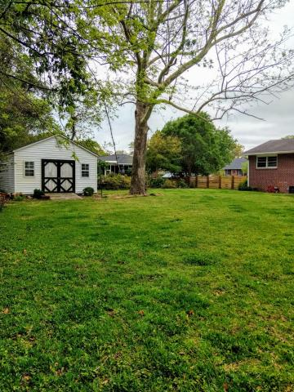

William S. Smith, Broker wssmith@hartnettrealty.com
843-906-5620
Reduced in Battery Point
Now $524,900!
788 Condon Drive
Battery Point ~ Charleston, SC 29412
MLS# 18006731 ~ $524,900
4 Bedrooms/2 Baths/No HOA/10 minutes from downtown.
New hardwood flooring/updated kitchen/wooden-fenced enclosed backyard and more
1156 Bowman Road, Suite 200
Mt. Pleasant, SC 29464

